Slide 1


Project 05-05
Tic-Tac-Toe

Slide 2
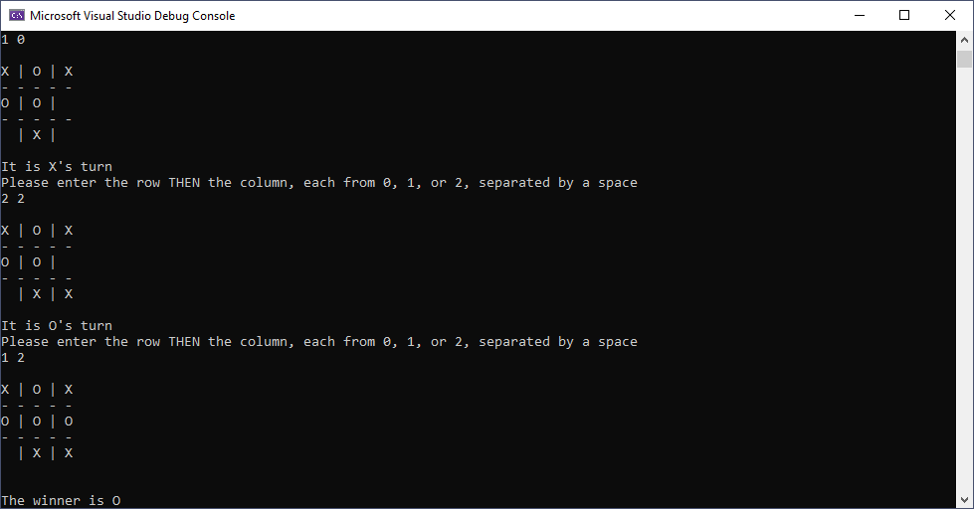

Project 05-05: Tic-Tac-Toe

