Slide 1


Section 6 Overview
Introduction to Object-Oriented Programming (OOP)
Classes
Objects
Unified Modeling Language (UML)
Help us to model our classes during design

Slide 2
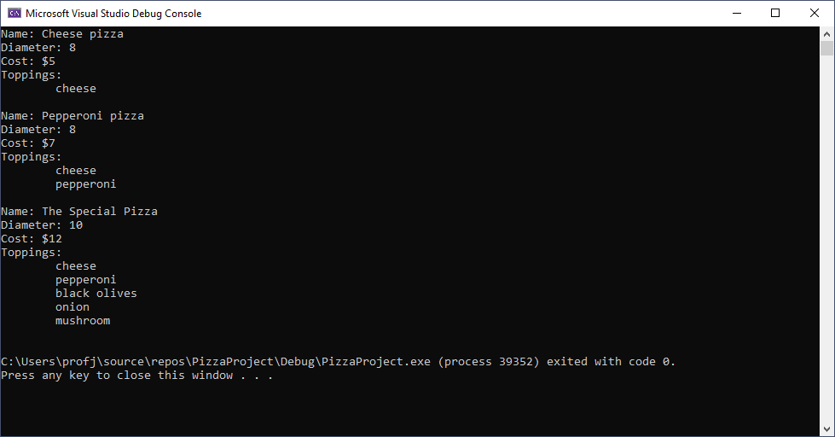
Section 6 Overview

