Slide 1


Section 7 Overview
Exceptions
Objects representing exceptional situations
Usually mean there is a problem with our code
Built-in exceptions and custom exceptions
Crucial to know how to handle exceptions for industry-level software development
Makes our code more robust and fault-tolerant
Testing and Debugging
Help us to find bugs and remove them as early as possible

Slide 2
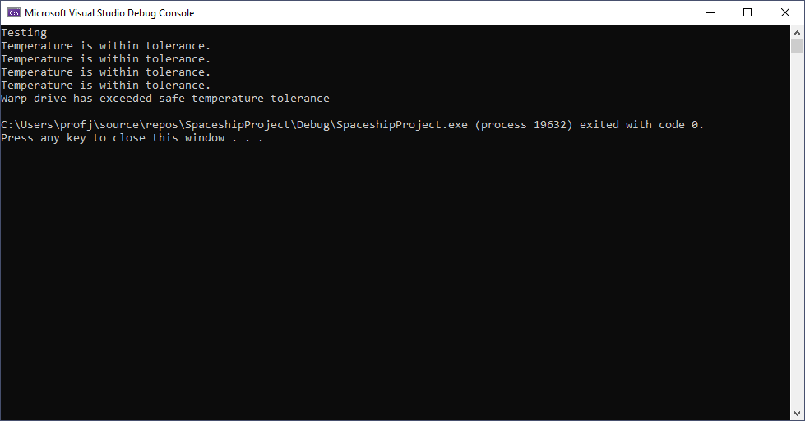
Section 7 Overview

