Slide 1


Logic Errors
logic_error class
In general, a logic error results from a fault in logic in our code
E.g., out of range error that we saw
We’ll consider another
length_error
Occurs in situations involving invalid lengths

Slide 2
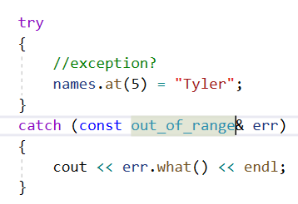
Logic Error Challenge
Handle the length_error using a try-catch statement
Print out the value returned by the what() method of the exception to the console
Before you start modifying code, make sure you have stopped the debugger
In Visual Studio 2019, this is Debug→Stop debugging

