Slide 1


Section 8 Overview
Pointers
Also called pointer variables
These are known as raw pointers to distinguish them from C++ 11 smart pointers (managed pointers)
Holds a memory address
Refer to the data of interest indirectly

Slide 2
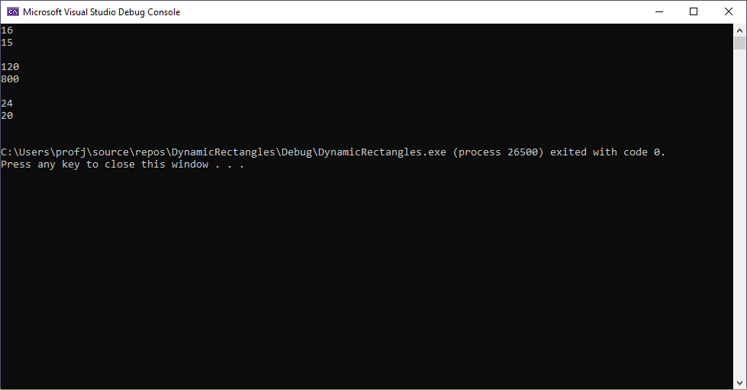
Section 8 Overview

