Slide 1


Section 9 Overview
File I/O
File input/output
Being able to read from and write to secondary storage is important for data persistence
Ability to store data long-term
Also, sometimes not everything fits in main memory, or memory might be at a premium

Slide 2
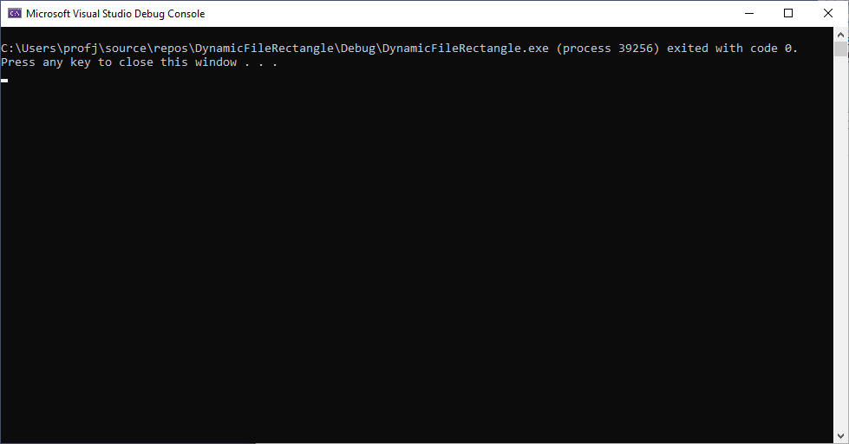
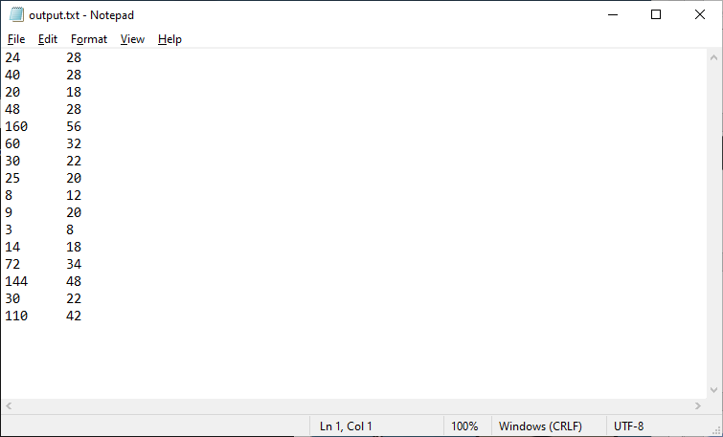
Section 9 Overview

