Slide 1

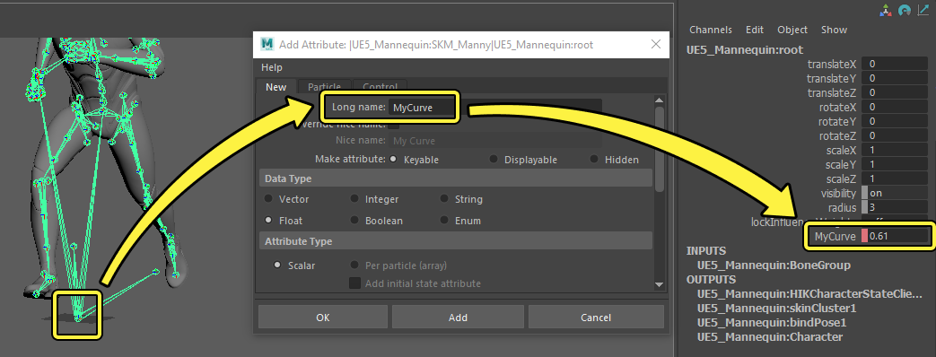
Animation Attributes

Slide 2
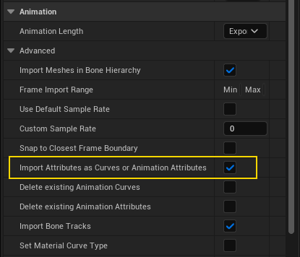
Animation Attributes

Slide 3
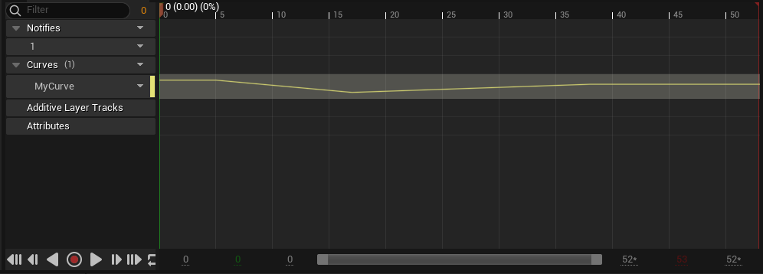
Animation Attributes

Slide 4
Animation Attributes
Animation Curves vs Animation Attributes
Curves - Float Attributes - Float, Integer, String, Transform
Curves - saved on Skeleton Attributes - saved on Animation Sequence
Curves - Curves header Attributes - Attributes header

Slide 5
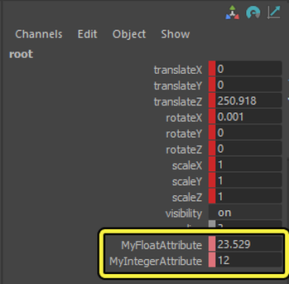
Animation Attributes

Slide 6
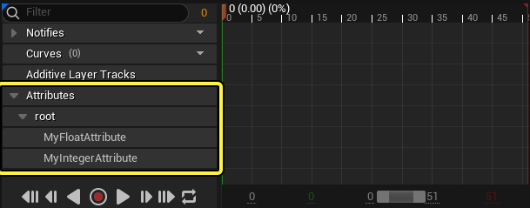
Animation Attributes

Slide 7
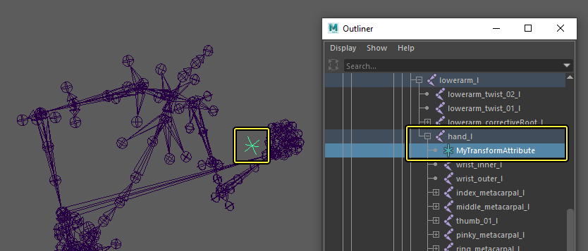
Animation Attributes

Slide 8
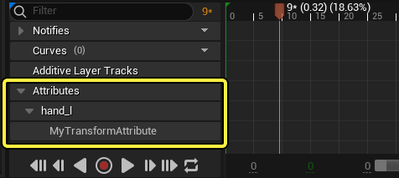
Animation Attributes

