Slide 1
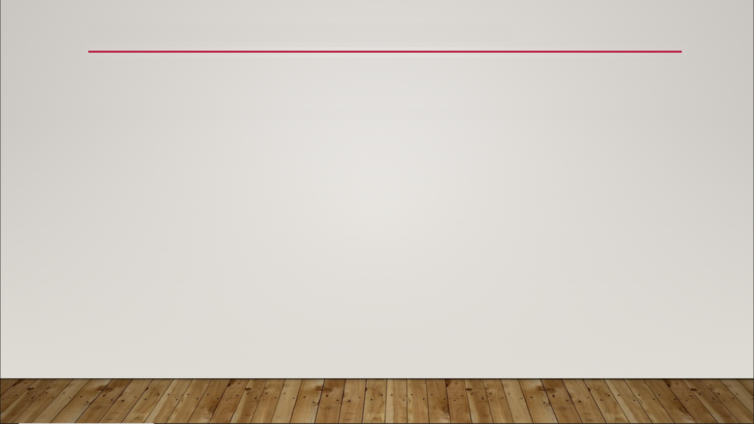
Animation Montages
Three main strengths
group animations together into a single asset
play animations in regular Blueprints
replace animations

