Slide 1
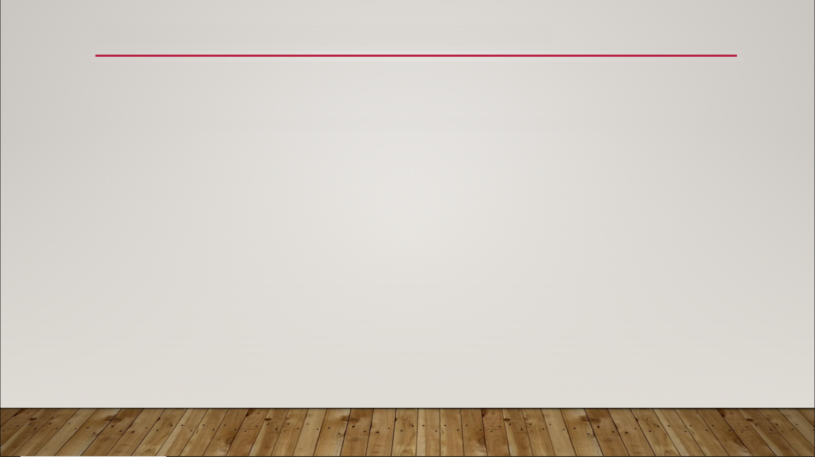
Anisotropy & Tangent Inputs
isotropic - has the same properties in all directions at any given point; looks same regardless of direction that light hits it
anisotropic - might have different properties depending on the direction or point; looks different based on direction that light hits it

Slide 2
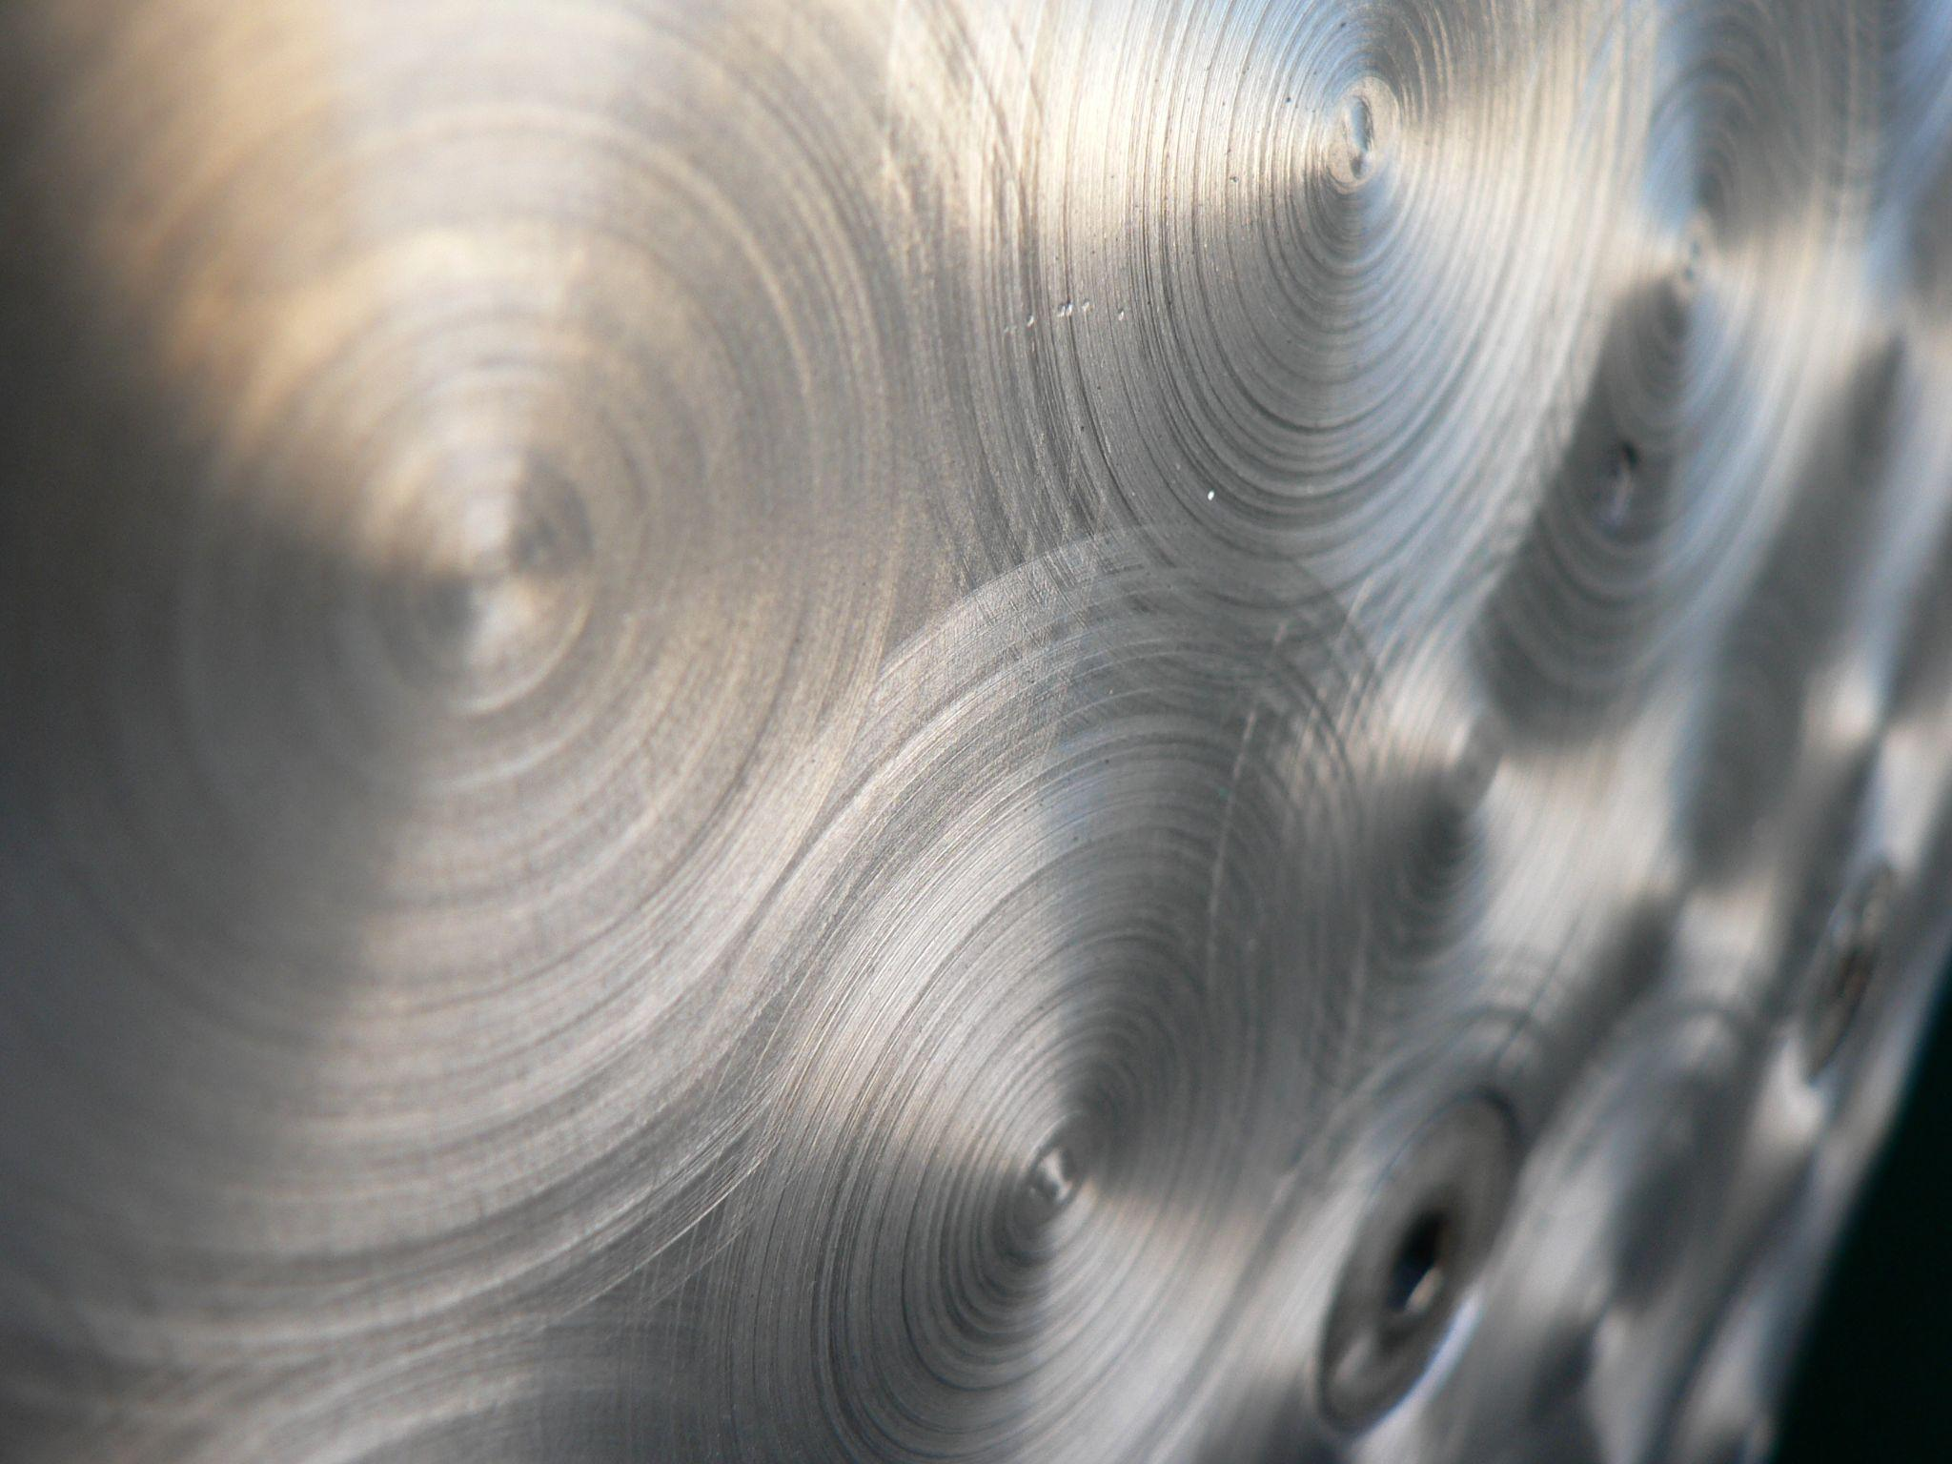
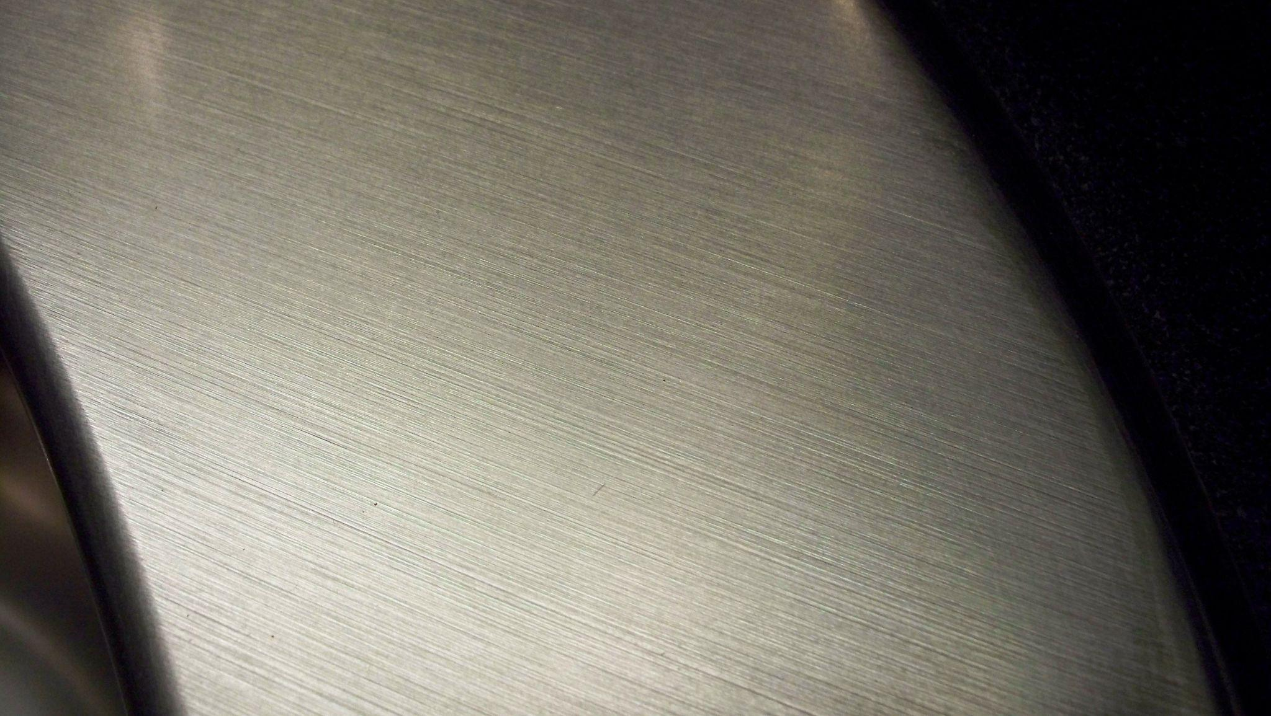
Anisotropy & Tangent Inputs

Slide 3
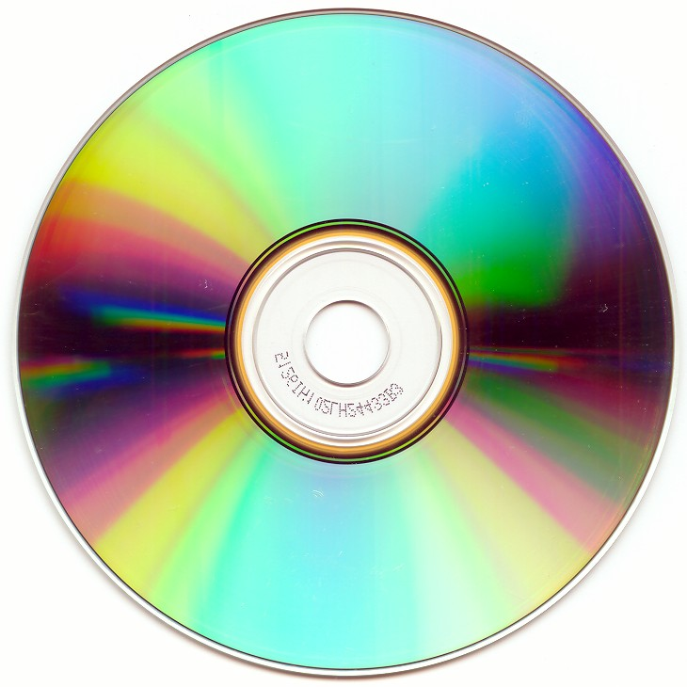
Anisotropy & Tangent Inputs

Slide 4
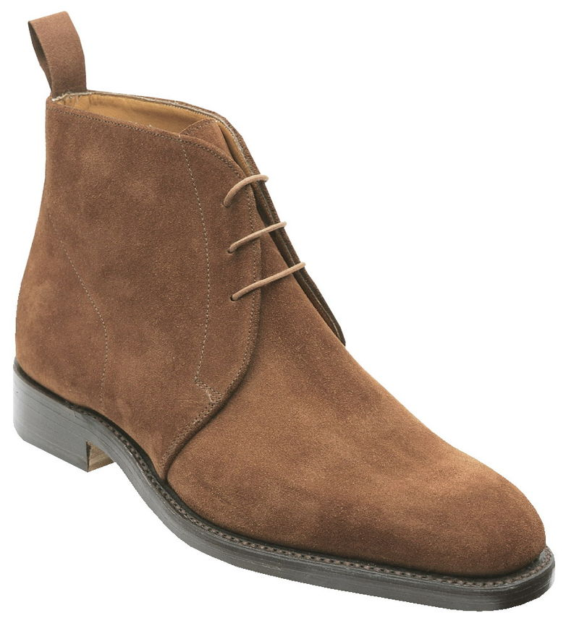
Anisotropy & Tangent Inputs

Slide 5
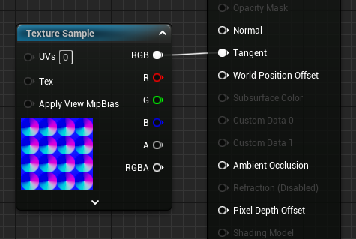
Anisotropy & Tangent Inputs

Slide 6
Anisotropy & Tangent Inputs
tangent-space normal maps - “tangent maps” for short; used by Unreal; axes oriented relative to the texture; purples and blues
object-space normal maps - axes oriented relative to the object that the texture is applied to; uses a variety of colors

Slide 7
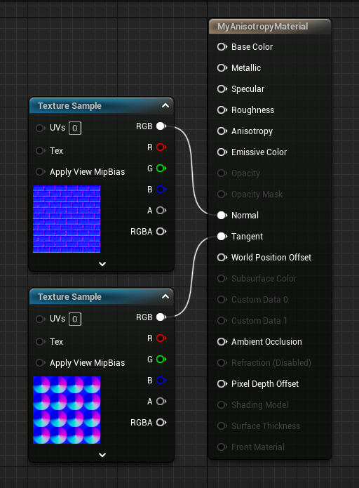
Anisotropy & Tangent Inputs

