Slide 1
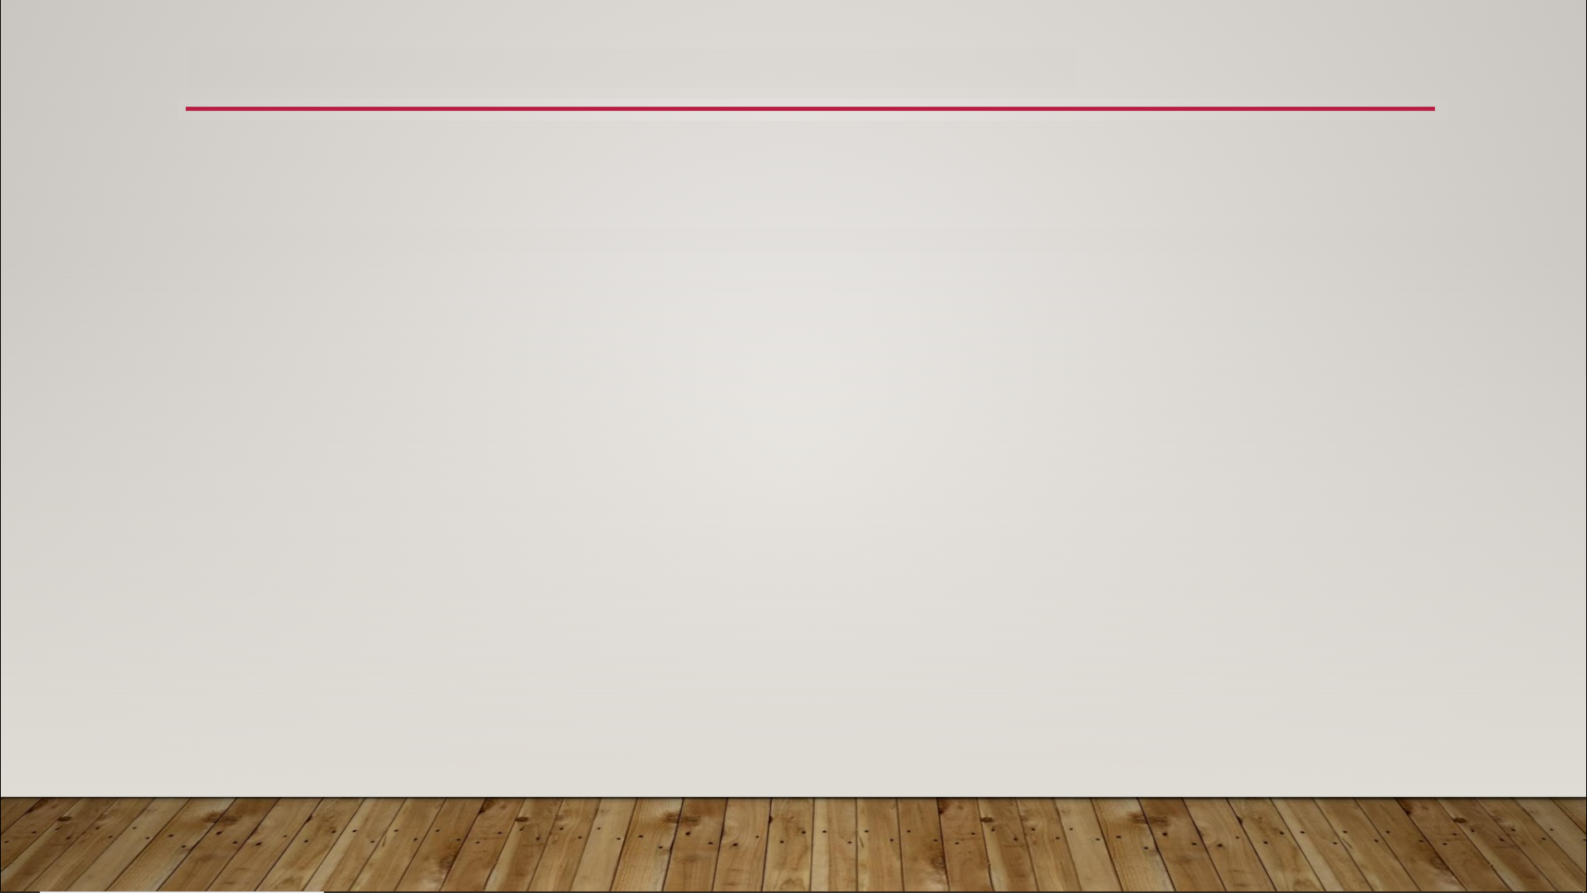
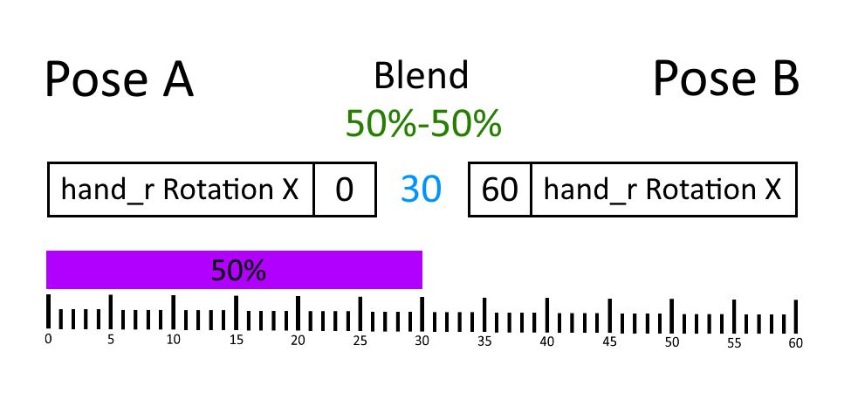
Blending Animations

Slide 2
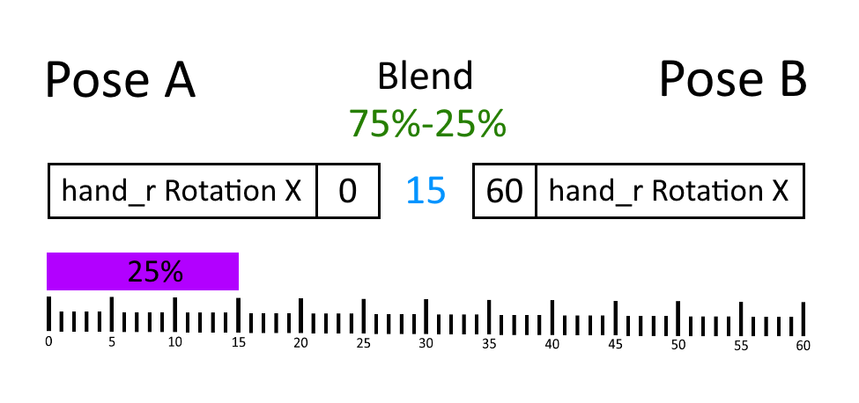
Blending Animations

Slide 3
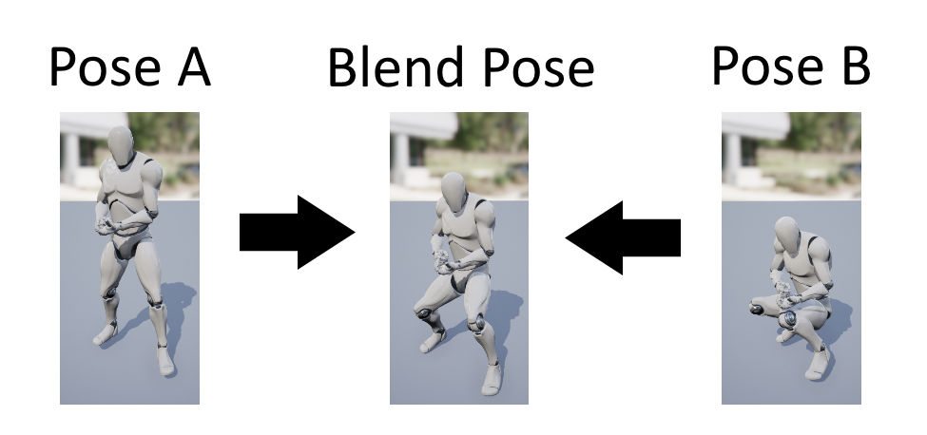
Blending Animations

Slide 4
Blending Animations
Common Ways to Use Skeletal Mesh Animation Blending
“steady blend” - every bone blended by same % for every frame; used to create “new” animations
“transitional blend” - % changes, frame by frame; used to create smoother transitions between animations
“per bone blend” - different % for different Bones; used to have different animations control different sets of bones

