Slide 1

Blueprints Review
Blueprints - used to script/program; alternative to using C++
Unreal Engine - large collection of pre-existing code used to make games
Unreal Editor - user-friendly way to customize the template code that is generated behind-the-scenes
Everything that can’t be created through an Editor feature must be programmed yourself

Slide 2
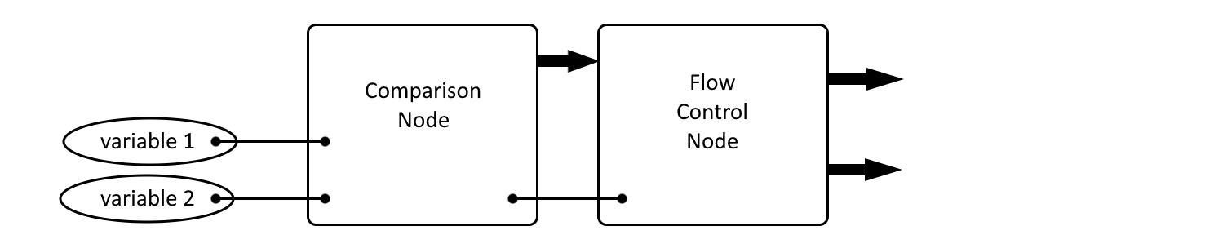
Blueprints Review
Every computer program is made from:
reading data
comparing data
writing data (based on data comparisons)
branching the code (based on data comparisons)

Slide 3
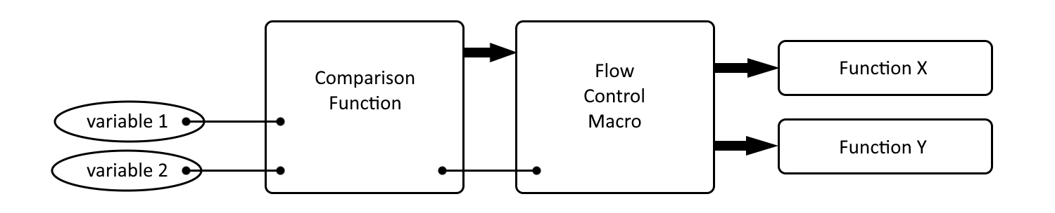
Blueprints Review
Functions
makes code easier to read and makes it reusable
Unreal comes with thousands of premade functions
most Event Graph nodes are actually functions

Slide 4
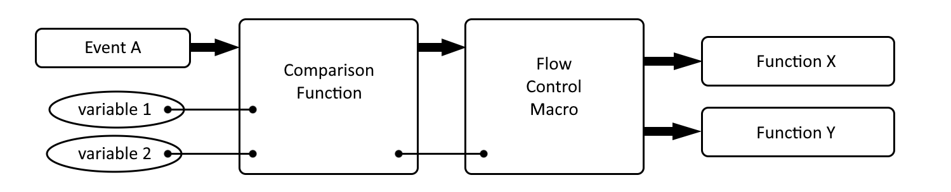
Blueprints Review
Events
are the primary way Unreal Engine controls which code gets executed when
Unreal comes with several predefined Events

Slide 5
Blueprints Review
Object-Oriented Programming
the dominant programming paradigm since the 1990s
C++ and Blueprints are object-oriented
class - the central unit of an object-oriented program
class - consists of variables, functions, and events

Slide 6
Blueprints Review
Objects
object-oriented programs are centered around the interactions between objects
blueprint - a document that specifies how something should be built
houses - instances of a house blueprint
objects - instances of a class
instantiate - a verb that means “to create an object from a class”

Slide 7
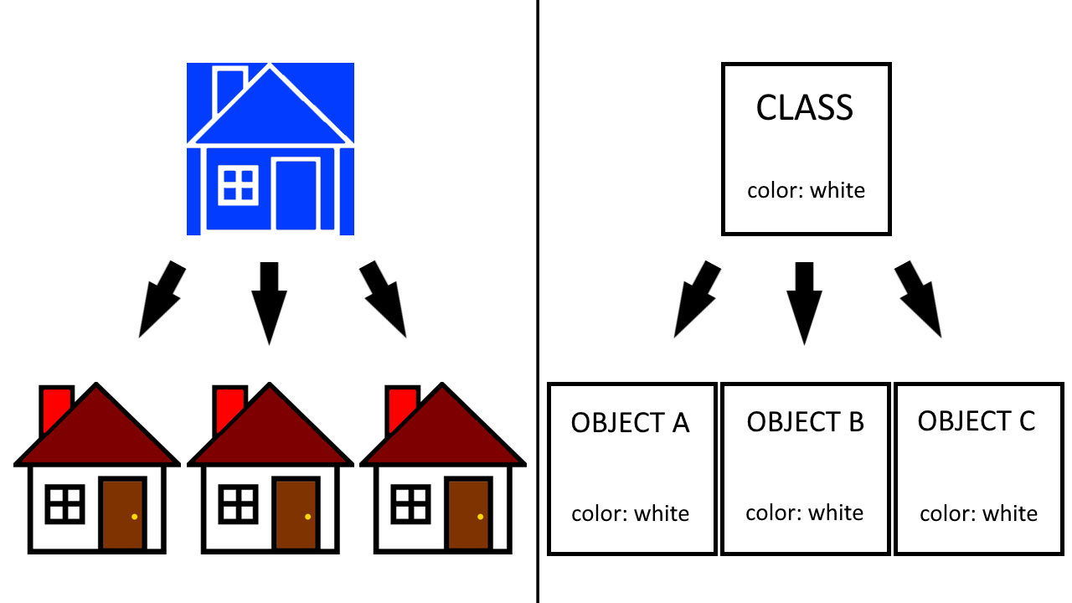
Blueprints Review

Slide 8
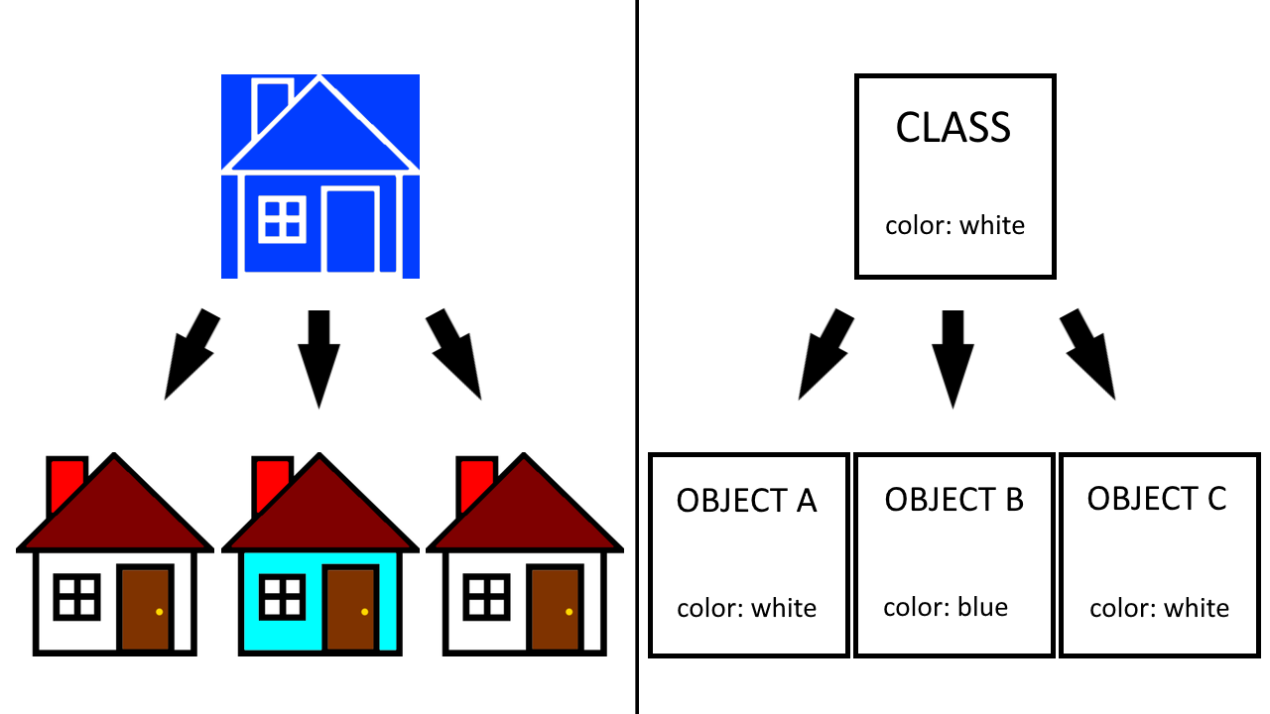
Blueprints Review

Slide 9
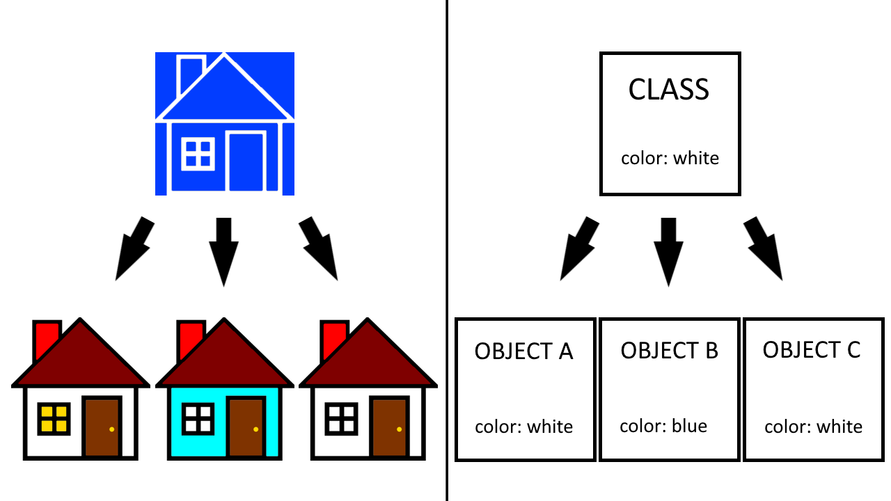
Blueprints Review

Slide 10
Blueprints Review
Inheritance
inheritance - child class inherits the specification of its parent class
makes defining related classes much quicker
allows you to make changes to common functionality in a single place

Slide 11
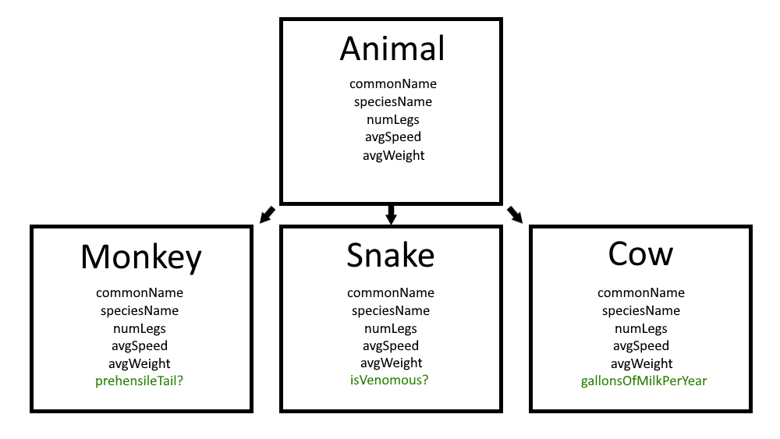
Blueprints Review

Slide 12
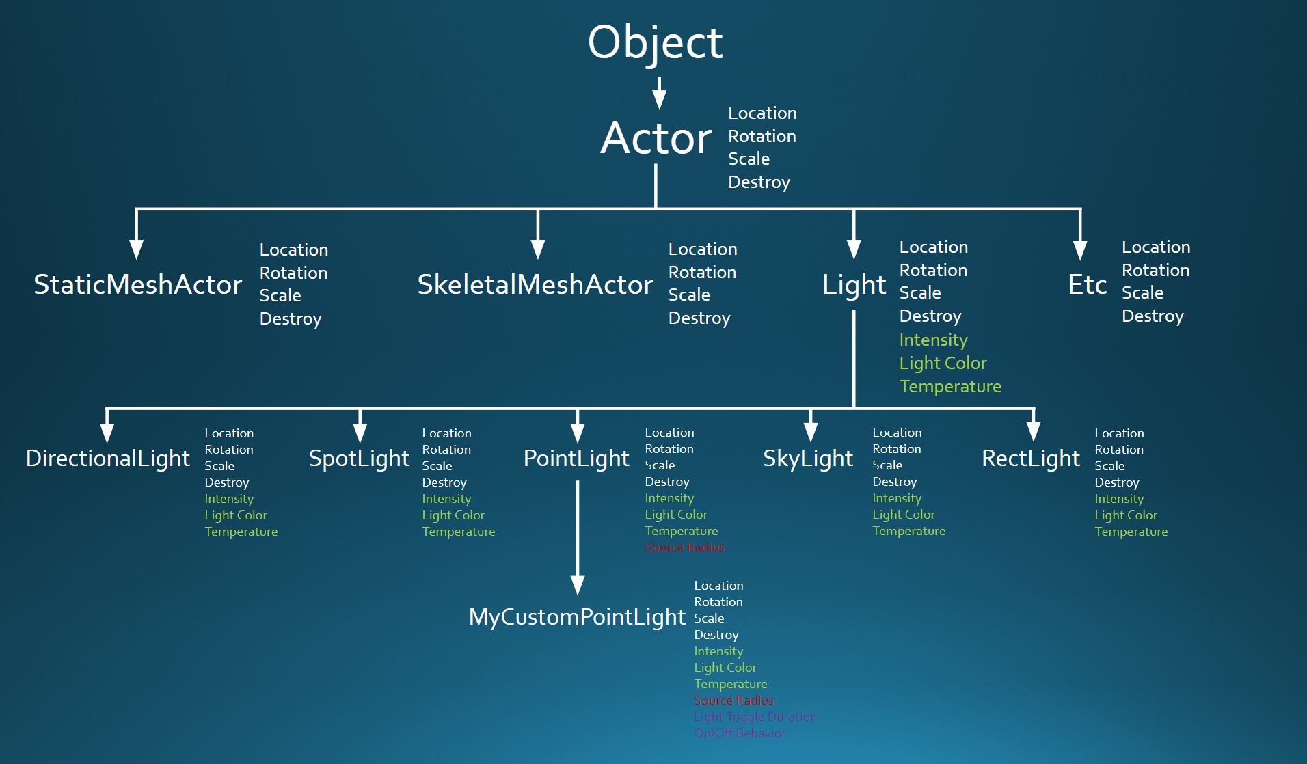
Blueprints Review

Slide 13
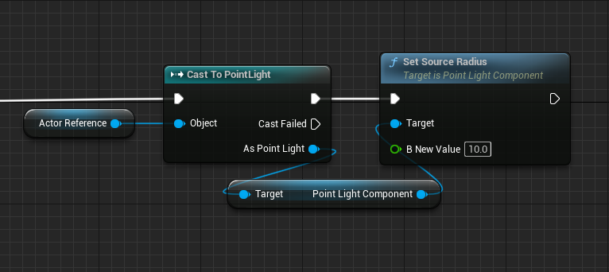
Blueprints Review

