Slide 1

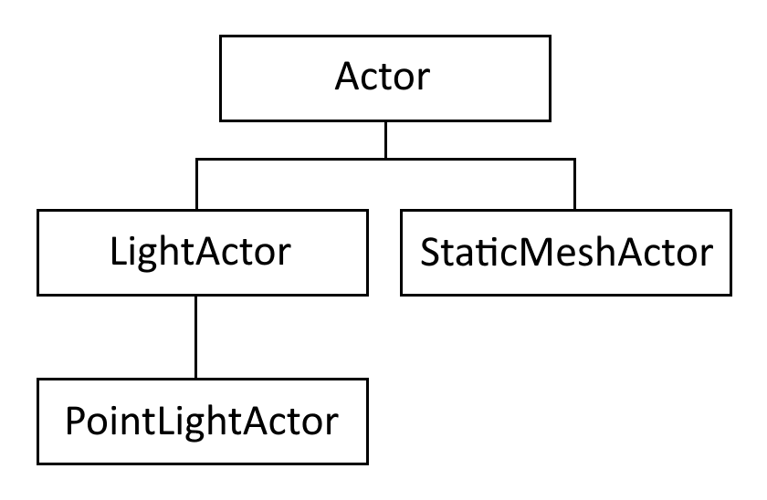
Function Properties

Slide 2
Function Properties
Engineering Theory
modular design - design a system from a set of smaller, self-contained modules
self-contained - internal functionality hidden from rest of system
interdependent system - system where the parts are highly dependent on one another to function correctly; hard to modify and more buggy

Slide 3
Function Properties
Variable and Function Scope
you should give class members the least amount of access possible
helps enforce good modular design

Slide 4
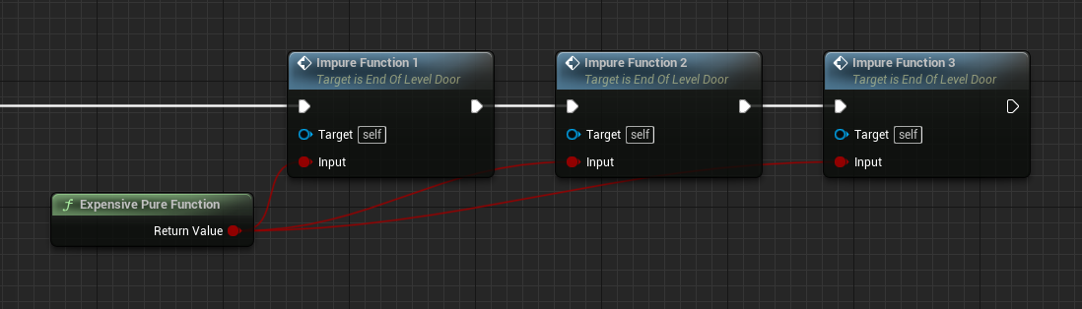
Function Properties

Slide 5
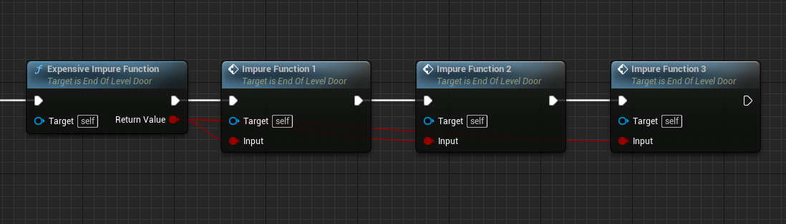
Function Properties

