Slide 1
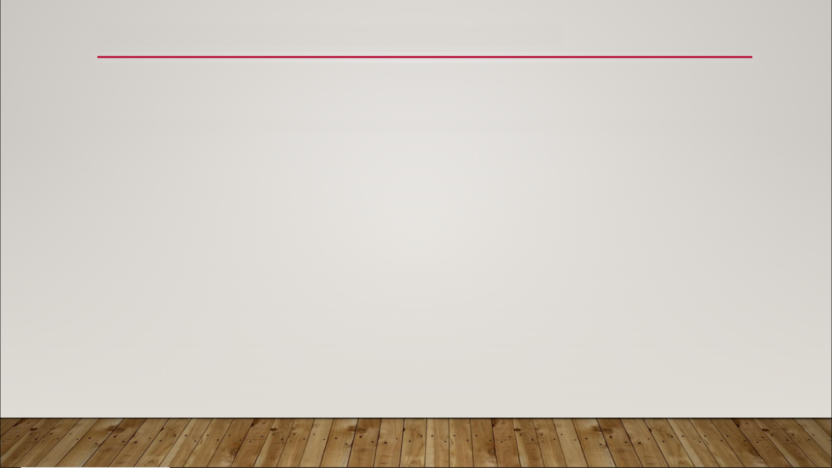
Functions Overview
Functions
concept comes from mathematics and computer science
used to define a set of instructions by name/symbol
useful in proofs, theorems, and code

Slide 2
Functions Overview
Advantages of Functions
reusability - can be used over and over
editability - easy to modify
reliability - less code defects
readability - easier to read, write, and comprehend

Slide 3
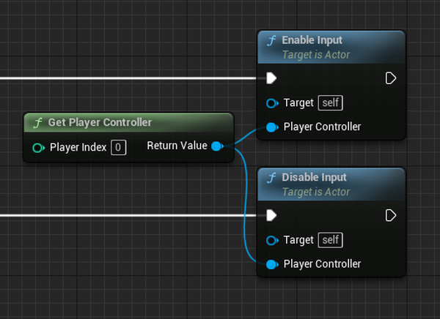
Functions Overview

Slide 4
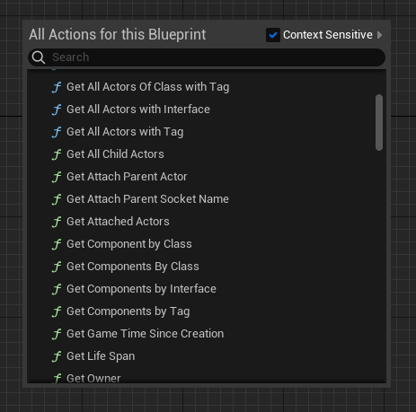
Functions Overview

