Slide 1
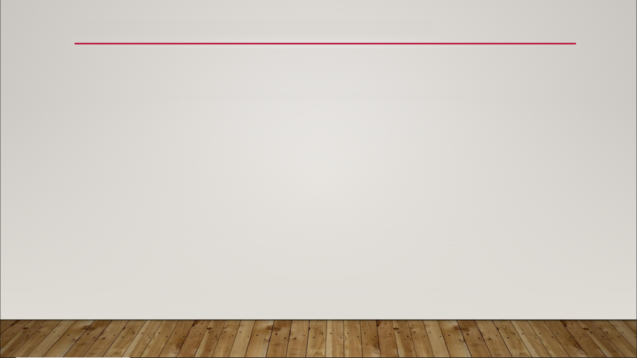
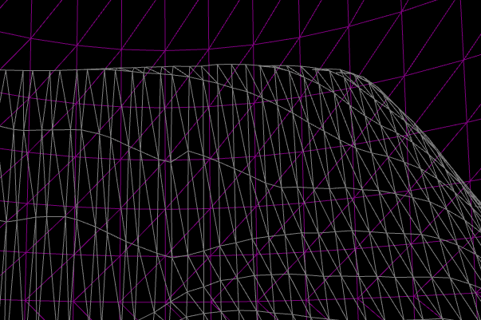
Landscape Sculpt Mode
Retopologize Tool

Slide 2
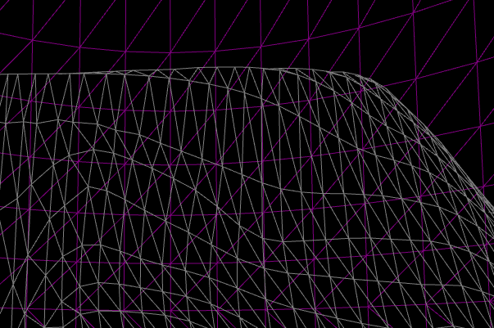
Landscape Sculpt Mode
Retopologize Tool

