Slide 1
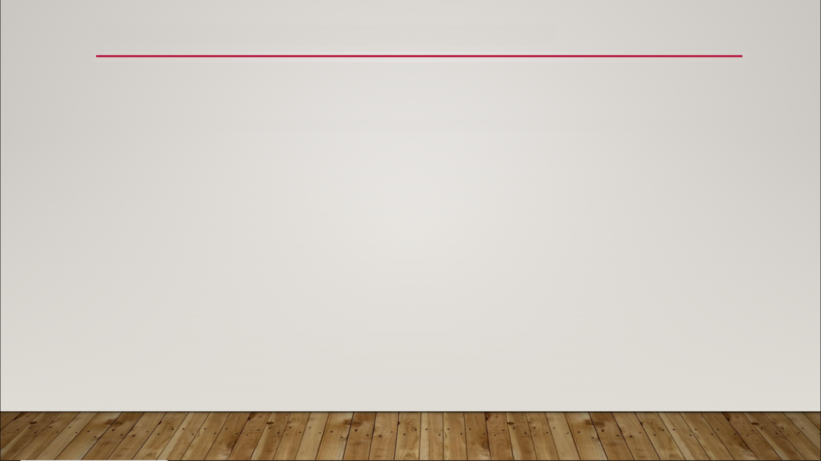
Maps
variable collection
unordered list of things
list of pairs of elements
two elements can be same or different types
every pair must be same type combination, such as String-Float
can’t use Boolean, Text, or Rotator type for first element of pair

Slide 2
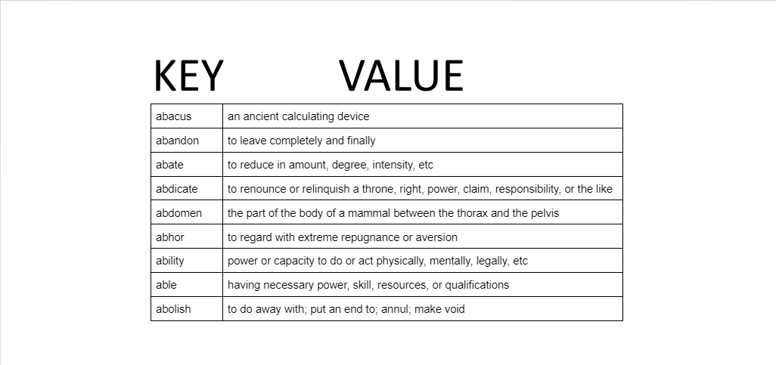
Maps

