Slide 1
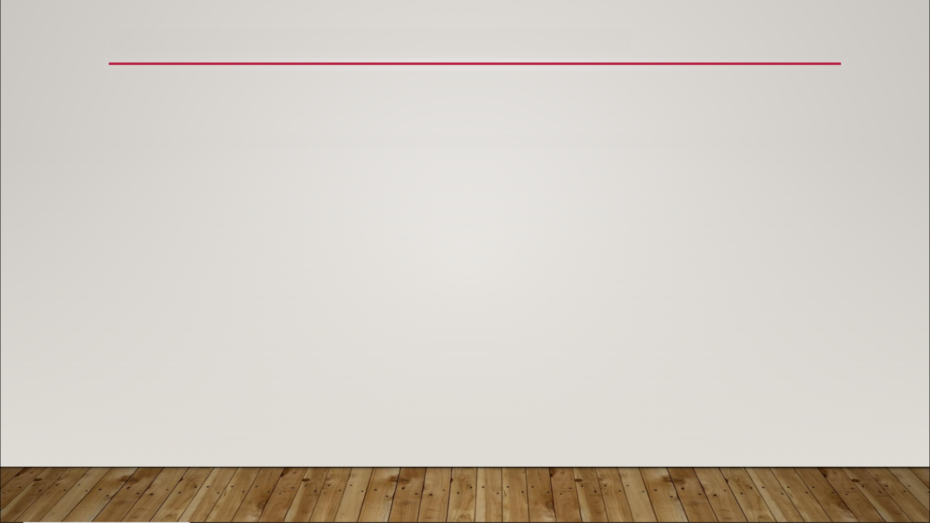
Morph Targets
skeletal animation - manipulate the Bones of a Skeleton asset to change the vertices of a Skeletal Mesh
morph target animation - manipulate the vertices of a Skeletal Mesh directly

Slide 2
Morph Targets
created in external software
3DS Max - Morph Targets
Maya - Blend Shapes
Blender - Shape Keys

Slide 3
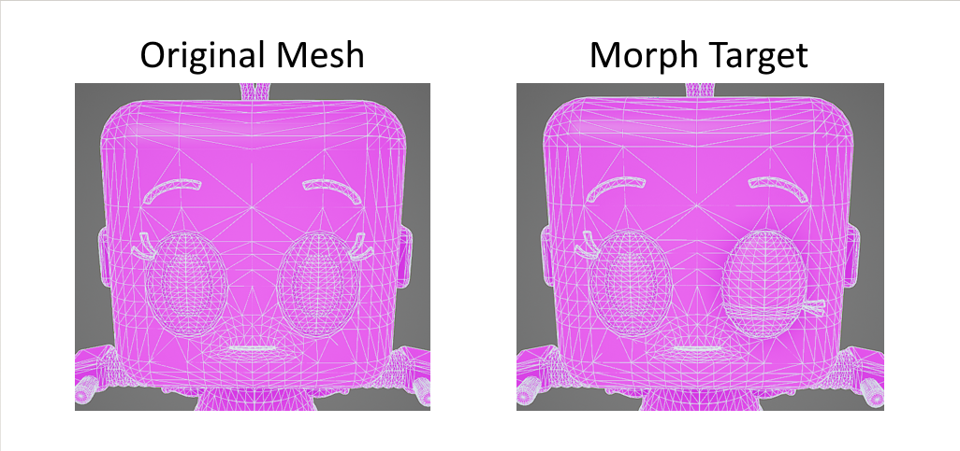
Morph Targets

Slide 4
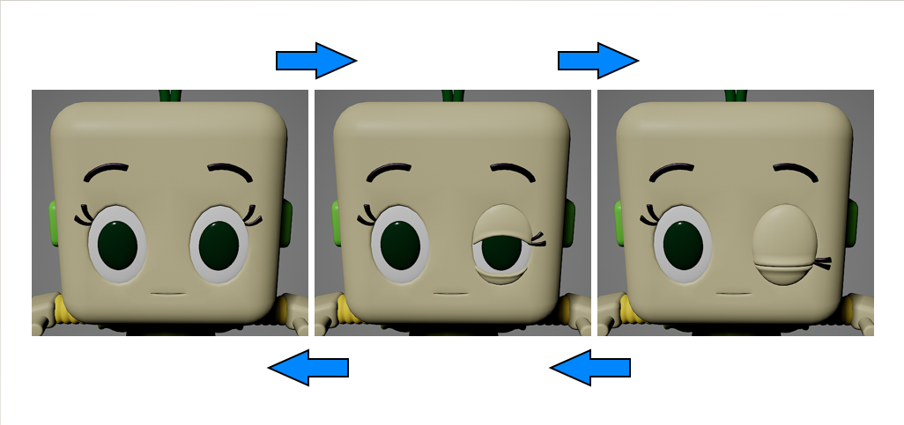
Morph Targets

Slide 5
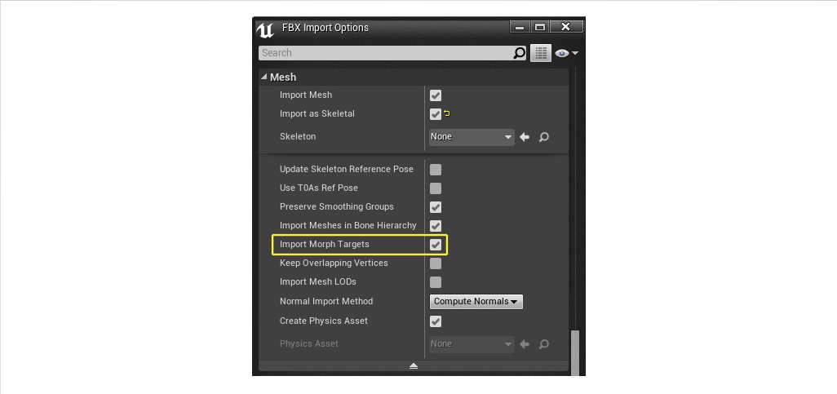
Morph Targets

