Slide 1
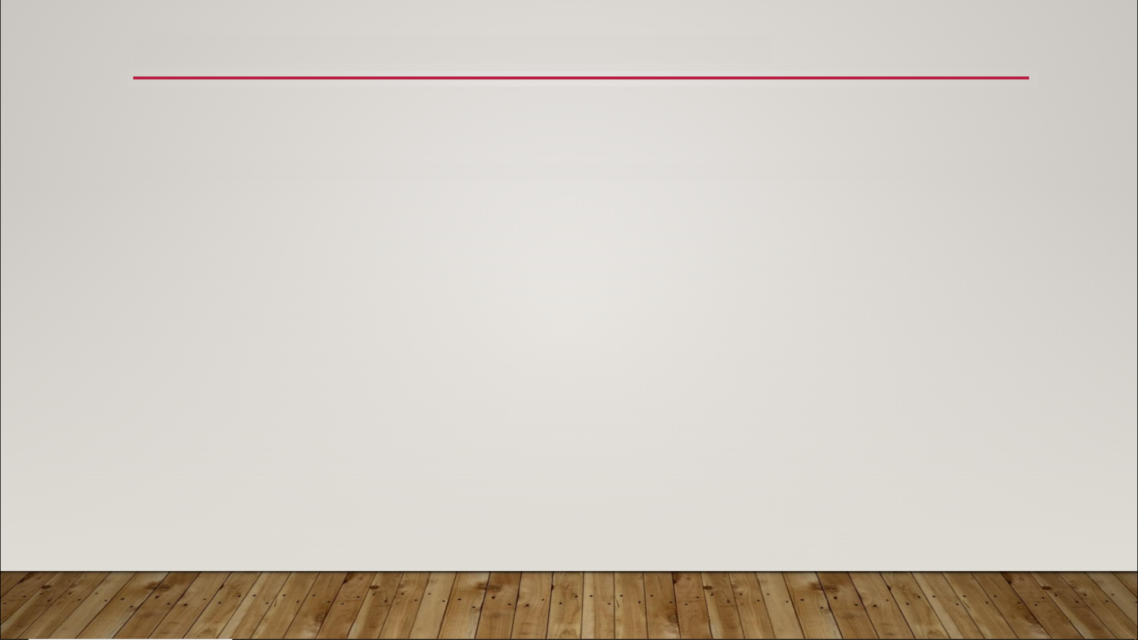
Sets
variable containers that contain a list of values of the same data type
unordered
can’t store duplicate values
slightly faster than Arrays

Slide 2
Sets
Reasons to use a Set instead of an Array:
faster performance
enforce the uniqueness of data
comparison of lists - union, intersection, and difference operations - Venn diagrams are used to graphically represents the comparison of two lists

Slide 3
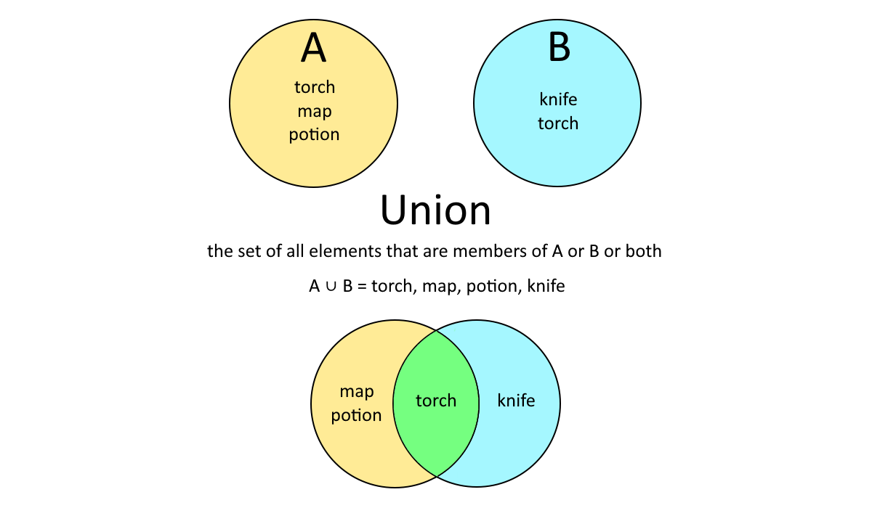
Sets

Slide 4
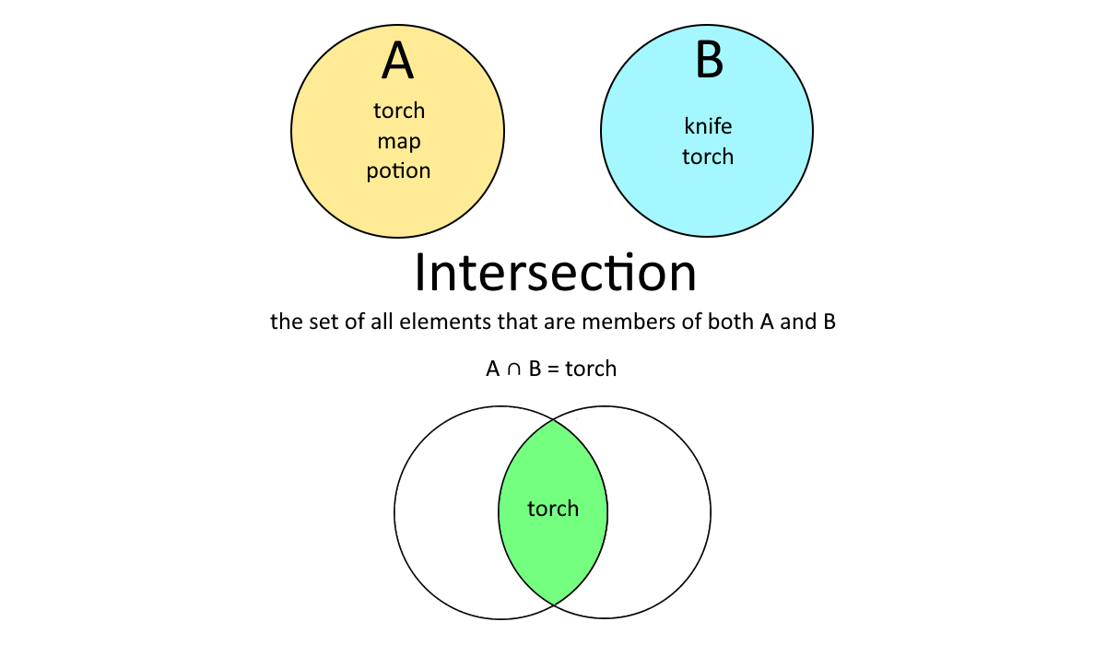
Sets

Slide 5
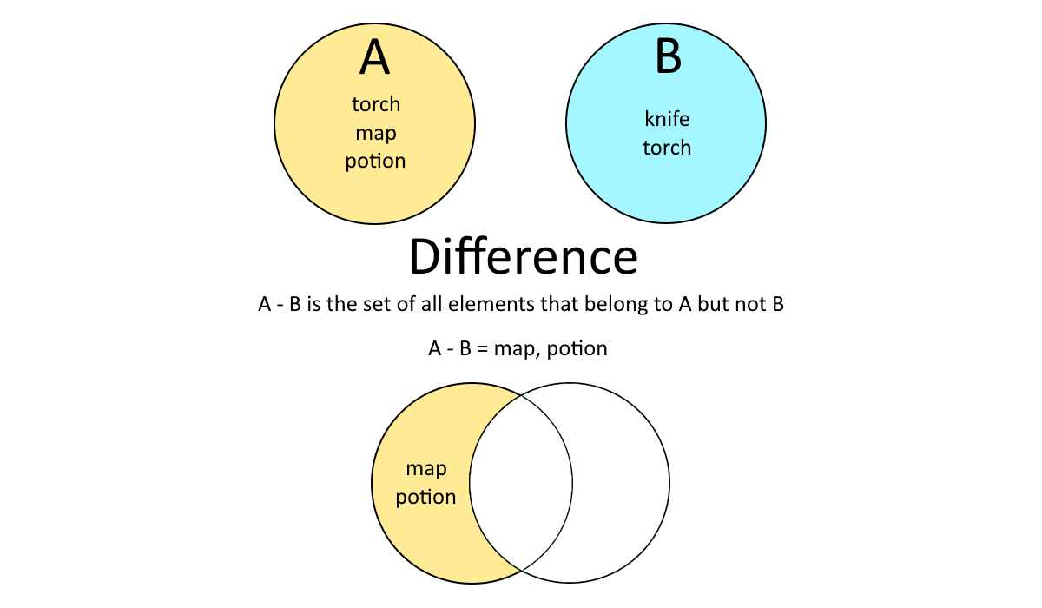
Sets

Slide 6
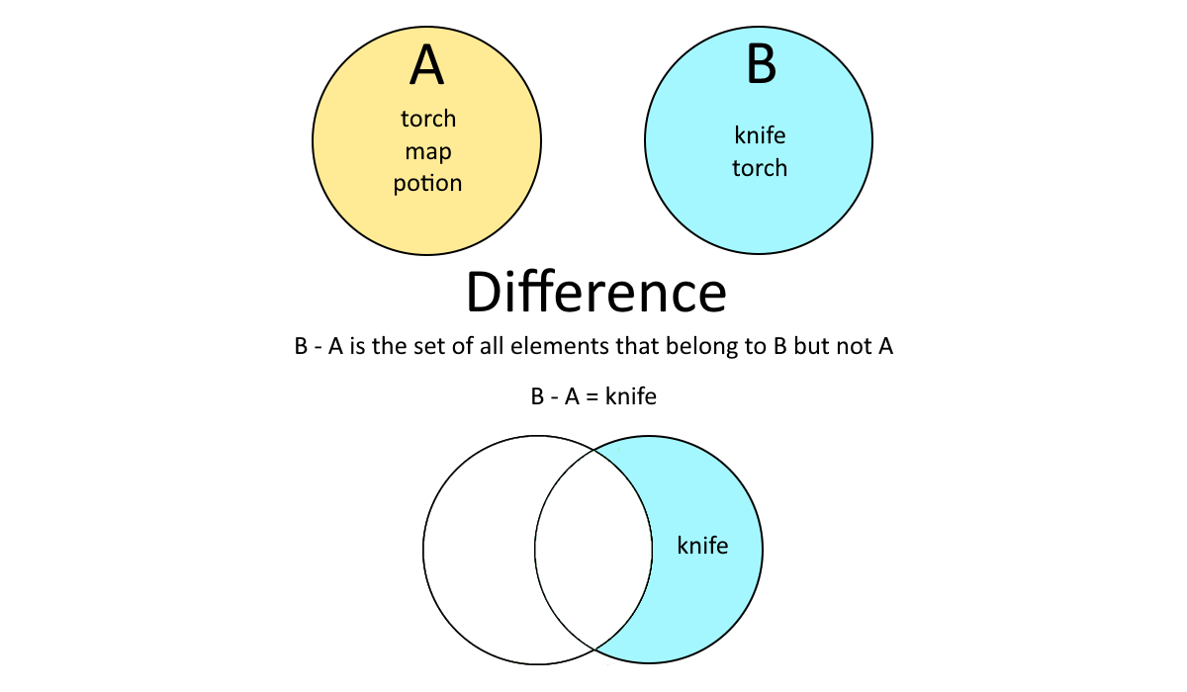
Sets

