Slide 1
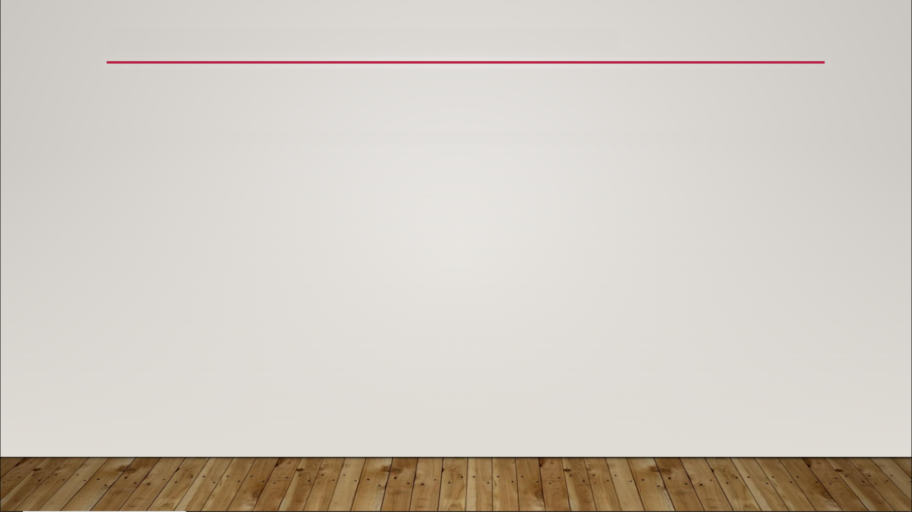
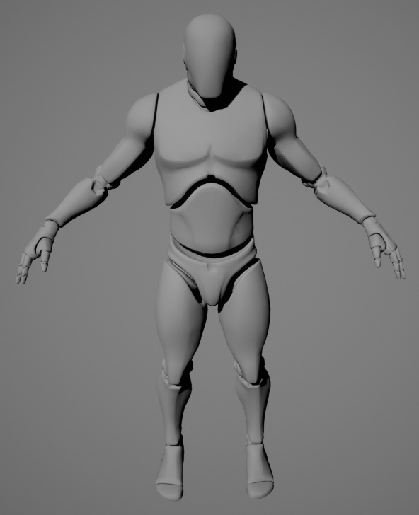
Skeletal Mesh Animation Overview

Slide 2
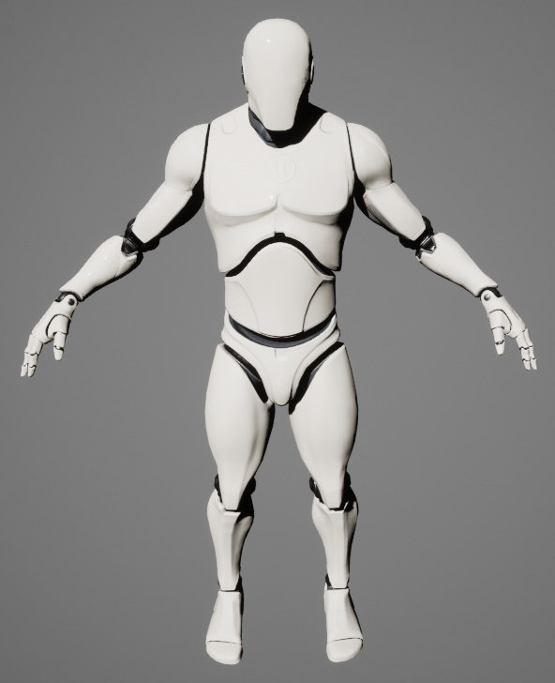
Skeletal Mesh Animation Overview

Slide 3
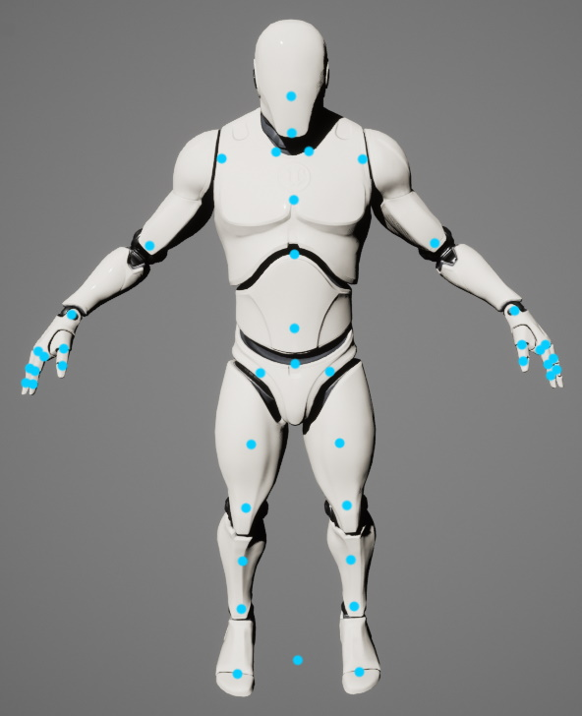
Skeletal Mesh Animation Overview

Slide 4
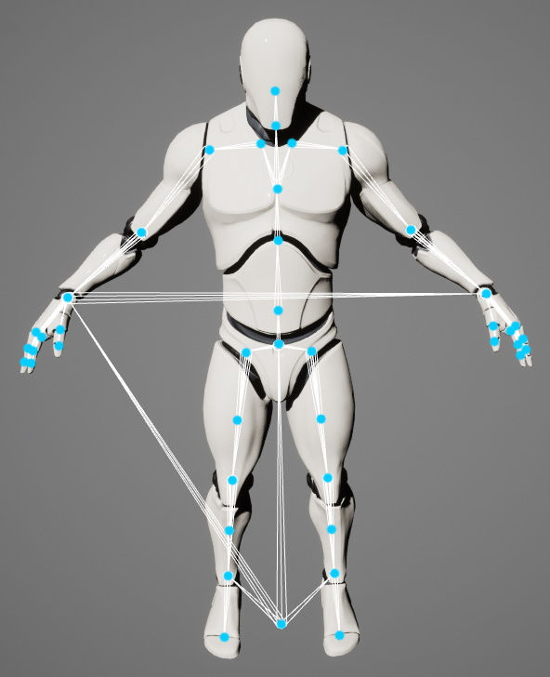
Skeletal Mesh Animation Overview

Slide 5
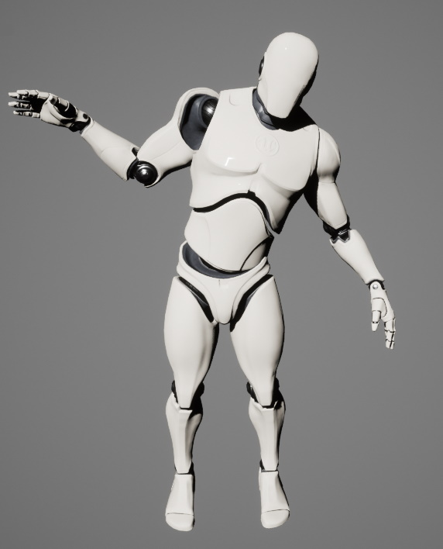
Skeletal Mesh Animation Overview

Slide 6
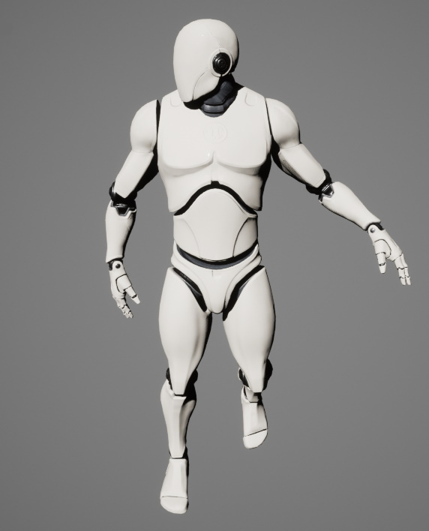
Skeletal Mesh Animation Overview

Slide 7
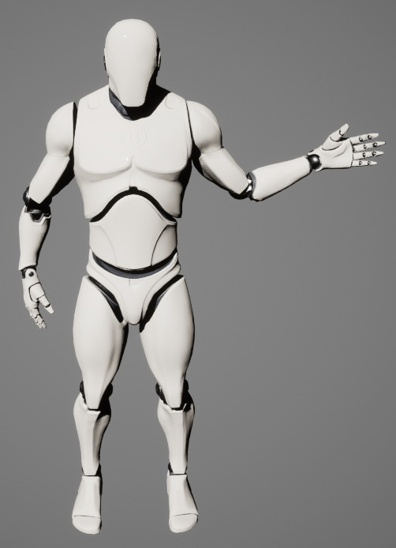
Skeletal Mesh Animation Overview

Slide 8
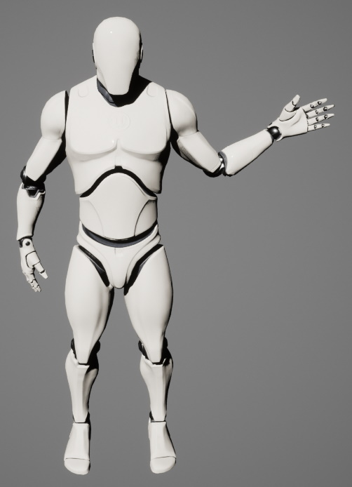
Skeletal Mesh Animation Overview

Slide 9
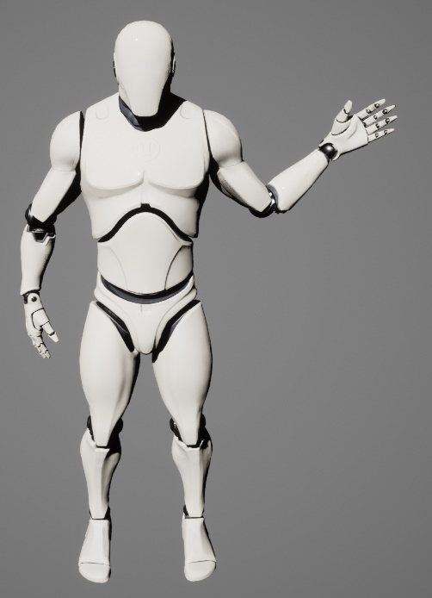
Skeletal Mesh Animation Overview

Slide 10
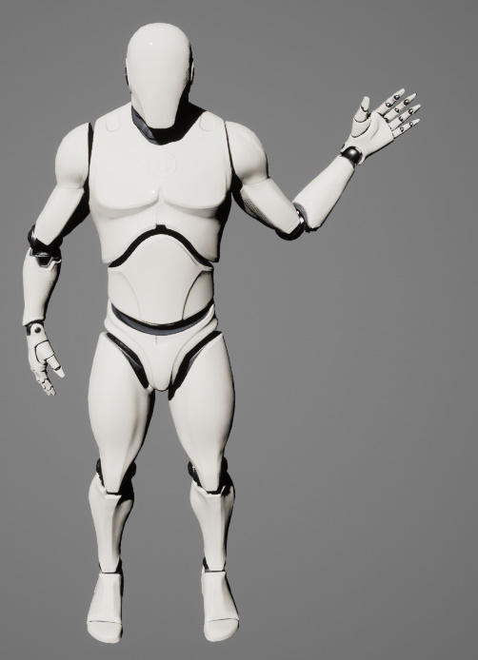
Skeletal Mesh Animation Overview

Slide 11
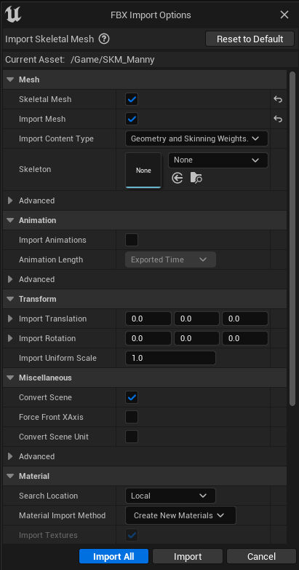
Skeletal Mesh Animation Overview

Slide 12
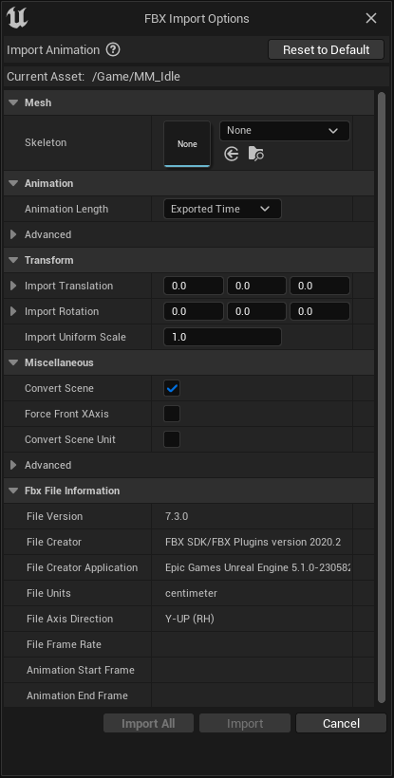
Skeletal Mesh Animation Overview

Slide 13
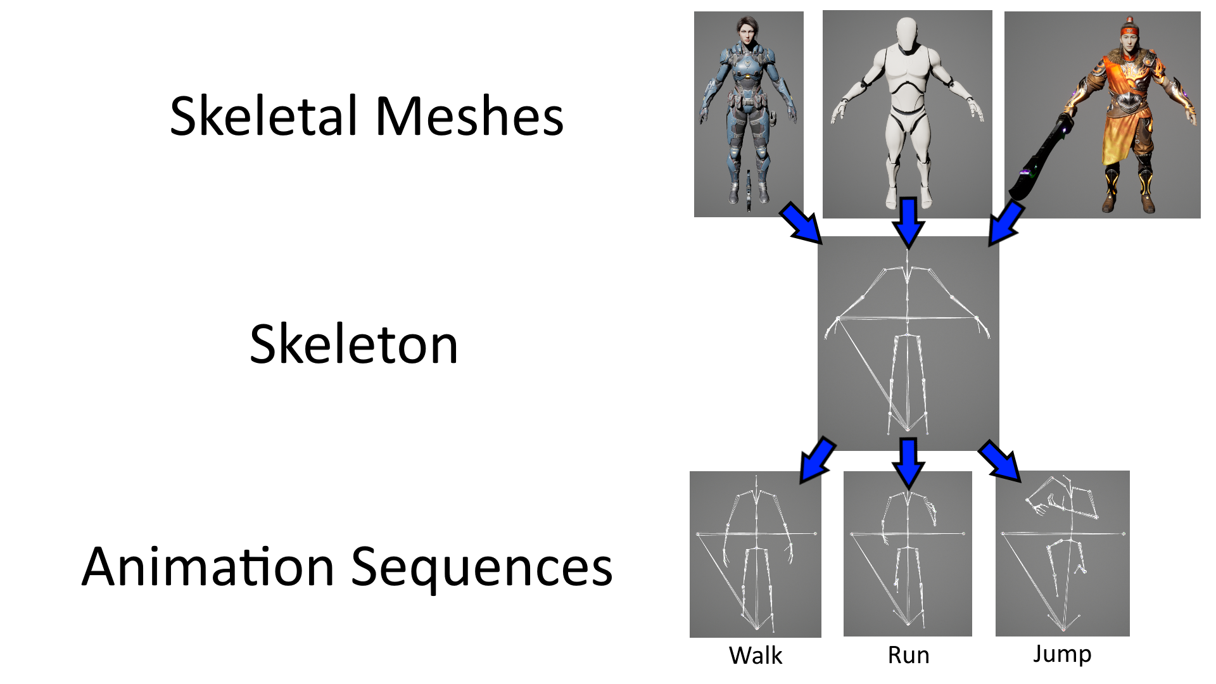
Skeletal Mesh Animation Overview

Slide 14
Skeletal Mesh Animation Overview
Things to do in Unreal Engine
what animations should play when
blending animations
combining animations
making animations have an effect

