Slide 1
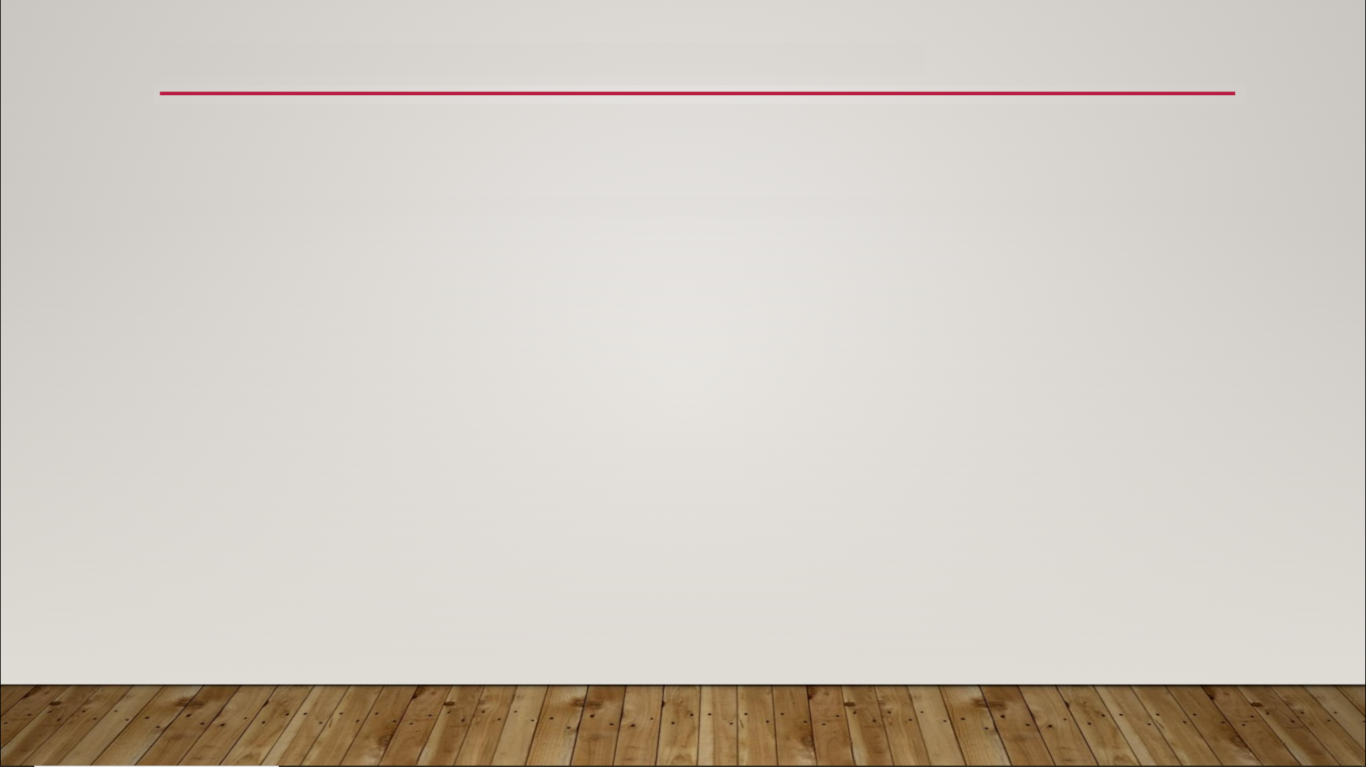
State Machines
a.k.a. finite-state machine
mathematics & computer science
model any system that can be in one of a finite number of states, at any given time

Slide 2
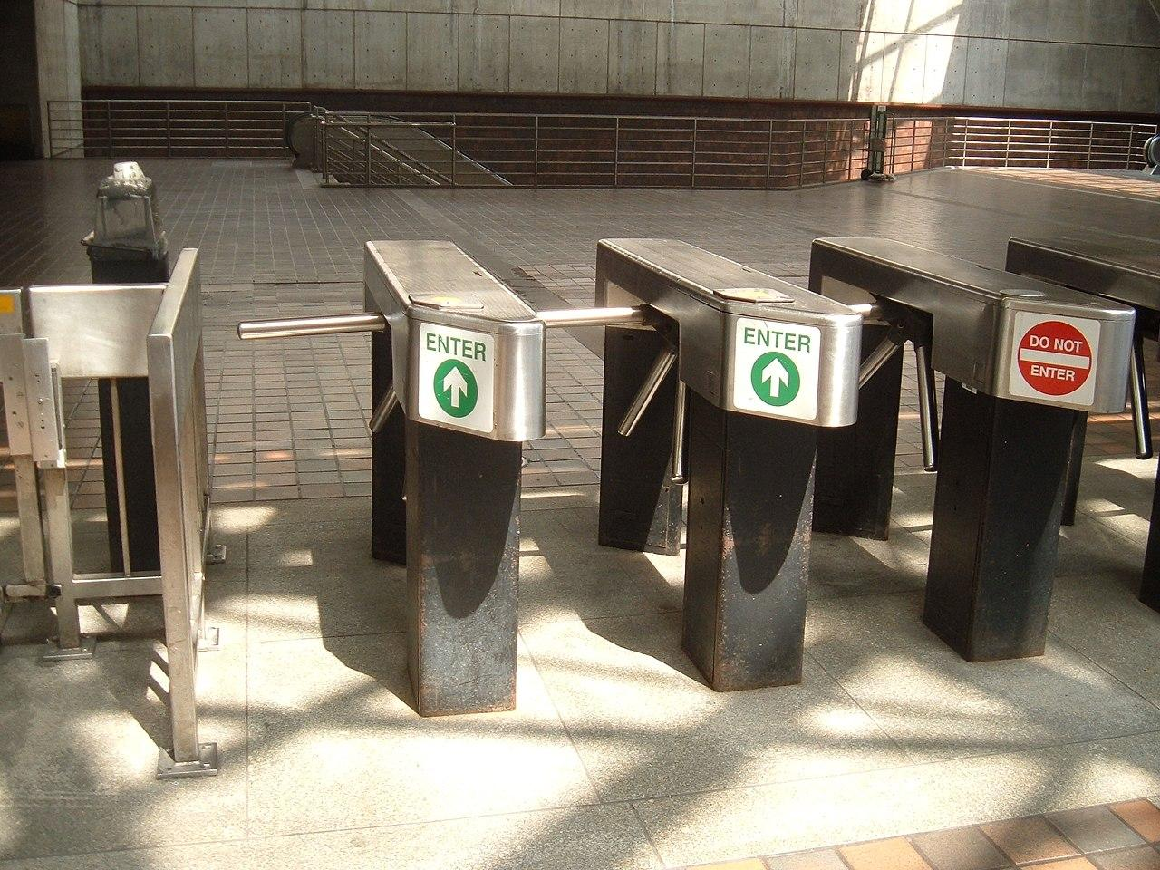
State Machines

Slide 3
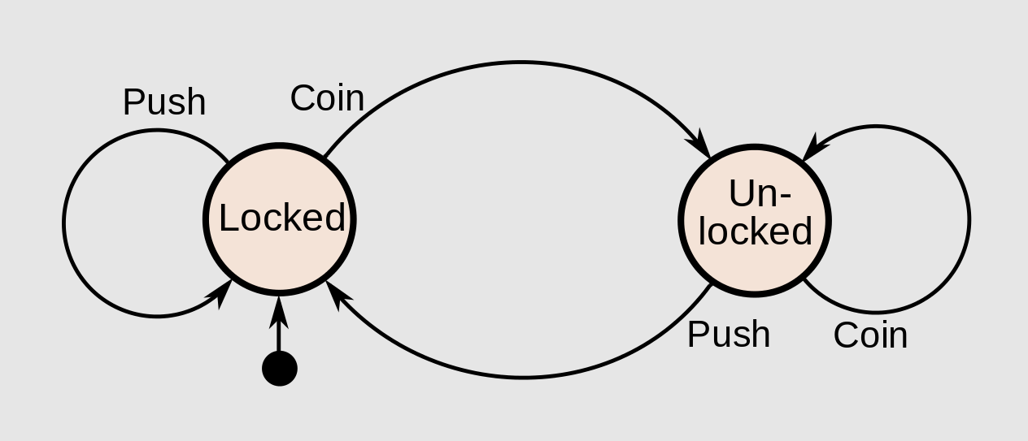
State Machines

Slide 4
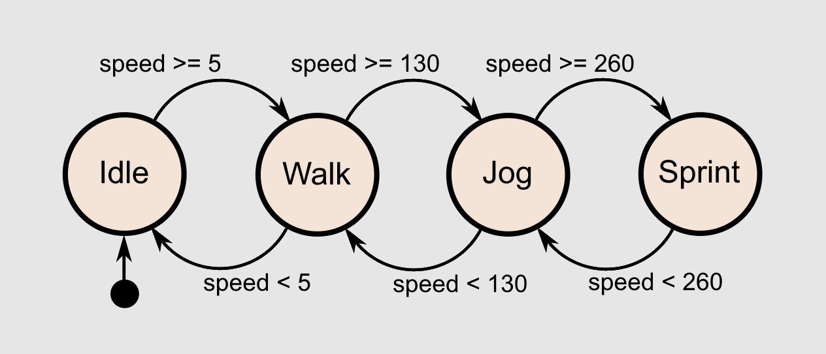
State Machines

