Slide 1
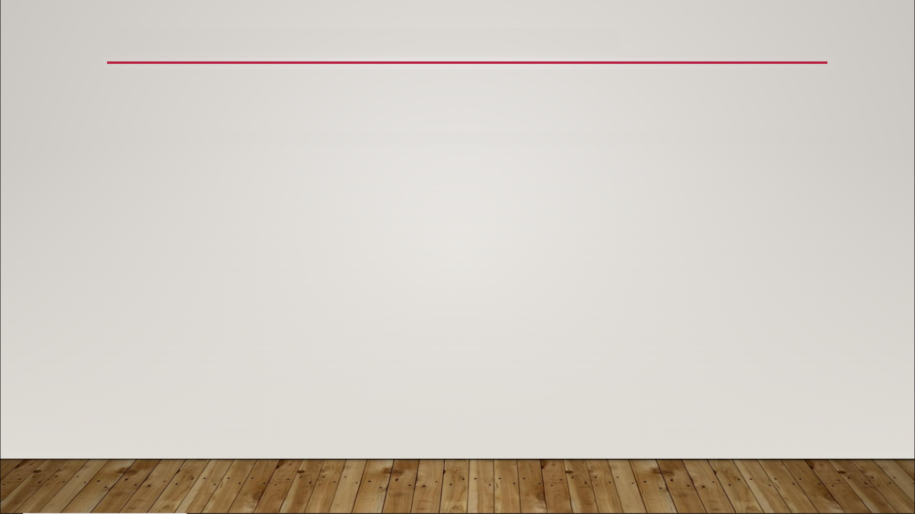
Texture Masking
technique where you use a black-and-white texture (texture mask) to limit the area that another texture or effect is applied to
one of the colors for where the effect should show
other color for where it should not show

