Slide 1
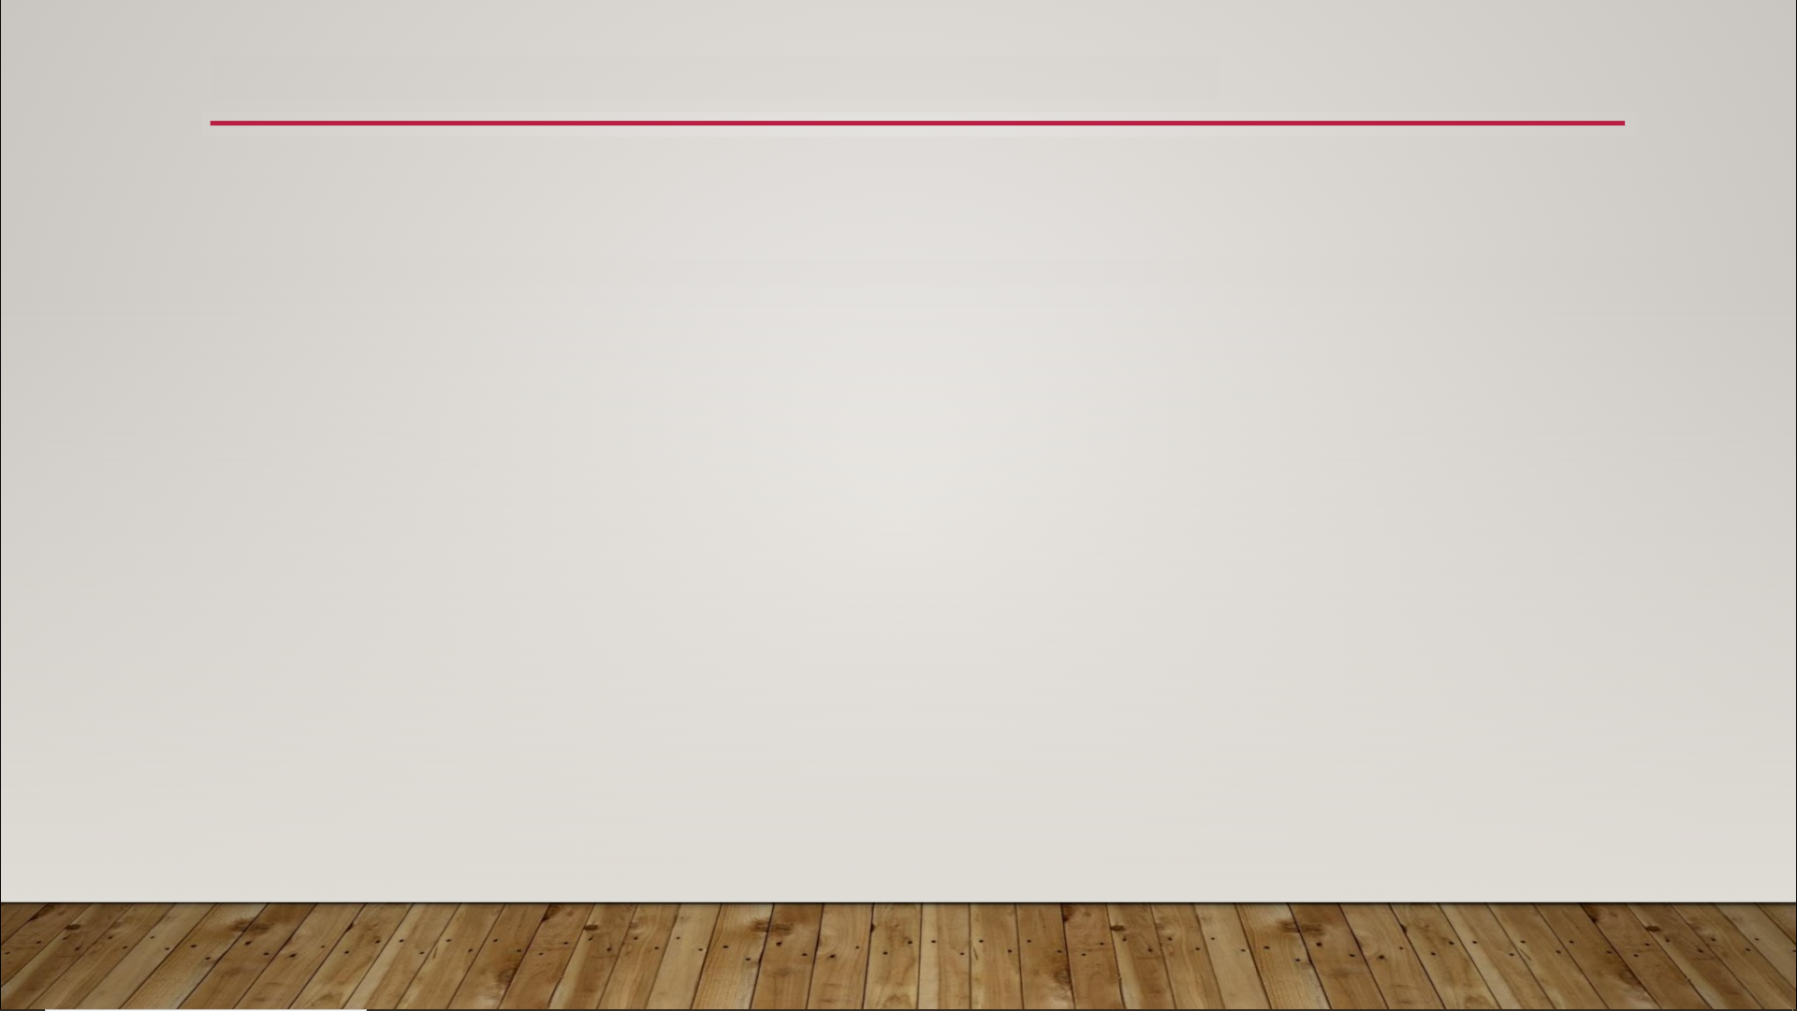
Textures
Resolution
both height and width must be a power of 2
power of 2 - number that can be created by taking the number 2 and raising it to some power
valid numbers: 2, 4, 8, 16, 32, 64, 128, 256, 512, 1024, 2048, 4096, 8192
often square, but don’t have to be - 64 x 1024 is perfectly valid
8192 x 8192 (8K): absolute largest, 4096 x 4096 (4K): practical limit
higher resolutions: better graphics, but slower

Slide 2
Textures
File Types
supported file types: .bmp, .float, .pcx, .png, .psd, .tga, .jpg, .exr, .dds, .hdr
use either Photoshop (.psd) or Targa (.tga) for Textures you design yourself
both of these files types are uncompressed and support an alpha channel
all images are compressed to the the same format internally regardless of the original type
if you’re using Photoshop, use .psd, otherwise use .tga

