Slide 1

Time Node
sine, cosine, and tangent functions - take an angle as input, and then output the ratio of the length of the sides of a right triangle formed from that angle

Slide 2
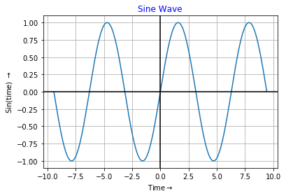
Time Node

Slide 3
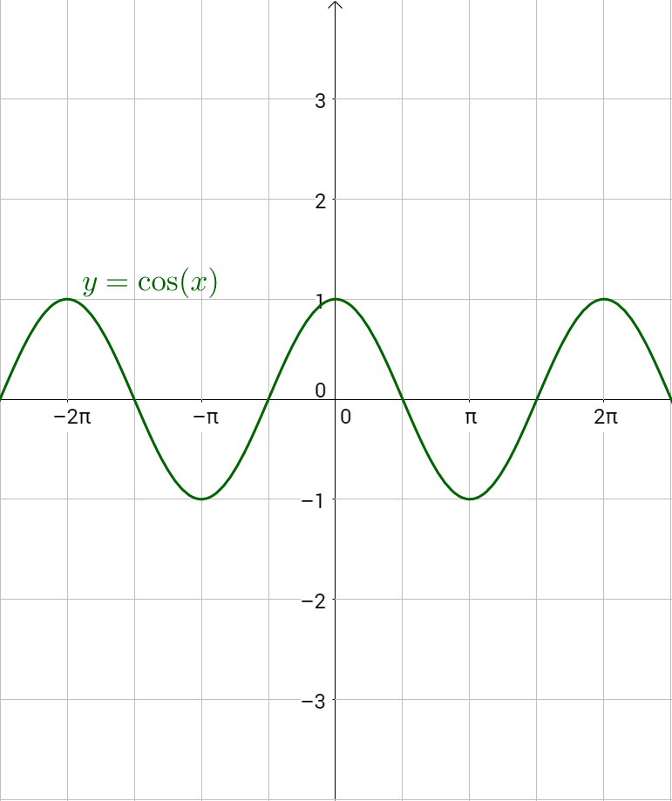
Time Node

Slide 4
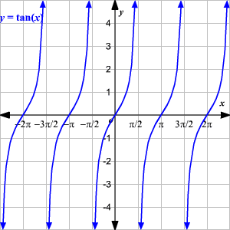
Time Node

