Slide 1
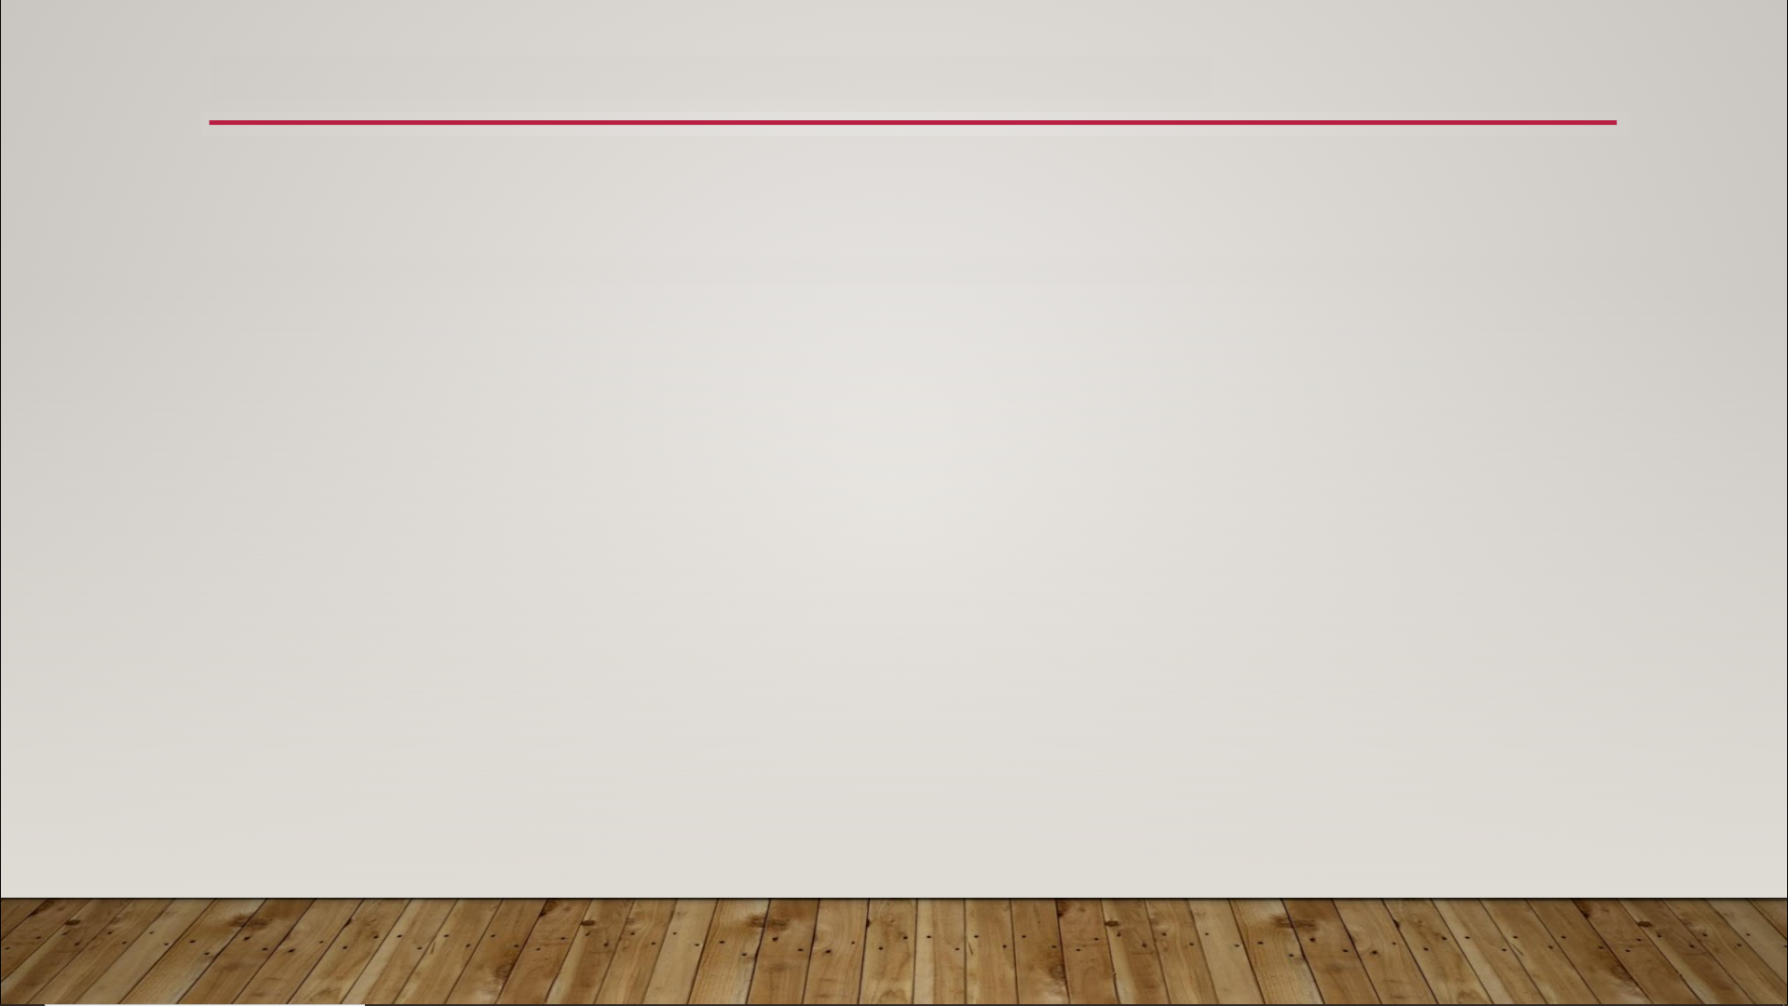
UV Mapping
In computer graphics, 3D objects are generally constructed from tiny, two-dimensional polygons (usually triangles) connected together

Slide 2
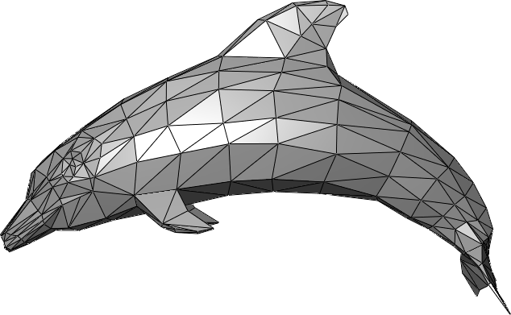
UV Mapping

Slide 3
UV Mapping
uv map - the information that maps each two-dimensional polygon of a mesh to some two-dimensional region of a texture
the polygons of a mesh are defined by their vertices
vertex - a point where two lines intersect (plural: vertices)

Slide 4
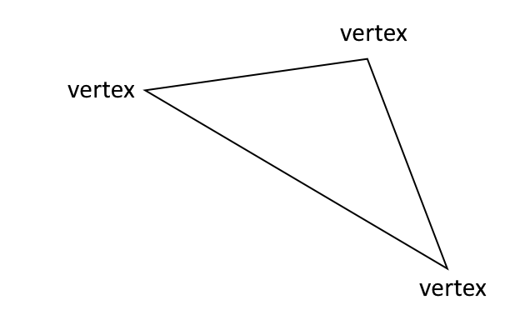
UV Mapping

Slide 5
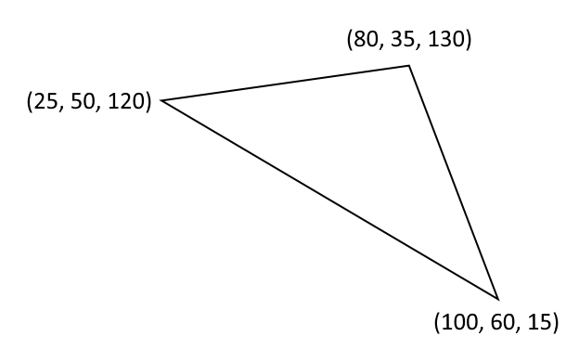
UV Mapping

Slide 6
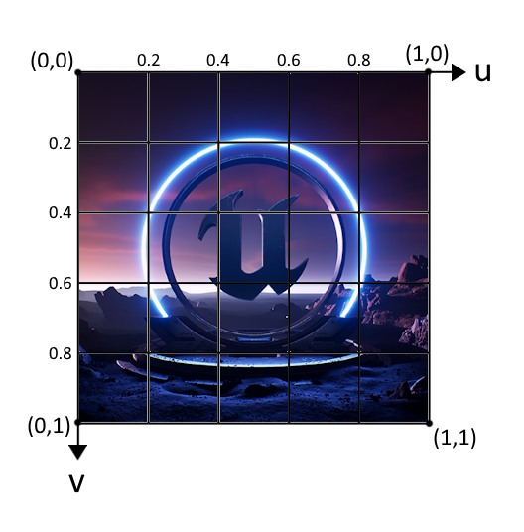
UV Mapping

Slide 7
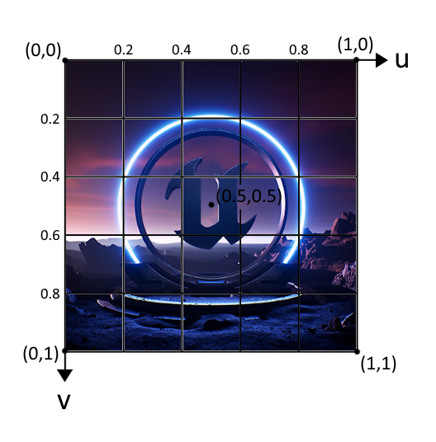
UV Mapping

Slide 8
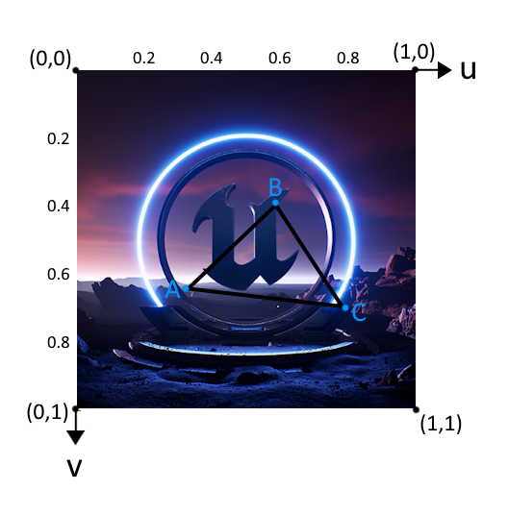
UV Mapping

Slide 9
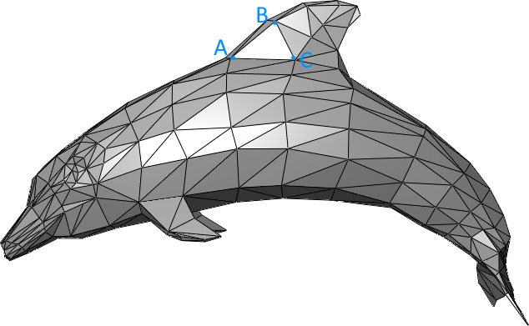
UV Mapping

Slide 10
UV Mapping

Slide 11
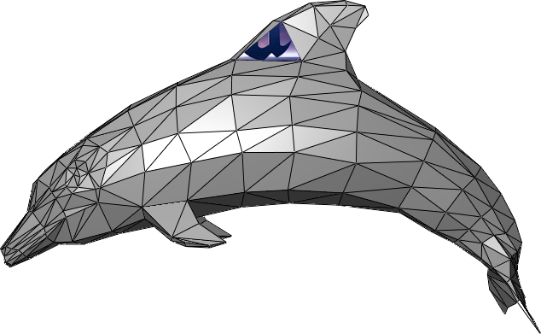
UV Mapping

Slide 12
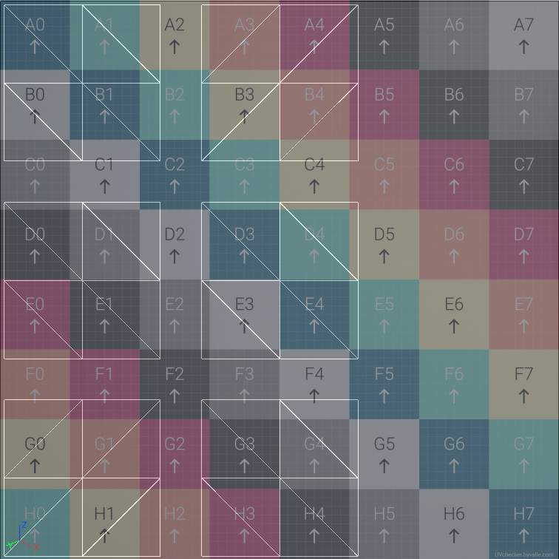
UV Mapping

