Slide 1

World Partition Overview
World Partition system - optimization system that solves memory and performance issues for huge Levels
open world - game mechanic in which players are free to explore a virtual world without barriers and to choose which objectives to attempt next

Slide 2
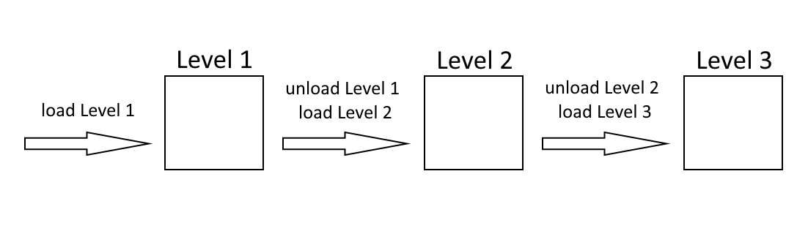
World Partition Overview

Slide 3
World Partition Overview
to achieve open worlds, a system is needed to load and unload assets as the player moves around
World Composition (UE4) - large Levels composed of several smaller sublevels, which are streamed in and out manually using Level Streaming
World Partition (UE5) - entire world stored in a single, persistent Level divided into grid cells that are automatically streamed in and out based on their distance from a designated streaming source

Slide 4
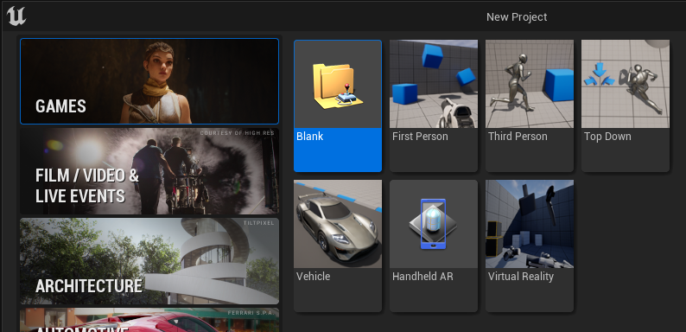
World Partition Overview

Slide 5
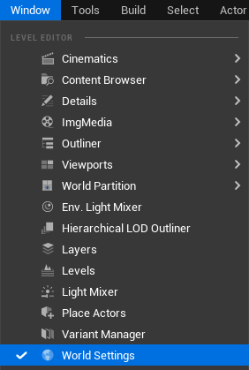
World Partition Overview

Slide 6
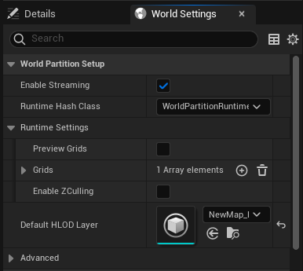
World Partition Overview

Slide 7
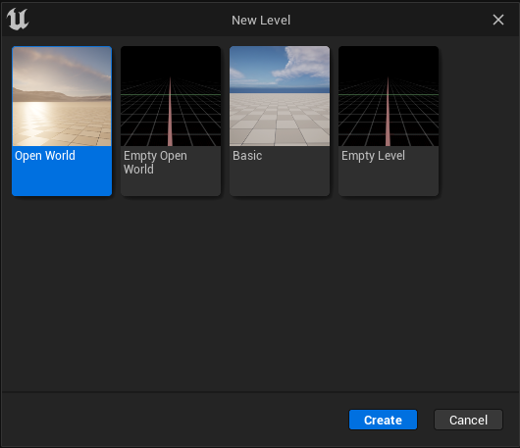
World Partition Overview

