Slide 1
AdaBoost Regressor
Model 1
Trained with Input Dataset (Equal Weight)
Model 2
Updated Dataset with Adjusted Weight for Weaker Sample from Model 1
Model 3
Updated Dataset with Adjusted Weight for Weaker Sample from Model 2
Final Model
………………..…

Slide 2
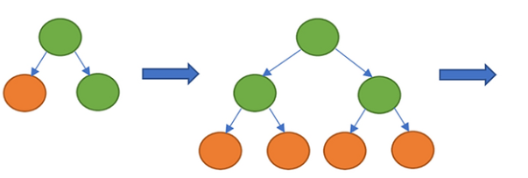
XGBoost Regressor
Input
Dataset
Prediction 1
WeightAdjusted
Prediction 2
WeightAdjusted
Prediction 3
WeightAdjusted
Average of Predictions

Slide 3
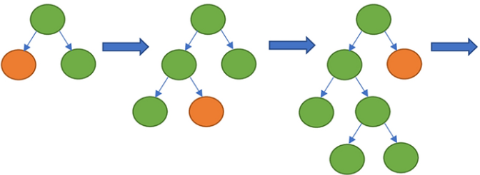
LightBGM Regressor
Input
Dataset
Prediction 1
ErrorsAdjusted
Prediction 2
ErrorsAdjusted
Prediction 3
ErrorsAdjusted
Average of Predictions

