Slide 1

Variational Recurrent Autoencoder for Anomaly Detection on Time-Series satellite data
Francesco Danese - 1926188
Elective in Artificial Intelligence
Professor: Christian Napoli
Sapienza University of Rome

Slide 2

ESA Telemetry Anomaly Dataset
A Multivariate Time-Series:
Multiple channels each monitoring a particular sensor.
Real-Valued / Discrete / Binary.
Label for each time-step: Nominal / Rare event / Anomaly.
Target Channels: where anomalies can happen and should be detected.
Non-Target Channels: affect target channels but don’t present anomalies
VRAE for Anomaly Detection on Time-Series satellite data- Francesco Danese
2

Slide 3
ESA Telemetry Anomaly Dataset
Telecommands:
Inputs commanded from Earth with exact timestamp.
Can cause anomalies -> Useful for detection
Can cause rare events -> Useful for avoiding False Positives
A complex model could exploit Target channels, Non-Target channels and Telecommands
VRAE for Anomaly Detection on Time-Series satellite data- Francesco Danese
3

Slide 4

Data Preprocessing
Non-Homogeneous sampling rates:
→Due to years-long acquisition and sporadic modifications
→ Resampling and interpolation
Different scales and domains:
→ Per-Channel standardization
→ Discretize categorical channels
VRAE for Anomaly Detection on Time-Series satellite data- Francesco Danese
4

Slide 5

Previous Approaches
Global STD:
Any sample distant at least ‘N’ std. from the mean → Anomaly
Can’t detect local anomalies, not good for non-stationary signals
Does not elaborate channels dependencies or correlations
Telemannon-ESA:
LSTM-Based → forecast 10 consecutive time points based on 250 preceding samples from multiple input channel
MAD between forecasted and real samples → Anomaly score
Score Thresholding
VRAE for Anomaly Detection on Time-Series satellite data- Francesco Danese
5

Slide 6
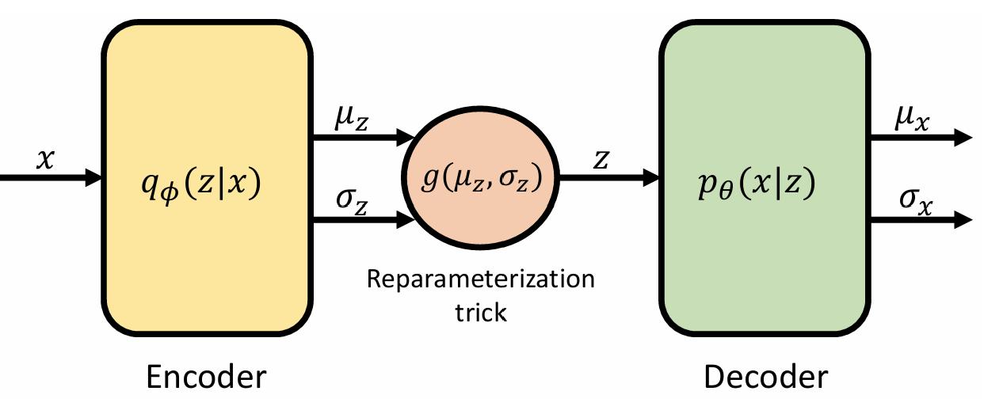
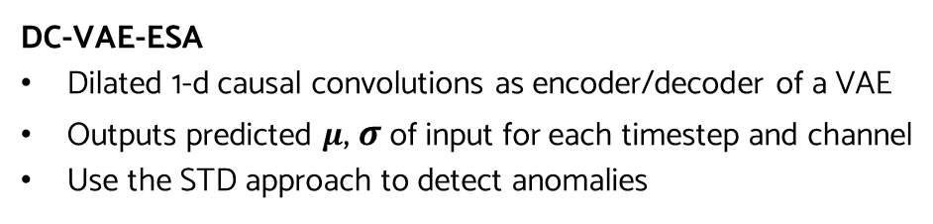
Previous Approaches
DC-VAE-ESA
Dilated 1-d causal convolutions as encoder/decoder of a VAE
Outputs predicted $μ$, $σ$ of input for each timestep and channel
Use the STD approach to detect anomalies
Building up on this…
VRAE for Anomaly Detection on Time-Series satellite data- Francesco Danese
6

Slide 7

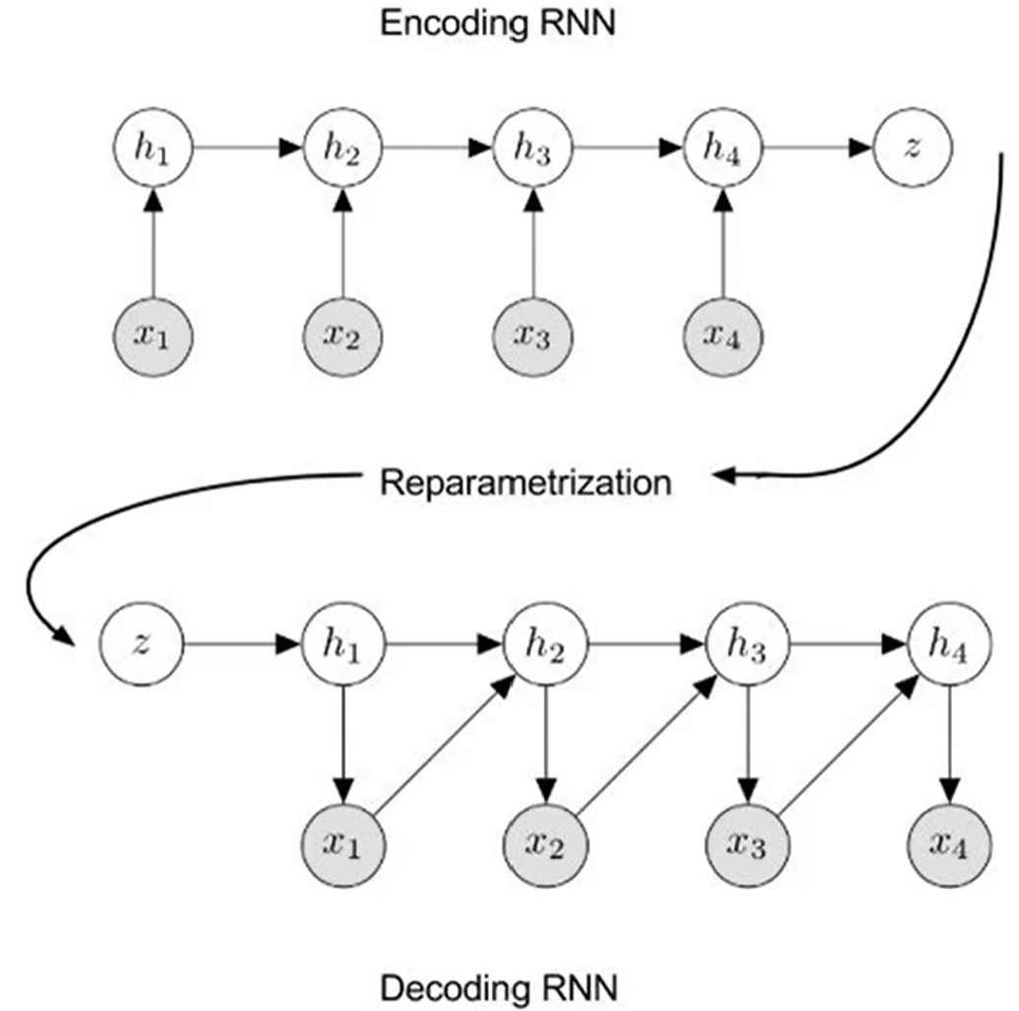


My new Approach
Variational Recurrent Autoencoder
- Combines the strenghts of a generative VAE and RNN
Reconstruct & Threshold
2 possible methods
Outputs $μ$, $σ$ and use STD approach
(Similar to DC-VAE)
VRAE for Anomaly Detection on Time-Series satellite data- Francesco Danese
7

Slide 8
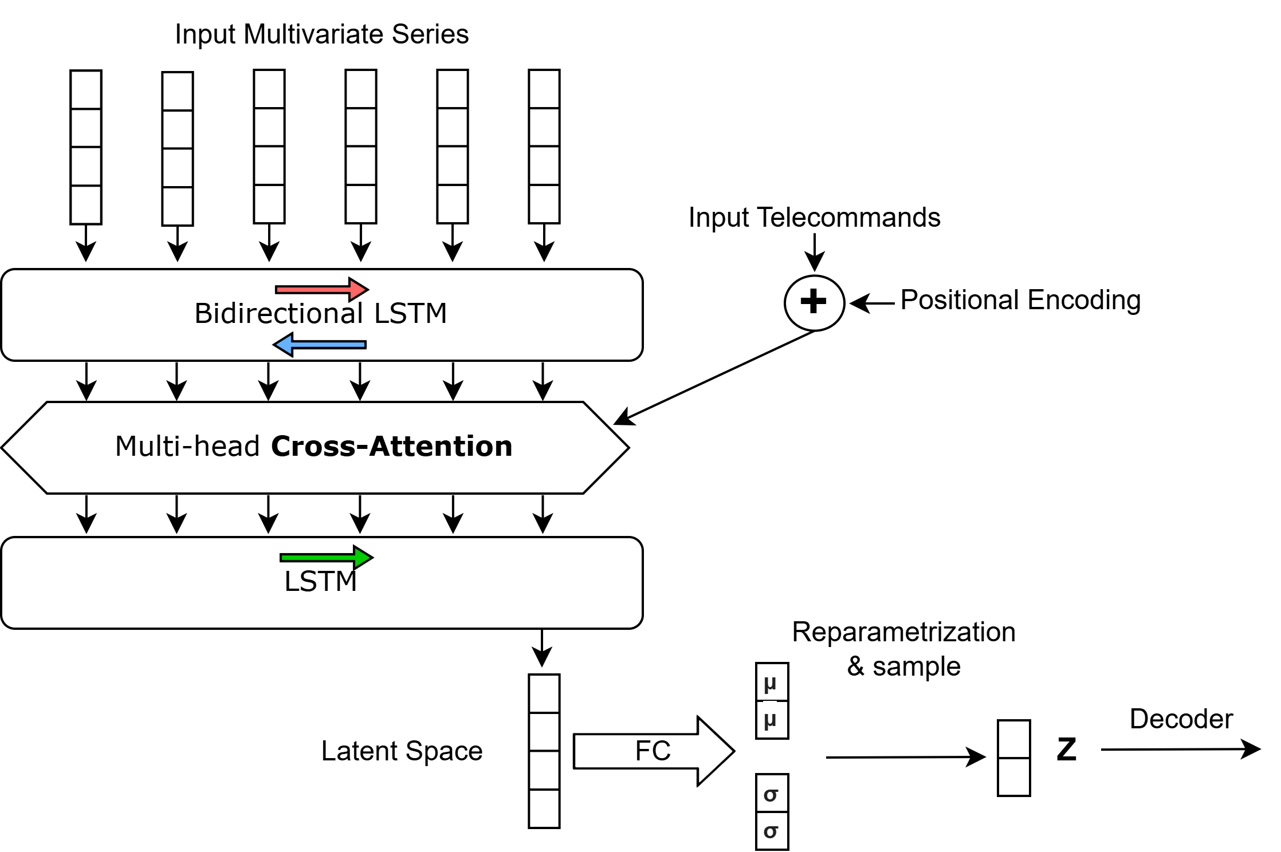
Bi-LSTM + Cross-Attention
Inspired by diffusion models that alternates convolutions and cross-Attention layers for input conditioning
Encoder:
Compute Anomaly Score
Decoder: specular to encoder but first layer is Autoregressive LSTM
VRAE for Anomaly Detection on Time-Series satellite data- Francesco Danese
8

Slide 9
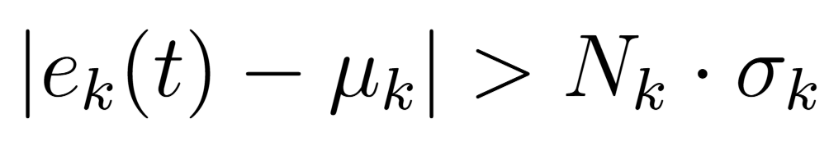
Dynamic Thresholding
Anomaly Score:
For each reconstructed time-step, compute the Absolute Error of each channel
Compute the Mean (over time-steps) Absolute Error of each channel and also its STD on the training set
Thresholding:
Take Abs. Erorr of channel k at time t , the (training) mean and std:
→ Flag as Anomaly if
VRAE for Anomaly Detection on Time-Series satellite data- Francesco Danese
9

