Slide 1

ROBO-MAID: Keep your house spotless with PDDL and IndiGolog.
Francesco Danese - 1926188
Planning and Reasoning 2024/2025
Professor: Andrea Marrella
Sapienza University of Rome

Slide 2






The house domain
In some rooms there is a trash bag
A single robot with actions:
Move(r1, r2): move between rooms
Clean(r): Clean the room
Pick-up-trash(r): Get the trash in the room
Pick-up-key(r): Get the key in the room
Unlock(r1, r2): Use the key
Drop-trash(r): Drop the bag in the trash-bin
Recharge(r): Fill the battery using the station
Some rooms are dirty
In some rooms there is a trash bin
Some rooms are locked and require a key
In some rooms there is a charging station
ROBO-MAID: Keep your house spotless with PDDL and IndiGolog.
2

Slide 3

Rules
Moving consumes 1 charge (can’t move with 0 charge, starts with 5)
Robot can move only between (unlocked) connected rooms
The robot can hold only 1 trash bag at a time
Robot can drop trash only in rooms with trash-bins
Each keys unlocks a specific connection
Task: All rooms are clean and the robot carries no trash.
ROBO-MAID: Keep your house spotless with PDDL and IndiGolog.
3

Slide 4
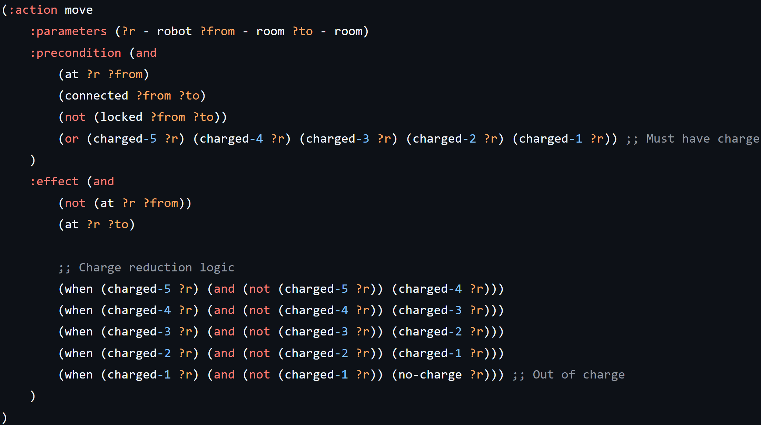
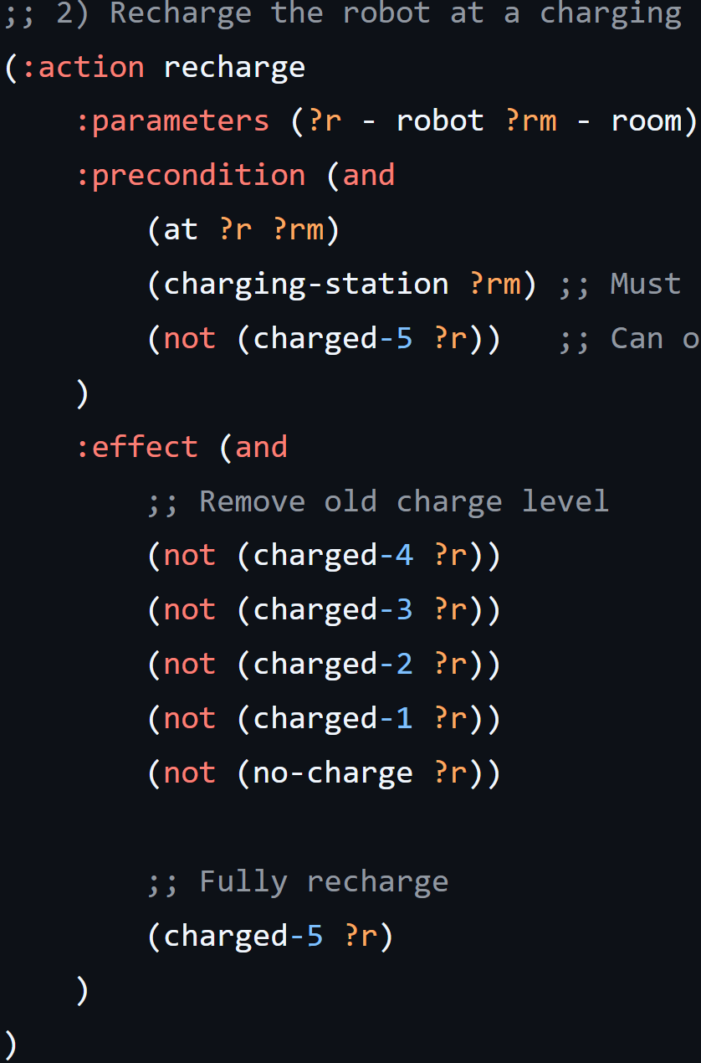
Some planners don’t support numerical planning →
→ Discretize charge levels while achieving the exact same logic
PDDL Domain - Actions
ROBO-MAID: Keep your house spotless with PDDL and IndiGolog.
4

Slide 5
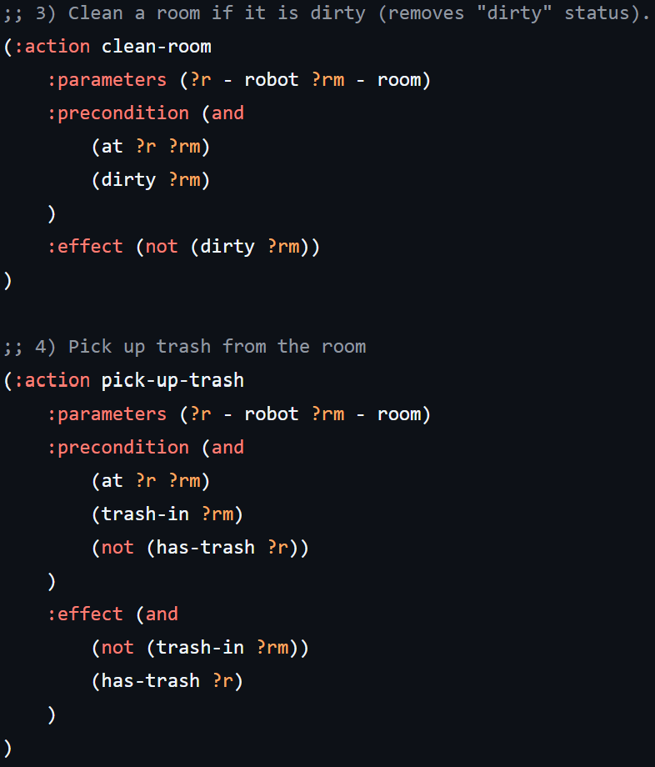
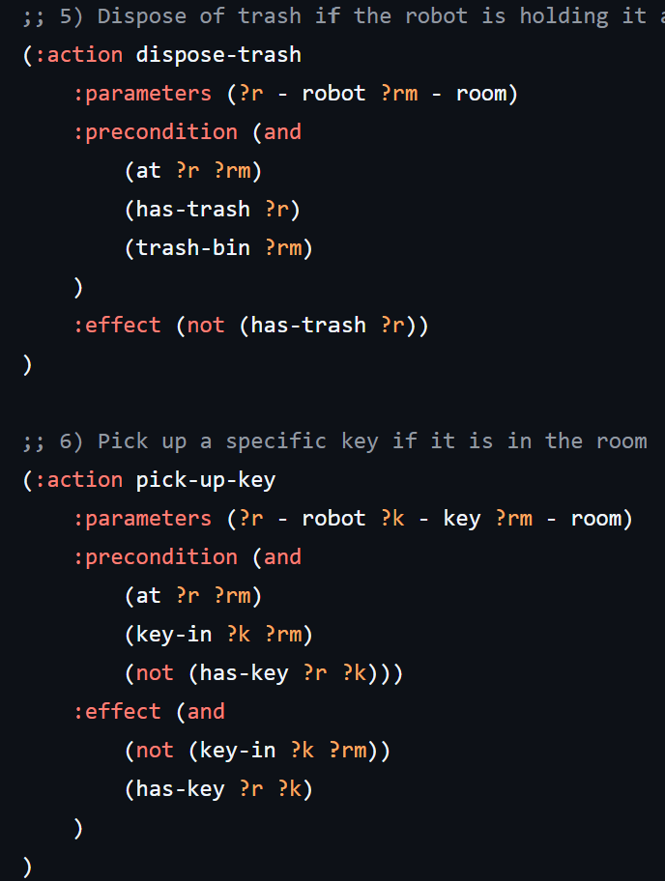
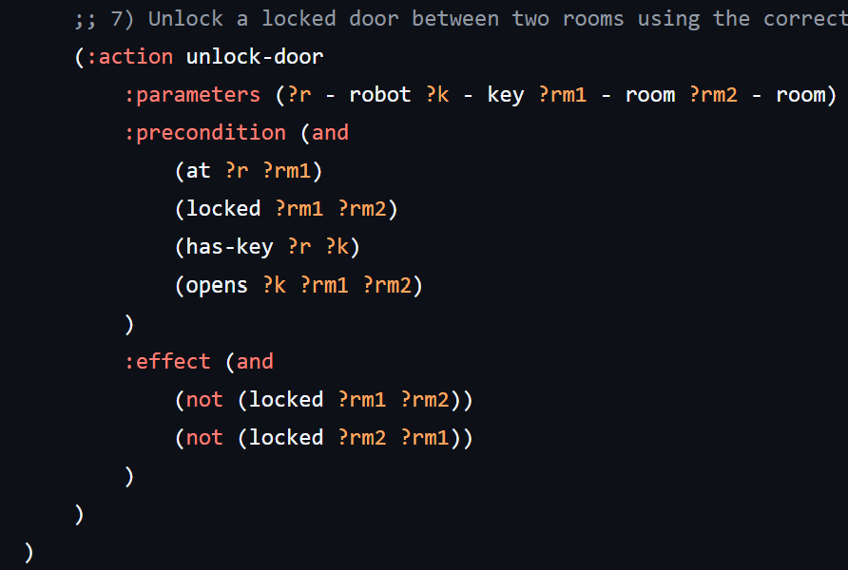
PDDL Domain - Actions
ROBO-MAID: Keep your house spotless with PDDL and IndiGolog.
5

Slide 6
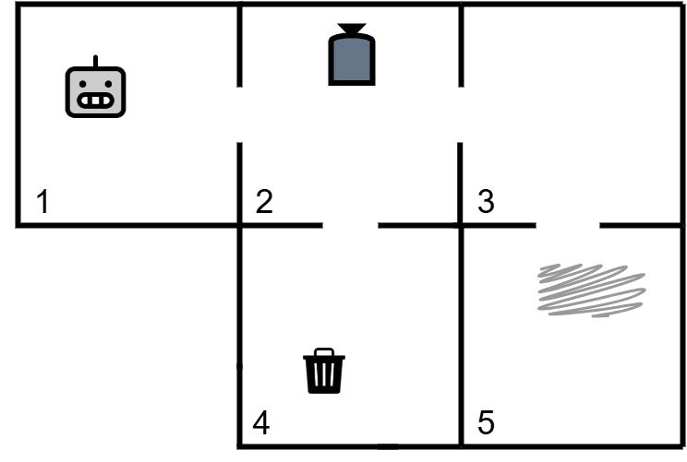
PDDL Problem - Easy
Fast Downard with A* : All heuristics give same results since the problem is easy
Solution length: 8 steps
Move(r1, r2)
Pick-up-trash(r2)
Move(r2, r4)
Drop-Trash(r4)
Move(r4, r2)
Move(r2, r3)
Move(r3,r5)
Clean(r5)
ROBO-MAID: Keep your house spotless with PDDL and IndiGolog.
6

Slide 7
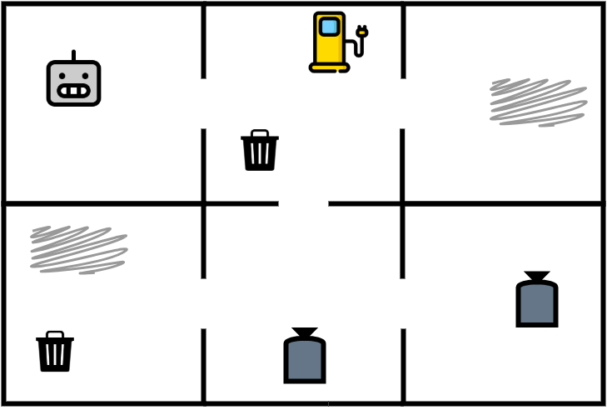
PDDL Problem - Medium
Fast Downard with A* Search
Heuristics | Solution length | Time
Blind | 16 | 0.0014 s
h_max | 16 | 0.0016 s
h_add | 16 | 0.0017 s
h_ff | 16 | 0.0019 s
The robot correctly plans when to pick-up trash, where to drop it or when to instead ignore it to optimize the path.
ROBO-MAID: Keep your house spotless with PDDL and IndiGolog.
7

Slide 8
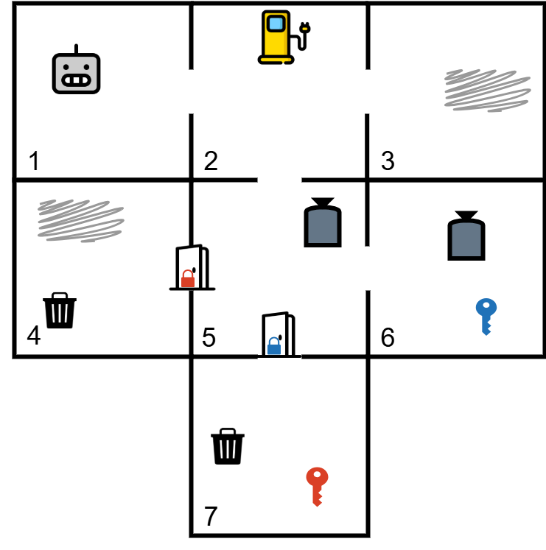
PDDL Problem - Hard
Fast Downard with A* Search
Heuristics | Solution length | Time
Blind | 23 | 0.0020 s
h_max | 23 | 0.0030 s
h_add | 28 | 0.0035 s
h_ff | 23 | 0.0038 s
The robot correctly plans when to pick-up trash, where to drop it or when to instead ignore it to optimize the path,
while efficiently managing keys and rechargings.
ROBO-MAID: Keep your house spotless with PDDL and IndiGolog.
8

Slide 9
IndiGolog
Slightly simplified domain to comply with the complexity of performing reasoning tasks in IndiGolog
All doors are unlocked
Only cleaning consumes 1 battery charge
Robot can have just 0 or 1 battery charge
(therefore it needs to recharge before cleaning a second time)
The rest of the domain behaves in the same way as the one described for PDDL.
ROBO-MAID: Keep your house spotless with PDDL and IndiGolog.
9

Slide 10
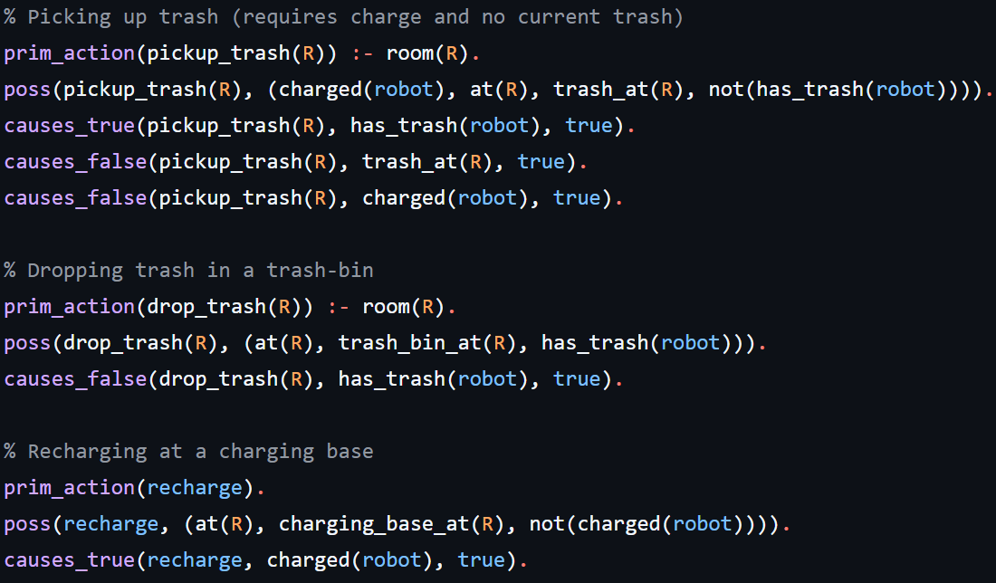
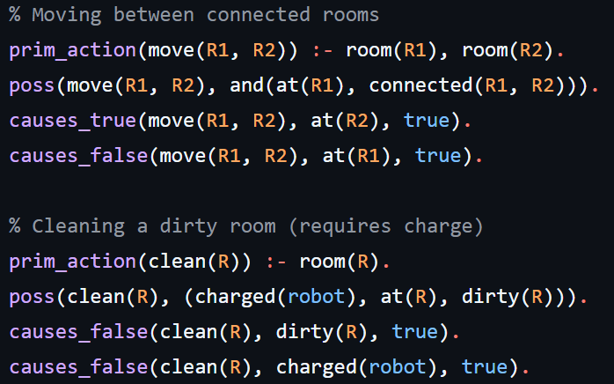
IndiGolog - Actions
ROBO-MAID: Keep your house spotless with PDDL and IndiGolog.
10

Slide 11
IndiGolog – Legality task
Consider a sequence of actions and want to study its executability from the initial situation → We execute a procedure with the sequence of actions and check whether it terminates successfully.
PROGRAM: Program has executed to completion!! History done: [move(room1, room2), move(room2, room5), …, recharge]
PROGRAM: Program fails: [[],drop_trash(room4)]
at history: [move(room1, room2), move(room2, room5), move(room5, room4)]
ROBO-MAID: Keep your house spotless with PDDL and IndiGolog.
11

Slide 12
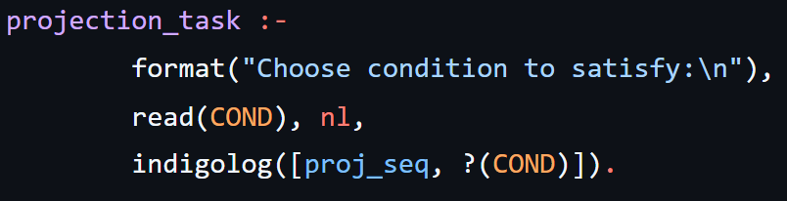
IndiGolog – Projection task
Consider a sequence of actions and want to study whether a fluent holds in the final situation. Define a procedure composed of a sequence of actions followed by a condition test over the fluent we want to check.
COND = has-trash(robot) → True
COND = trash-at(room6) → False
COND = at(room6) → False
COND = at(room3) → True
ROBO-MAID: Keep your house spotless with PDDL and IndiGolog.
12

Slide 13
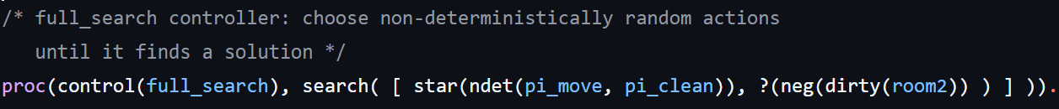
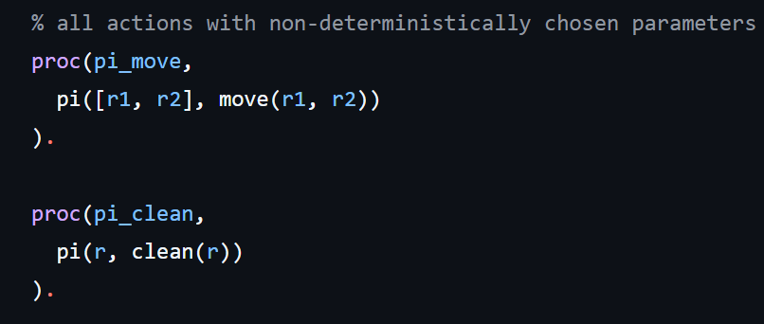
IndiGolog – Dumb controller
Room 2 initially dirty: Controller nondeterministicaly choosing between moving and cleaning finding a valid sequence of actions resulting in a clean room2.
→ PROGRAM: Program has executed to completion!! History done: [move(r1, r2), clean(r2)]
ROBO-MAID: Keep your house spotless with PDDL and IndiGolog.
13

Slide 14
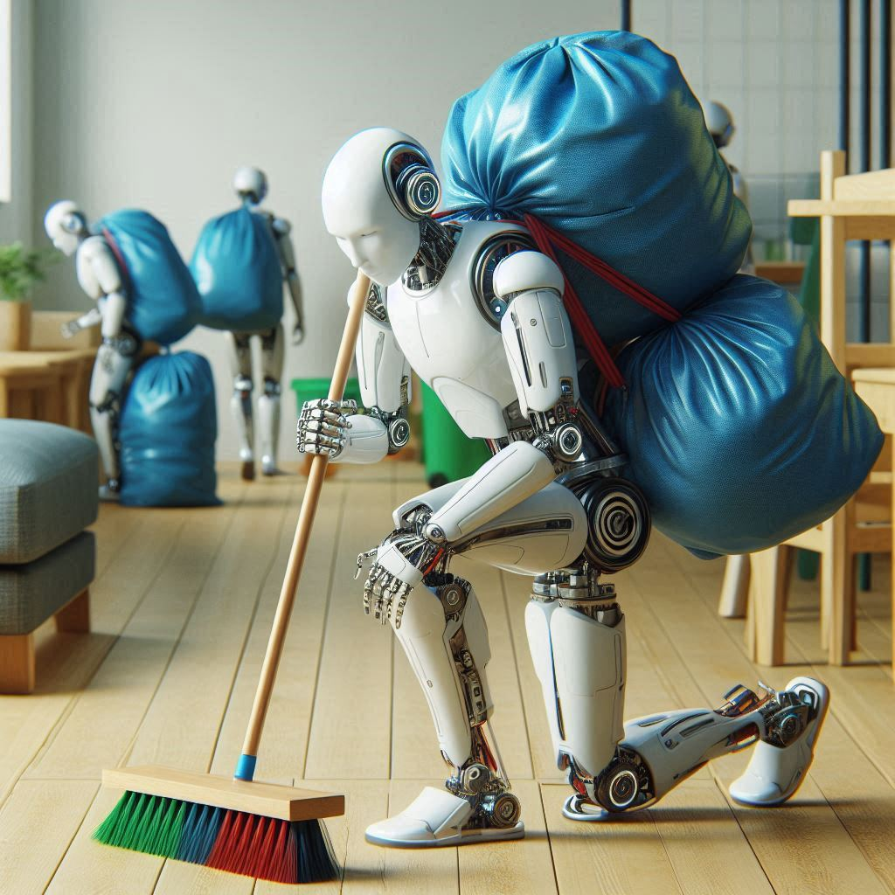
Thank you for the attention !
ROBO-MAID: Keep your house spotless with PDDL and IndiGolog.
14

