Slide 1

A Robust Person Identification Method through Wi-Fi Signals
Bachelor in Applied Computer Science and Artificial Intelligence
Francesco Danese 1926188
Supervisor
Prof. Luigi Cinque
Co-Supervisors
Prof. Danilo Avola
Prof. Marco Raul Marini
Prof. Daniele Pannone
Academic Year 2022/23
Notes:
Good morning/afternoon/evening everyone,
Today, I'm delighted to have the opportunity to present my internship report, which focuses on an incredibly fascinating field of study: Electroencephalography, or EEG for short specifically I worked on the denoised of the aforementioned waves.

Slide 2


Table Of Contents
Context
Objectives
Approaches
Proposed Solution
Results
Conclusions
Notes:
Through my presentation, I aim to provide you with a comprehensive overview of the project, highlighting its context, objectives, previous approaches, the methodology employed, and finally, the conclusions drawn from my research.

Slide 3
Context ●
Wi-Fi Sensing
The use of Wi-Fi signals to detect and interpret motion and presence
It exploits OFDM technology and Channel State Information (CSI) to measure signal fluctuations
Amplitude and phase of multiple subcarriers for higher granularity
Possible applications in Home Security, Gesture Recognition, Health Monitoring, Visitor Counting
Notes:
Before delving into the specifics of my internship experience, I'd like to take a moment to provide you with an overview of what EEG entails and why it's such a crucial area of research. EEG is a non-invasive technique that measures the electrical activity of the brain using electrodes placed on the scalp. By capturing these brainwave patterns, EEG enables us to gain insights into the functioning of the human brain, understand cognitive processes, and investigate various neurological conditions.
This technology is therefore used not only for a huge variety of medical investigations but is also gaining more space in commercial applications.

Slide 4
Table Of Contents
Context
Objectives
Approaches
Proposed Solution
Results
Conclusions
Notes:
Moving on to the core topic of the internship, I’d like to give an insight of what are the Objective of this study.

Slide 5
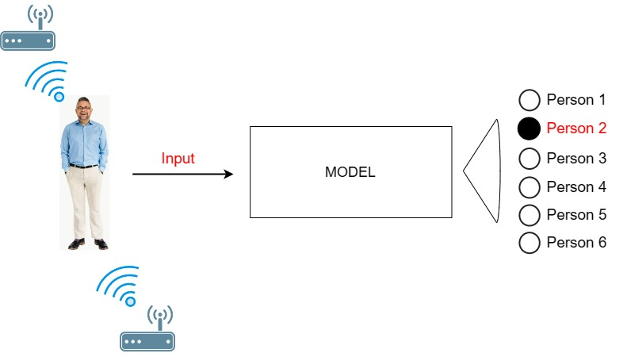
Objectives ●○
Person Identification
Notes:
Moving on to the core topic of the internship, I’d like to give an insight of what noise in the EEG field. When performing and electroencephalraphy, we are not only recording the signal coming from our neural activity, but also signals coming from muscles, especially eyes, that are placed closely to the electrodes. The signal recorded from the sensors is then a mixture of all of these different signals coming from different parts of our bodies.

Slide 6

Objectives ○●
Objective
The objective is to develop a new Wi-Fi based system to achieve Person ID in a controlled environment
The goal is to lay the foundation for Person Classification via EM waves as a first-of-a-kind approach
Notes:
The main scope of this project was to devise an innovative approach that surpasses existing methods in extracting the true essence of brain signals and unveiling the underlying neural activity eliminating distortions.
Our approach capitalizes on cutting-edge techniques, empowering us to push the boundaries of what has been done up to these days.
We aim not only to meet expectations but to exceed them, unlocking new possibilities for accurate and reliable EEG analysis.

Slide 7
Table Of Contents
Context
Objectives
Existing Approaches
Proposed Solution
Results
Conclusions

Slide 8
Existing Approaches ●○
For other tasks
e.g occupation, localization, gesture recognition…
DATA
ACQUISITION
FEATURE EXTRACTION
DENOISING
PREDICTION
Stat. Filters
Hampel
Butterworth
DWT
FFT
KNN
SVM
CNN
LSTM
Ensembles
CSI
RSSI
MIMO
Amplitude
Phase
Temp. Diff
Statistics
Notes:
Taking a step back onto previous approaches, we can see that some work has been done. Starting from the elederly stages of EEG denoising we have some common signal analyss methods, such as furier transforms and wavelet transforms. Then we have some signal analysis methods specifically suited for EEG such as regression filtering and blind source separation. In the latest years a compltely different approach has been proposed, the artificial intelligence has taken a step further in that task producing promising results. Here are some architectures that hav e been used, such as fully connected neural networks, Convolutional neural networks, recurrent neural networks encoder and, lastly transformers, whse result i’ve had the challenge to measure myself with.

Slide 9
Existing Approaches ○●
For Person ID
Close to nothing, lack of literature
One single paper exploiting the person’s gait
→ Requires walking back and forth
→ Difficult and complex steps extraction
Decision Tree Classifier
Private Dataset

Slide 10
Table Of Contents
Context
Objectives
Approaches
Proposed Solution
Results
Conclusions

Slide 11
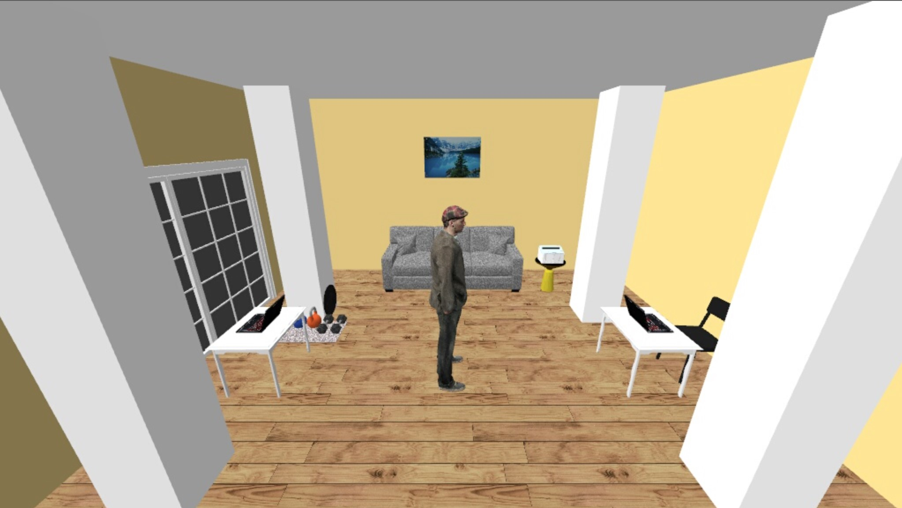
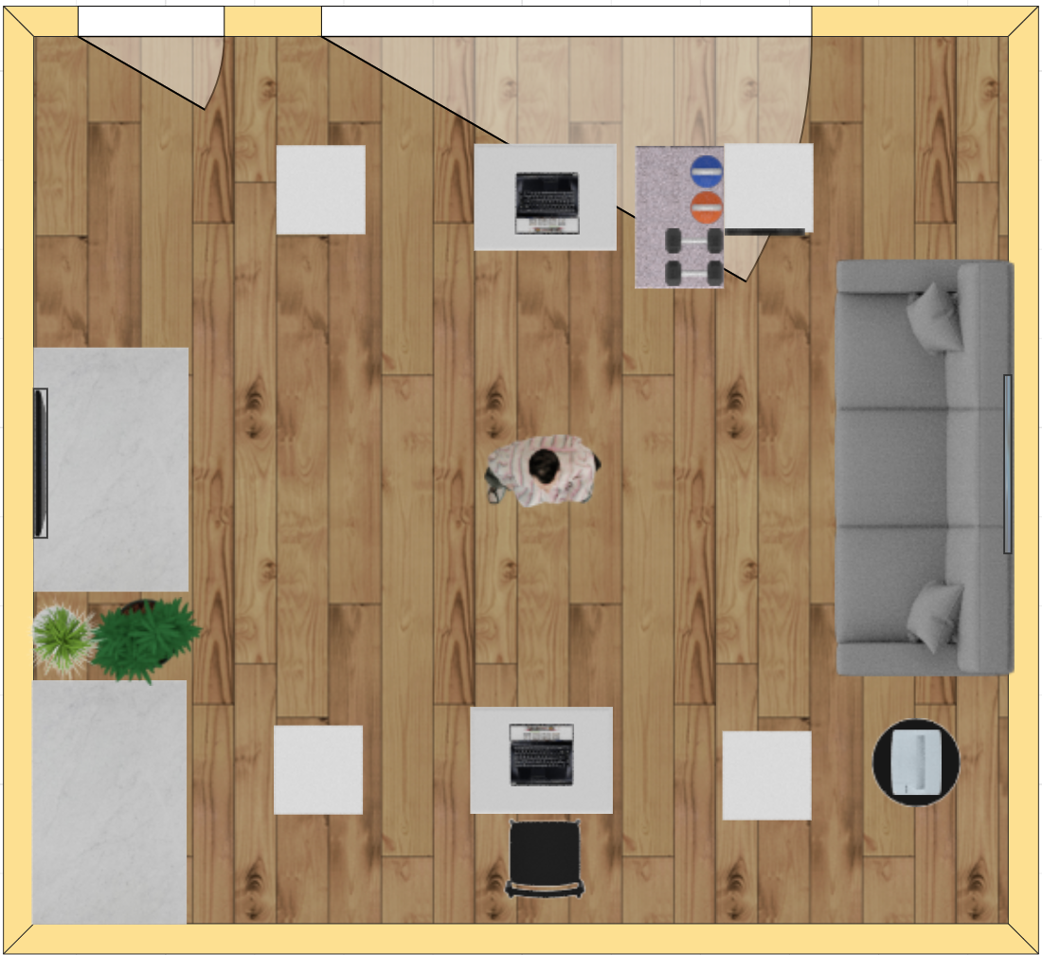
Proposed Solution ●○○○○
Data Gathering
6 different individuals (classes)
6 different orientations
Total of 15 minutes of acquisition per person
Rate of 100 packets/second
≈ 900 datapoints per class

Slide 12
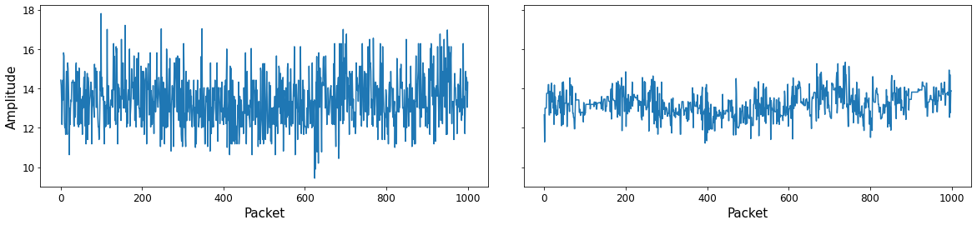
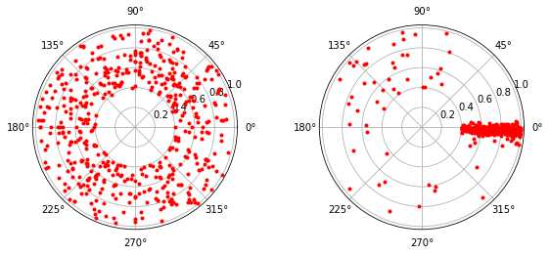
Proposed Solution ○●○○○
Pre-Processing
Amplitudes: Hampel Filter + Discrete Wavelet Transform
Phases: Calibration with Linear Transformation

Slide 13
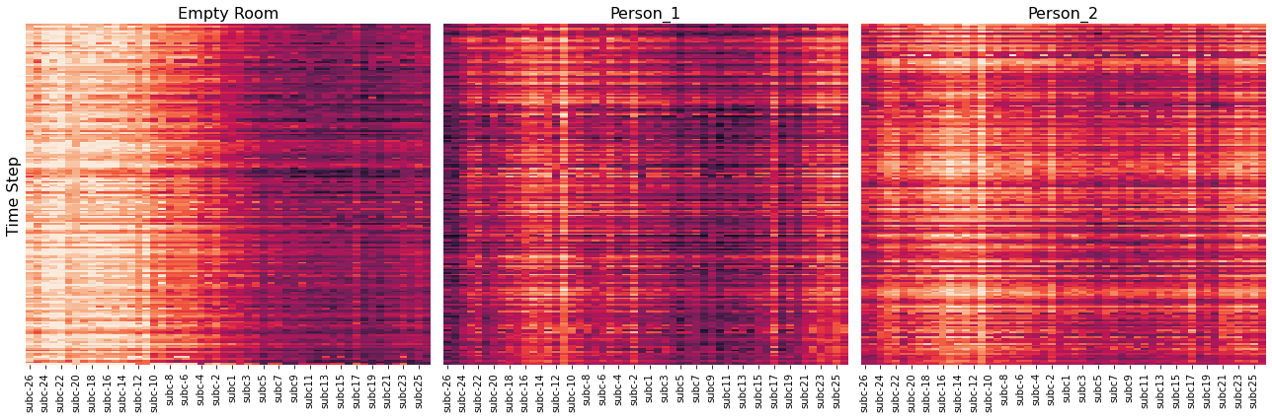
Proposed Solution ○○●○○
Amplitude Visualization

Slide 14
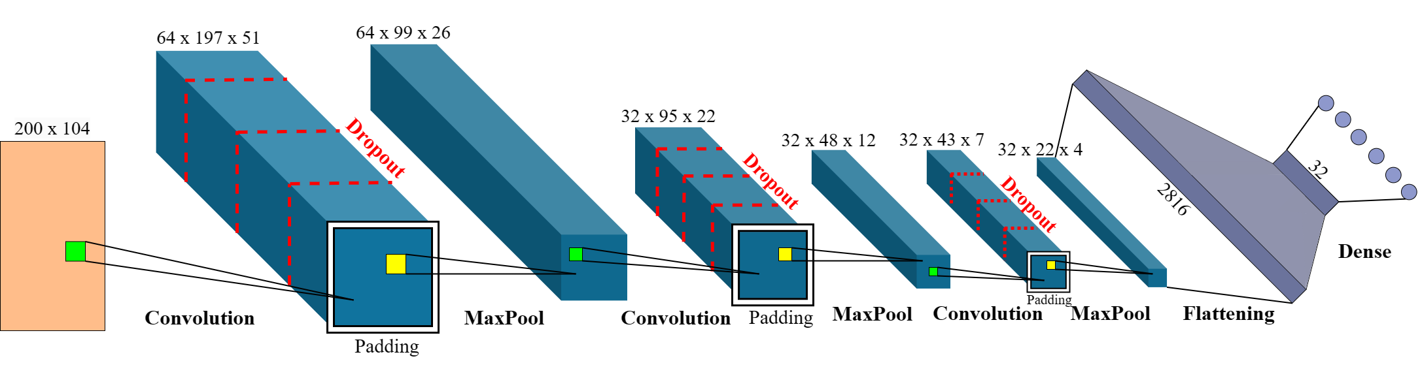
Proposed Solution ○○○●○
Proposed CNN Architecture
Designed from scratch with PyTorch

Slide 15
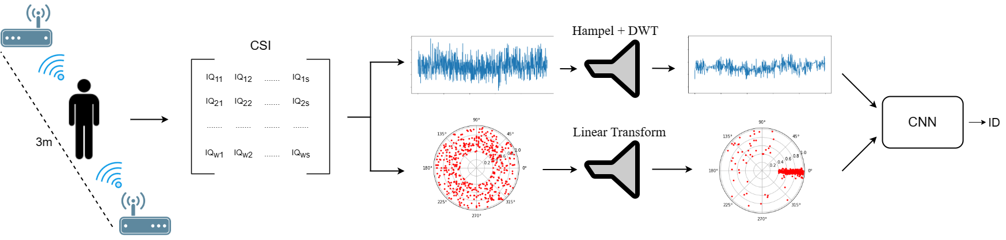
Proposed Solution ○○○○●
Complete Workflow

Slide 16
Table Of Contents
Context
Objectives
Approaches
Proposed Solution
Results
Conclusions

Slide 17
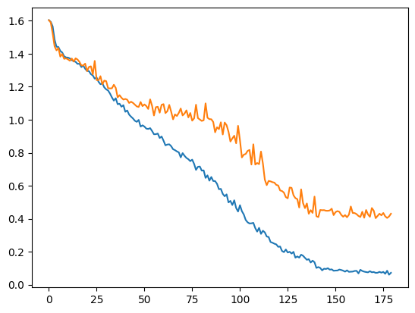
Results ●○
Training
Cross-Entropy Loss
SGD with Momentum (0.9) with batch size = 64
Initial LR = 0.001 for 180 epochs
Simple LR scheduler
- Train
- Validation
Loss
Epochs
Notes:
The clean EEG signals and noise signals are augmented adding random disturb
The EEG signals are partially reused to match the EMG and EOG signals
Data are divided in training, validation, and test sets
The noise signals are added to the EEG signals
The noisy EEG signals are normalized by dividing them by the standard deviation

Slide 18
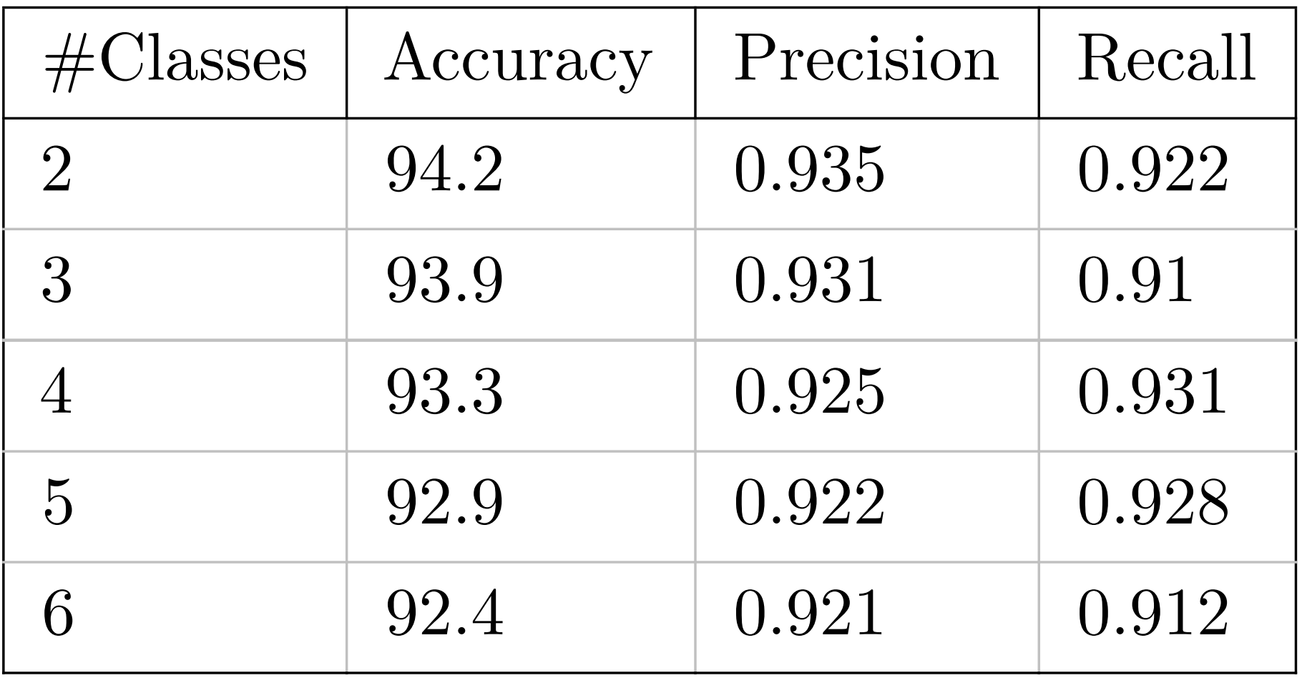
Results ○●
Validation
Different number of classes
5-Fold Cross-Validation
Average over 3 possible people combinations
0

Slide 19
Table Of Contents
Context
Objectives
Approaches
Proposed Solution
Results
Conclusions

Slide 20
Conclusions ●
Conclusions
A first step towards Wi-Fi sensing for person identification
A novel dataset in the empty public scenario
A starting system and model for classification
And a continuous evolution of Wireless devices and Deep Learning models that might open the future to new unexpected applications

Slide 21
A Robust Person Identification Method through Wi-Fi Signals
Thank you for listening!
Any questions?
Francesco Danese

