Slide 1


WQ24 – FINAL PROJECT PRESENTATION
Title: Quantum Machine Learning for Conspicuity Detection in Production
TEAM: HEPA_QUANTUM_LEARNERS
Womanium Quantum+AI Project

Slide 2
Outline
Introduction
Project Solutions
a)-Task 2
b)- Task 3
c)- Task 4
d)- Task 5
General comments on the tasks
Future scope
Conclusion
Womanium Quantum+AI Project

Slide 3
I. Introduction
AI (Artificial intelligence): is the ability of a computer to think as a human being.
ML (machine learning) is a subset of AI that uses algorithms to allow computers to learn on their own without being explicitly programmed; globally, it is a technique by which computer learns from data.
QML (Quantum machine learning ) on the other side, integrates quantum computing into the learning process, aiming to leverage quantum mechanics to potentially solve certain problems more efficiently than classical ML.
In this presentation, our goal is to explore the potential of hybrid quantum computing in accelerating the process of detecting deviations and weak points in production as classical method are very time consuming.
To do that, we will :
Show some basic workflow in Quantum Machine Learning through some tutorials
Develop some models for solving certain problems
Womanium Quantum+AI Project

Slide 4
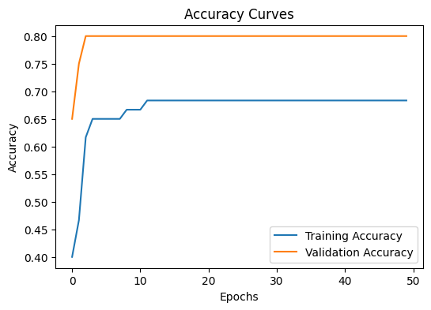
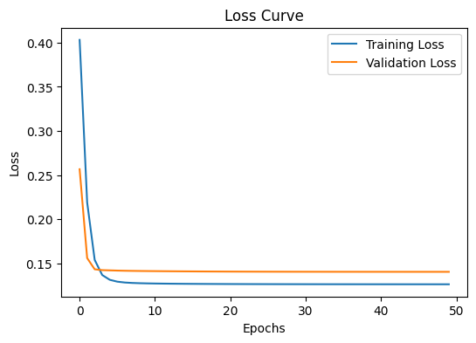
II. Project Solutions
Task 2.
In this task, our goal is to implement and present the usual steps in the variational classifier workflow.
We trained a variational circuit to perform binary classification on the make moons dataset (https://scikit-learn.org/stable/modules/generated/sklearn.datasets.make_moons.html) and got the following results:
From these curves, we can see that the model is learning from the data, as evidenced by the decrease in loss and a high accuracy (0.8).
The model does not appear to be overfitting during the range of epochs shown, since the loss continues to decrease or remains stable, rather than increasing (which could indicate that the model is starting to memorize the training data rather than learning generalizable patterns).
Womanium Quantum+AI Project

Slide 5
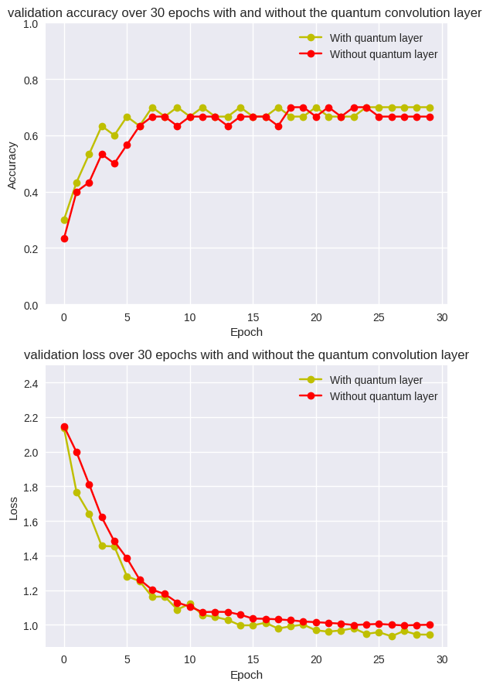
II. Project Solutions
Task 3.
In this task, our goal is to implement and present the usual steps in the quanvolutional neural network.
We trained a variational circuit and implemented the QNNs model powering Image Recognition with Quantum Circuits on the MNIST dataset(https://storage.googleapis.com/tensorflow/tf-keras-datasets/mnist.npz) and got the following results:
From these figures, we see that the model with the quantum layer has a slightly high accuracy and converges to a loss around 0.8 compared to the classical model. This indicates that the quantum model have minimized the classification error better than the quantum model
Womanium Quantum+AI Project

Slide 6
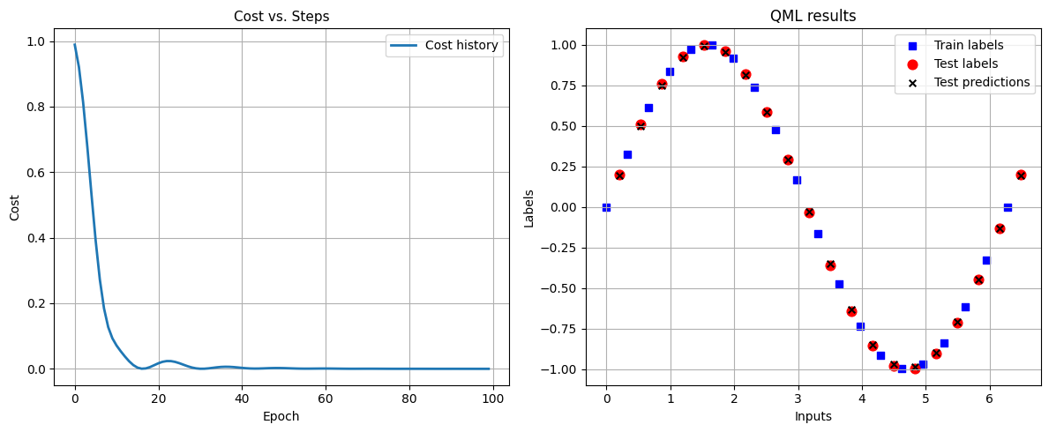
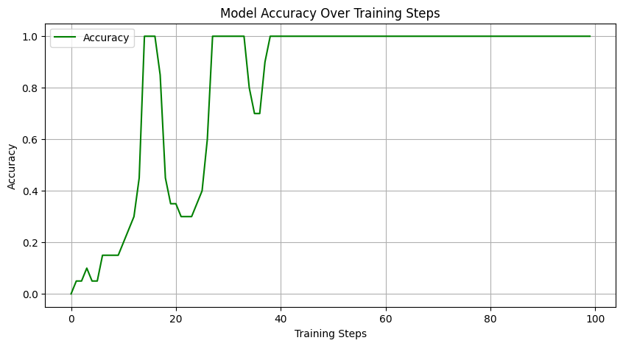
II. Project Solutions
Task 4.
In this task, our goal is to develop a model and use it to learn the sine function on the interval [0, 2π].
These plots shows how the cost function (likely the loss function) decreases sharply during the early epochs, have slight oscillations around the minimum cost between epoch 19 to 40 , and stabilizes close to zero. This suggests that the model has minimized the error in predicting the sine function values.
Compares the true labels (training and test data) against the model's predictions. The test predictions seem to closely follow the sine wave, indicating that the model has successfully learned to approximate the sine function for the given input range. Lastly, The plateau at 1.0 accuracy suggests that the model has generalized well to the sine function over the input interval.
Womanium Quantum+AI Project

Slide 7
II. Project Solutions
Task 5.
In this task, our goal is to develop a model and use it to detect the weld defect of the aluminium 5083 TIG
Womanium Quantum+AI Project

Slide 8
III. General comments
From all the tasks involved in this project, we succeeded in explaining the workflows of the algorithms and succeeded in developing the different hybrid quantum classical methods and saw how they took less computational times than when the models were purely classical. For task 5, preprocessing the data was not an easy thing to do, but we manage it. Our Variational model couldn’t classify better the weld defects, which we can see on the accuracy curve for example but could be looked in further.
IV-Future scope
For the nearest future, we aimed to fine tune the model for detecting the weld defect of the aluminium 5083 TIG.
To do that, we will try changing:
The parameters of the variational circuit
Change the variational circuit. Maybe make it mor expressive with lots of entanglement
Choose a better classical optimizer
-play around with the number of epochs and the learning rates
Play around with different encoding techniques to see what works the best.
V- Conclusion
From all the graphs and metrics evaluated to test the models, we saw that while the quantum approach is promising, its benefits might be more pronounced in different settings or with further optimizations.
Womanium Quantum+AI Project

