Slide 1
APPLICATION ORCHESTRATION USING
KUBERNETES
-BroGrammers

Slide 2
OVERVIEW
INTRODUCTION PROBLEMS
ABSTRACT OUTCOME
PHASES CONCLUSION
EXECUTION

Slide 3
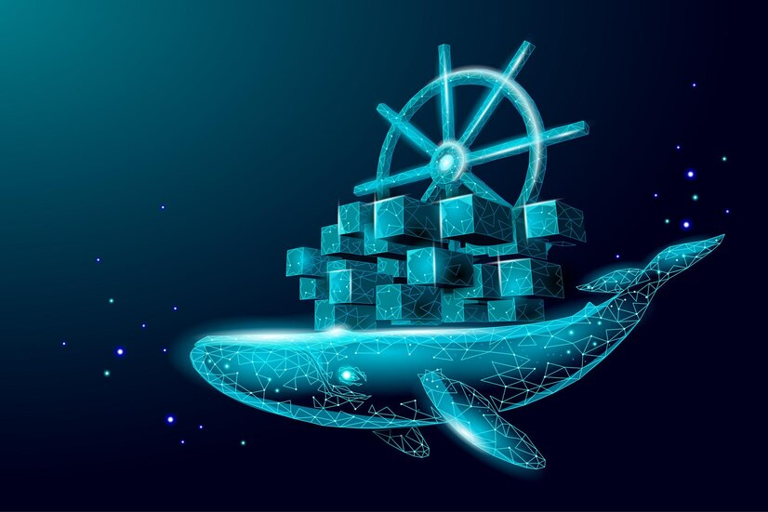
Introduction
Application orchestration using Kubernetes is a powerful and efficient way to manage and deploy applications in a containerized environment
Kubernetes is an open-source container orchestration platform that allows you to automate the deployment, scaling, and management of containerized applications.

Slide 4
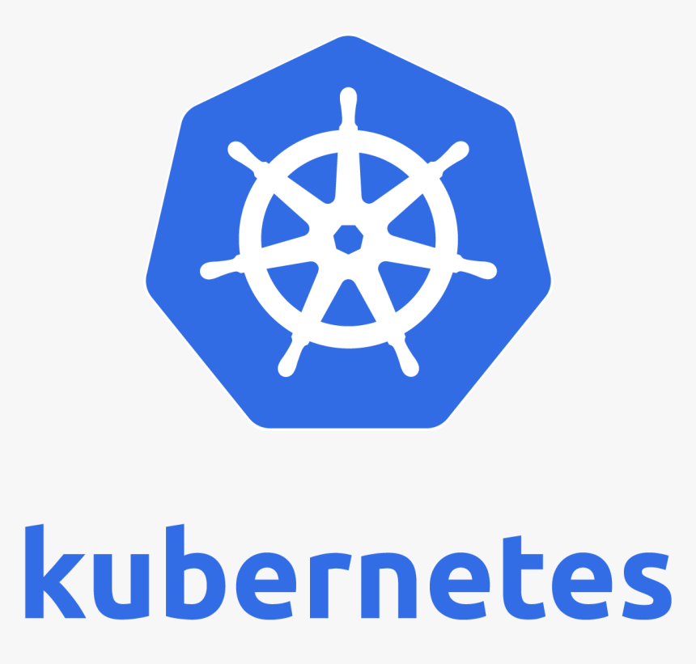
Abstract
Faculty of Recorded Media Arts
Department of Film and Television
The Project defines, how an application be hosted when contanarized and produced into Kubrnetes Cluster.
Kubernetes makes the deployement, scaling, managing of a containerized application automatic. It also scales the application up and down based on the demand.Hence, this automation tool helps in lot greater ways that ease the task of handling and deploying application when compared to deploying them without it.

Slide 5
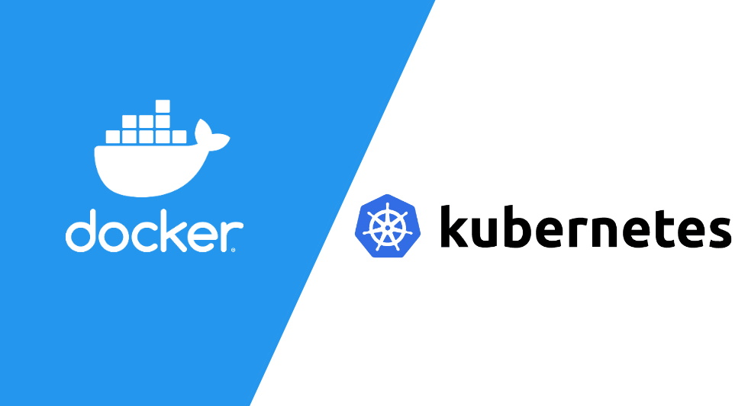
Phases
The First Phase:
The phase consists of dockerizing the application.
An application is developed and the Docker images are built and pushed into Docker Hub
The Second Phase:
The thus built images are used to start containers in pods of kubernetes cluster.
A minikube cluster is setup and used as an application orchestration tool .

Slide 6
The application related YAML files are configured with the image names that were built. The YAML files are the main entities used to deploy image based containers into kubernetes. The files define the deployements and services related to each microservice.
Execution
Monitoring is also the main phase in production of an application. There are many tools and platforms present to follow up the metrics related to our application, out of which Prometheus and Grafana are most widely used because of their user friendly and flexibile interface
The initial step is to start the minikube kubernetes cluster and then deploy the containers and its componenets using “Kubectl”, a command line tool.

Slide 7
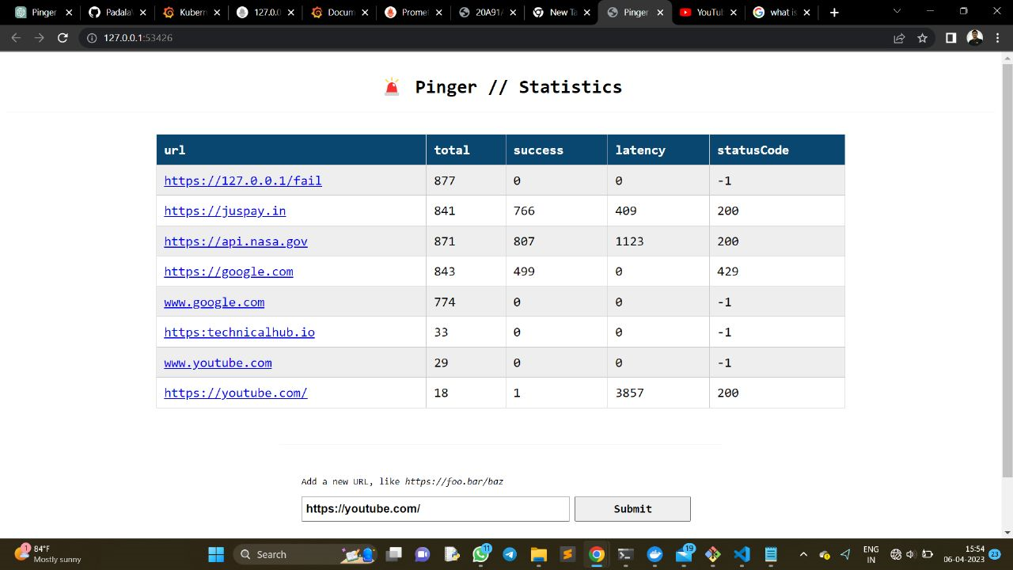
The snapshot shows the front-end interface of the application orchestrated using K8S.
The service component of the front-end microservice is responsible for the output.

Slide 8
Challenges Faced :
First Problem
Second Problem
We faced issues while minikube cluster pulling the docker hub images.
Due to network issue we were unable to integragte minikube and prometheus

Slide 9
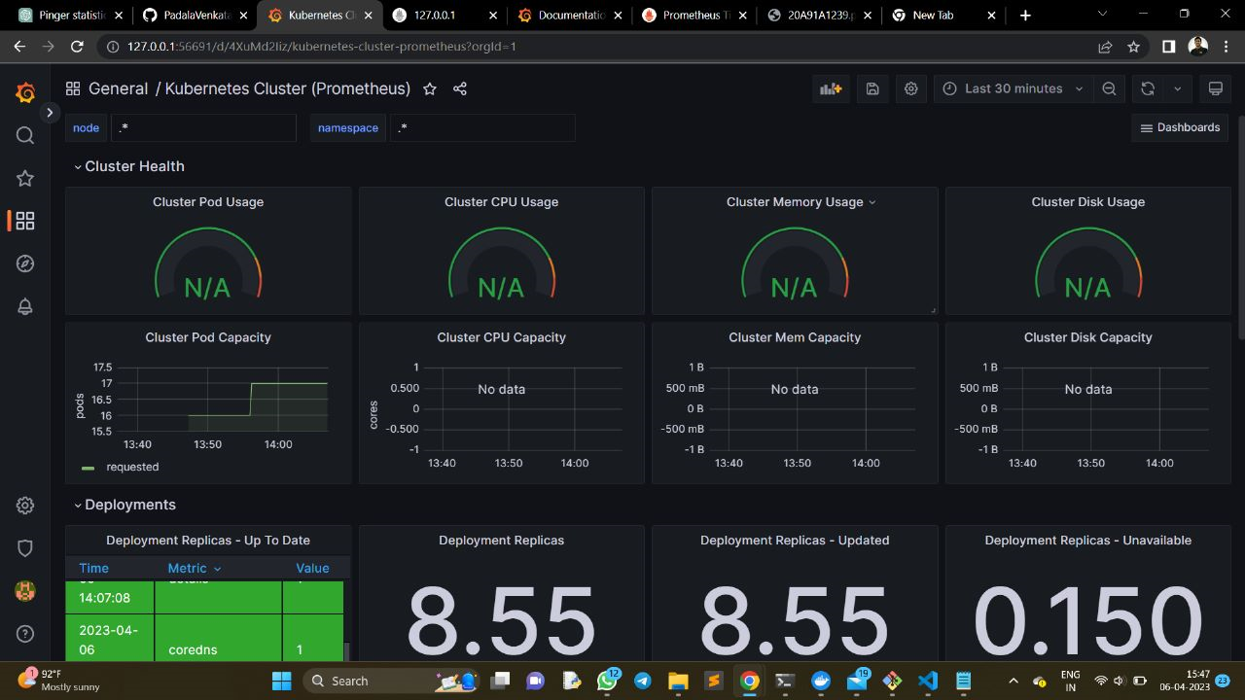
CONCLUSION :
The monitoring snapshot here describes the metrics viz. CPU Usage, Memory Usage etc..
These define the Cluster Health and other data including Deployements metrics can also be monitored. The tool GRAFANA enables all these.

Slide 10
Thank You
Vaseem(TL)
Nithin Reddy
Krishna Reddy
Navya

