Slide 1
Financial Analysis Using Excel

Slide 2
Introduction
- Purpose: Provide insights into financial functions and analysis using Excel.
- Scope: Utilizing Excel functions like PV, NPV, IRR, EMI, and more.
- Objectives:
- Apply financial concepts to real-world scenarios.
- Use Excel functions for better financial decision-making.
- Generate a summary report based on analysis.

Slide 3
Key Findings
- Excel provides powerful financial functions to analyze investments and loans.
- Net Present Value (NPV) and Internal Rate of Return (IRR) are crucial for evaluating investments.
- Equated Monthly Installments (EMI) calculation helps in loan planning.
- Decision-making is enhanced by understanding cash flow timing and interest rates.

Slide 4
Actionable Insights
- Use NPV for comparing different investment opportunities.
- Use IRR for evaluating project profitability.
- EMI calculations help in loan repayment planning.
- Understand the impact of different interest rates on financial decisions.

Slide 5
Methodologies
- Data Collection: Financial dataset preparation.
- Application of Excel Formulas:
- PV (Present Value): =PV(rate, nper, pmt, [fv], [type])
- NPV (Net Present Value): =NPV(rate, value1, [value2], ...)
- IRR (Internal Rate of Return): =IRR(values, [guess])
- EMI Calculation: =PMT(rate, nper, pv, [fv], [type])
- Analysis through case studies and financial models.

Slide 6
Approaches
- Financial Modeling in Excel with real-world scenarios.
- Scenario Analysis: Comparing different loan and investment options.
- Year-on-Year Analysis for tracking financial performance.
- Visualization using graphs and charts.

Slide 7
Insights
- PV and NPV help in assessing the value of future cash flows.
- IRR and MIRR determine project viability.
- EMI calculations assist in selecting the best loan repayment plan.
- Cash flow analysis aids in investment decisions.

Slide 8
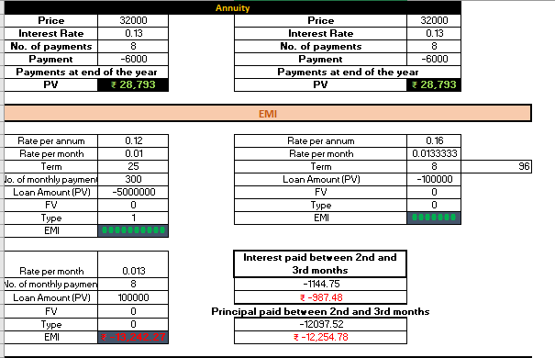
INSIGHTS

Slide 9
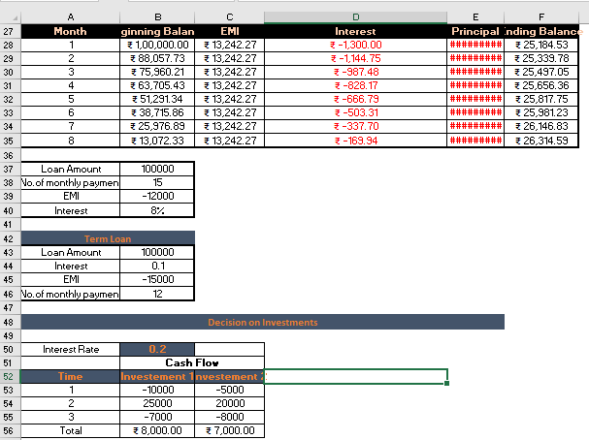
INSIGHTS

Slide 10
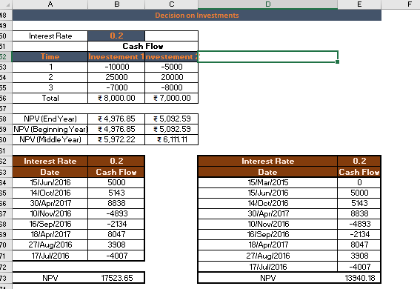
INSIGHTS

Slide 11
Conclusions
- Financial functions in Excel simplify complex calculations.
- Choosing the right method depends on business objectives and financial goals.
- NPV and IRR offer strong investment evaluation tools.
- Effective use of these functions enhances decision-making for businesses and individuals.

Slide 12
Thank You

