Slide 1
Hr Database Management System

Slide 2
Introduction
This project explores the HR database, analyzing employee salaries, departments, job roles, and hierarchical relationships. The study involves various SQL queries to extract meaningful insights.
To extract valuable insights from HR data using SQL queries, focusing on salary trends, departmental analysis, and workforce distribution.
Helps organizations optimize HR management by identifying salary gaps, workforce trends, and department-wise salary distributions.

Slide 3
Key Findings
- Identified departments with highest and lowest salaries
- Found employees earning above average salaries
- Analyzed department-wise salary distribution
- Determined highest-paid employees
- Evaluated employment trends across departments

Slide 4
Actionable Insights
- Adjust salary structures to retain top talent
- Address pay gaps among employees
- Improve hiring strategies for departments with fewer employees
- Implement better promotion policies based on salary trends
Identify salary discrepancies and implement competitive compensation plans to retain top talent and reduce attrition rates.

Slide 5
Methodologies & Approaches
- Used SQL queries for data extraction and analysis
- Applied subqueries, joins, and aggregation functions
- Analyzed salary trends with GROUP BY and HAVING clauses
- Utilized constraints to ensure data integrity

Slide 6
Insights from SQL Queries
Below are some key queries used in the analysis:
1. Highest Salary by Department
2. Employees with Salaries Above Average
3. Departments with Employees Earning Above 10,000
4. Employees with Highest Salary
5. Employees with Lowest Salary

Slide 7
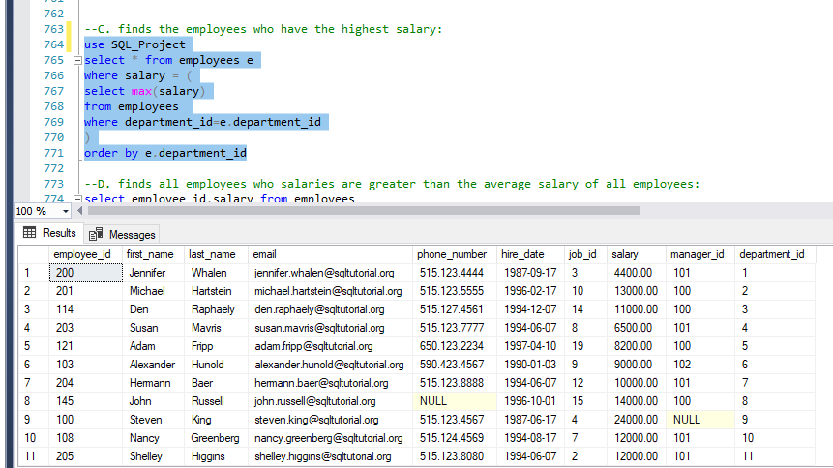
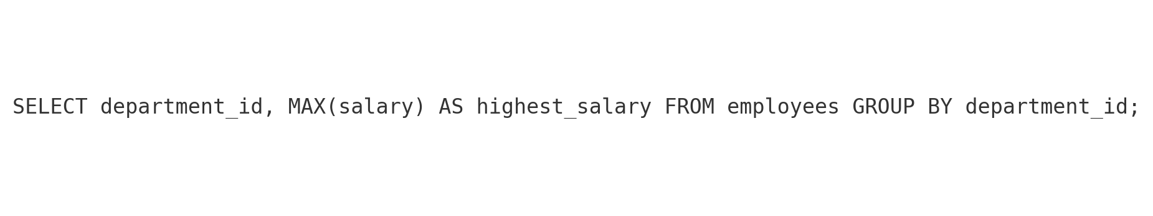
Highest Salary by Department

Slide 8
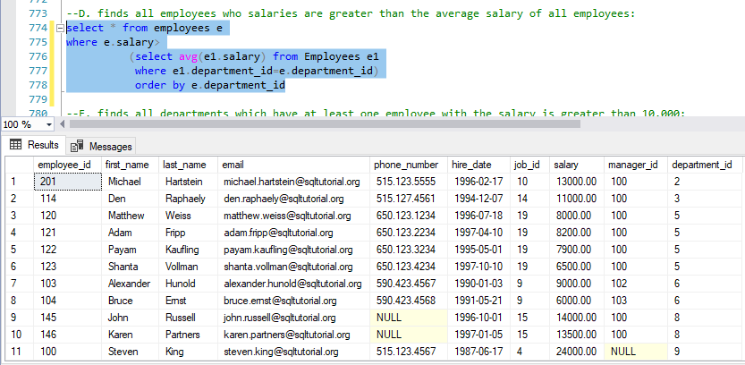
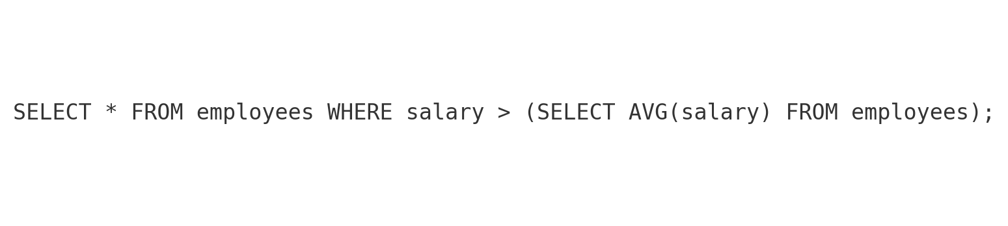
Employees Above Average Salary

Slide 9
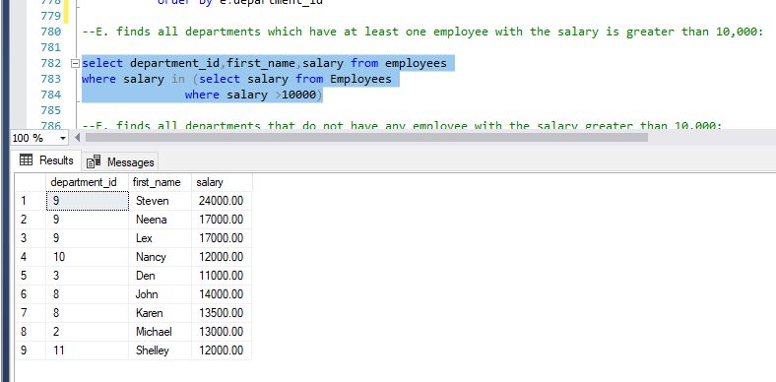
Departments with Employee Salary > 10,000

Slide 10
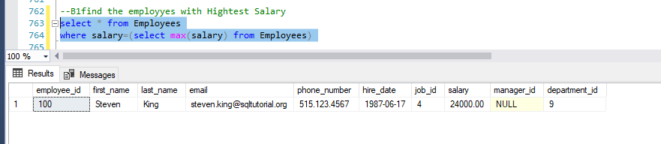
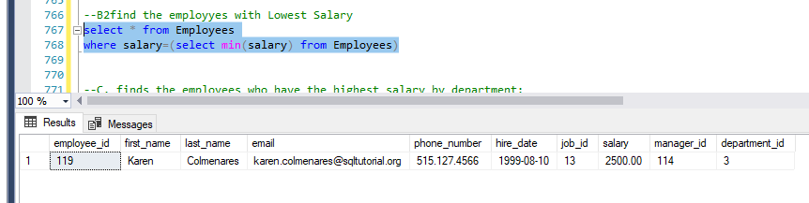
Employee with Highest Salary
Employee with Lowest Salary

Slide 11
Conclusion
The HR database analysis provided valuable insights into employee distribution, salary trends, and departmental performance. The study helps in making informed decisions for better workforce management.

