Slide 1

Aspekte der systemnahen Programmierung bei der Spieleentwicklung
Technische Universität München - Lehrstuhl für Rechnerarchitektur und parallele Systeme
Peano-Kurven (A214)
Mohamed Attia, Patrick Zimmermann, Thomas Torggler
München, der 16. Februar 2021

Slide 2
Motivation: Beispiel des Ansatzes
•

Slide 3
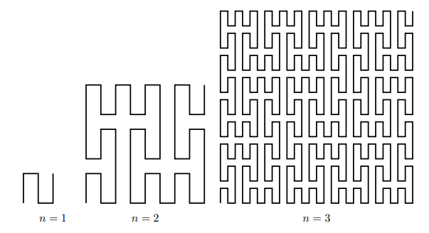
Motivation: Raumfüllende Kurven
•

Slide 4
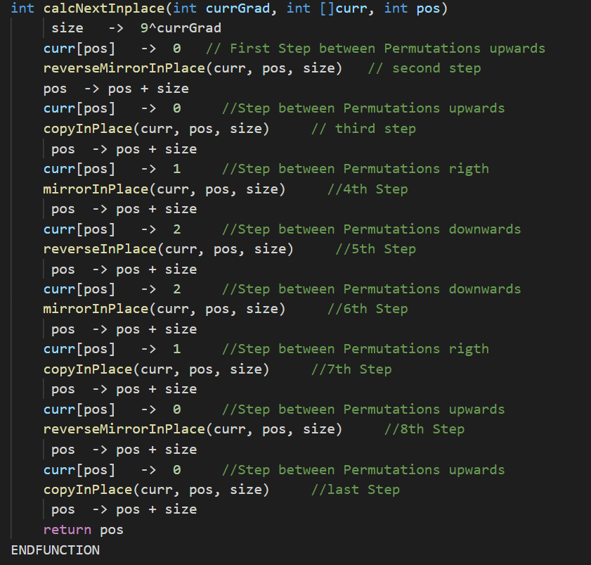
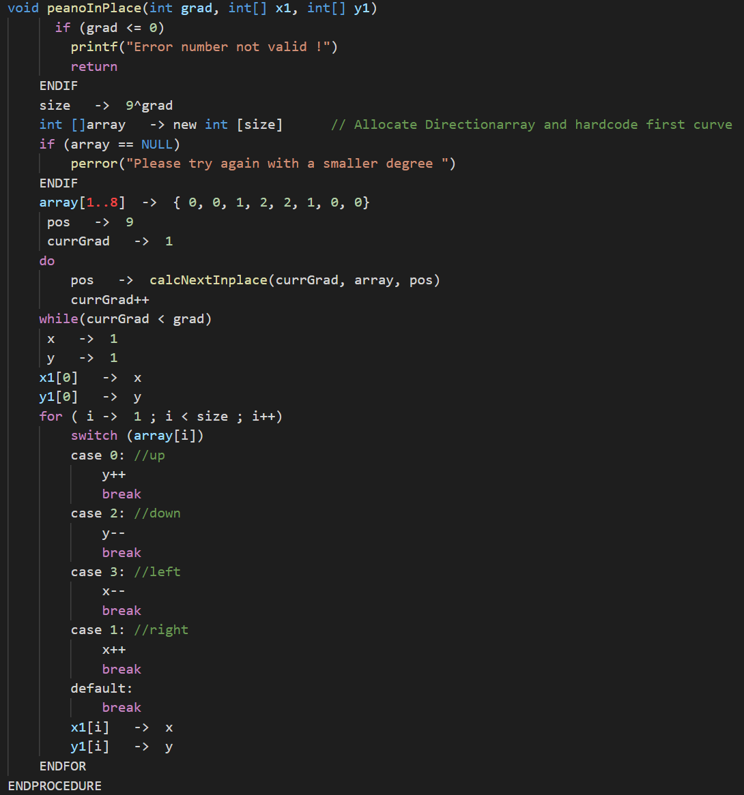
Lösungsansatz
Data centric processing
Data pushed towards operator
Queries compiled into native machine code (LLVM)
Maximize data and code locality

Slide 5
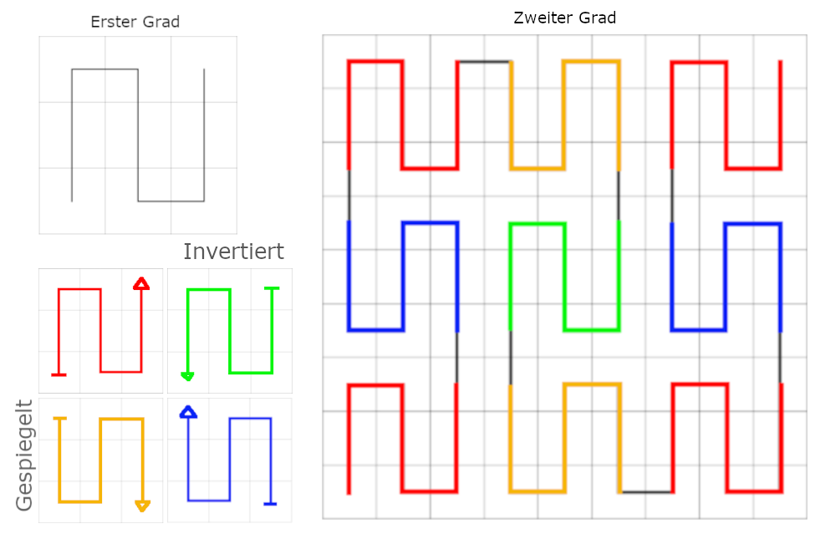
Lösungsansatz: Richtungsarray
Data centric processing
Data pushed towards operator
Queries compiled into native machine code (LLVM)
Maximize data and code locality

Slide 6
Korrektheit:
•

Slide 7
Performanzanalyse:
•

Slide 8
Performanzanalyse:
•

Slide 9
Fazit: Verbesserungsmöglichkeiten
•

Slide 10
Advanced Parallelization Techniques: 1st Type
Inter-tuple parallelism: SIMD registers
SIMD instructions => speed up processing
Delay branching
BUT …
LLVM directly allows for modelling SIMD values as vector types
The impact is relatively minor

Slide 11
Evaluation
We implemented this in our HyPer system
• initially we generated C++ code from code fragments
• then, switched to the data-centric LLVM code: comparison C++ vs. LLVM

Slide 12
Evaluation: C++ <==> LLVM
 | Q1 | Q2 | Q3 | Q4 | Q5
HyPer: C++ [ms] Compile time[ms] | 142 | 374 | 141 | 203 | 1416
 | 1556 | 2367 | 1976 | 2214 | 2592
HyPer: LLVM [ms] Compile time[ms] | 35 | 125 | 80 | 117 | 1105
 | 16 | 41 | 30 | 16 | 34
VectorWise [ms] | 98 | - | 257 | 436 | 1107
MonetDB [ms] | 72 | 218 | 112 | 8168 | 12028
DB X [ms] | 4221 | 6555 | 6410 | 3830 | 15212

Slide 13
Evaluation: C++ <==> LLVM

Slide 14
Evaluation
We implemented this in our HyPer system
• initially we generated C++ code from code fragments
• then, switched to the data-centric LLVM code: comparison C++ vs. LLVM
Compared it with other systems
• MonetDB 1.36.5, Ingres VectorWise 1.0, DB X (commercial DBS)
• 5 TPC-H queries (Q1,2,3,4,5) adapted to TPC-C for OLAP

Slide 15
Evaluation: DB X
 | Q1 | Q2 | Q3 | Q4 | Q5
HyPer: C++ [ms] Compile time[ms] | 142 | 374 | 141 | 203 | 1416
 | 1556 | 2367 | 1976 | 2214 | 2592
HyPer: LLVM [ms] Compile time[ms] | 35 | 125 | 80 | 117 | 1105
 | 16 | 41 | 30 | 16 | 34
VectorWise [ms] | 98 | - | 257 | 436 | 1107
MonetDB [ms] | 72 | 218 | 112 | 8168 | 12028
DB X [ms] | 4221 | 6555 | 6410 | 3830 | 15212

Slide 16
Evaluation: DB X
Warm execution time

Slide 17
Evaluation: MonetDB
 | Q1 | Q2 | Q3 | Q4 | Q5
HyPer: C++ [ms] Compile time[ms] | 142 | 374 | 141 | 203 | 1416
 | 1556 | 2367 | 1976 | 2214 | 2592
HyPer: LLVM [ms] Compile time[ms] | 35 | 125 | 80 | 117 | 1105
 | 16 | 41 | 30 | 16 | 34
VectorWise [ms] | 98 | - | 257 | 436 | 1107
MonetDB [ms] | 72 | 218 | 112 | 8168 | 12028
DB X [ms] | 4221 | 6555 | 6410 | 3830 | 15212

Slide 18
Evaluation: MonetDB
Warm execution time

Slide 19
Evaluation: VectorWise
 | Q1 | Q2 | Q3 | Q4 | Q5
HyPer: C++ [ms] Compile time[ms] | 142 | 374 | 141 | 203 | 1416
 | 1556 | 2367 | 1976 | 2214 | 2592
HyPer: LLVM [ms] Compile time[ms] | 35 | 125 | 80 | 117 | 1105
 | 16 | 41 | 30 | 16 | 34
VectorWise [ms] | 98 | - | 257 | 436 | 1107
MonetDB [ms] | 72 | 218 | 112 | 8168 | 12028
DB X [ms] | 4221 | 6555 | 6410 | 3830 | 15212

Slide 20
Evaluation: VectorWise
Warm execution time

Slide 21
Evaluation
We implemented this in our HyPer system
• initially we generated C++ code from code fragments
• then, switched to the data-centric LLVM code: comparison C++ vs. LLVM
Compared it with other systems
• MonetDB 1.36.5, Ingres VectorWise 1.0, DB X (commercial DBS)
• 5 TPC-H (Q1,2,3,4,5) queries adapted to TPC-C for OLAP
All ﬁve queries (using the Callgrind Tool of Valgrind 3.6.0)
• MonetDB ⬄ LLVM version of HyPer

Slide 22
Evaluation: Branches and Cache Misses
 | Q3 |  | Q4 |  | Q5
 | LLVM | MonetDB | LLVM | MonetDB | LLVM | MonetDB
branches | 14,362,660 | 127,944,656 | 32,243,391 | 408,891,838 | 11,427,746 | 333,536,532
Mispredicts | 696,839 | 1,884,185 | 1,182,202 | 6,577,871 | 639 | 6,726,700
I1 misses | 791 | 386,561 | 508 | 290,894 | 490 | 2,061,837
D1 misses | 2,341,531 | 7,557,629 | 3,480,437 | 20,981,731 | 776,417 | 8,573,962
L2d misses | 1,420,628 | 5,947,845 | 3,424,857 | 17,072,319 | 776,229 | 7,552,794
I refs [mil] | 208 | 944 | 282 | 3,140 | 159 | 2,089
Eﬃciently Compiling Eﬃcient Query Plans for Modern Hardware| 10.06.2020 | Seminar - Modern Database Systems

Slide 23
Conclusion
Data-centric query processing shows excellent performance
Minimize number of memory accesses
Data kept in CPU registers
Increases locality, reduces branching
LLVM is an excellent tool for code generation
Fast on demand code generation
Good code quality
Portable and well maintained
Low compile times

Slide 24
Thank you for your attention !
Mohamed Attia, Patrick Zimmermann, Thomas Torggler

