Slide 1
TripAdvisor Sentiment Search Engine
Group 15 - SCS_3546_039
Megan Da Costa, Cameron Turner, Kashish Verma

Slide 2
TripAdvisor Search Engine Background
Travel search platforms such as TripAdvisor utilise millions of reviews and location based information, generating extensive data.
Users seek to use sentiment while querying through location-based data.
Deep Learning and Natural Language Processing can train a machine on meaning behind user searches and present results more closely related to their wants.
Semantic search engines allows for retrieval of contextual data based on meaning.
Goal Create an engine to search travel data for relevance based on semantic relation.

Slide 3
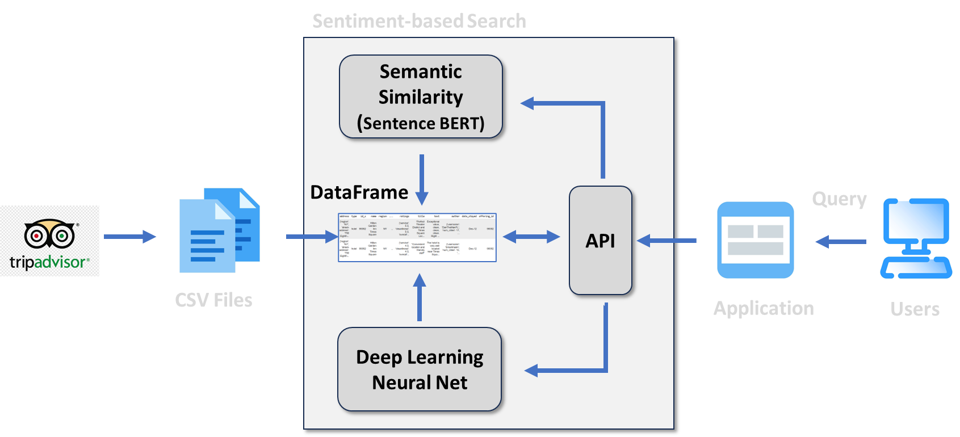
System Structure/Pipeline
Data from Kaggle dataset, consisting of Hotel Reviews based on location
01
Data Collection and Pre-Processing
02
Conversion of Textual Data
03
Deep Learning Predictive Analysis

Slide 4
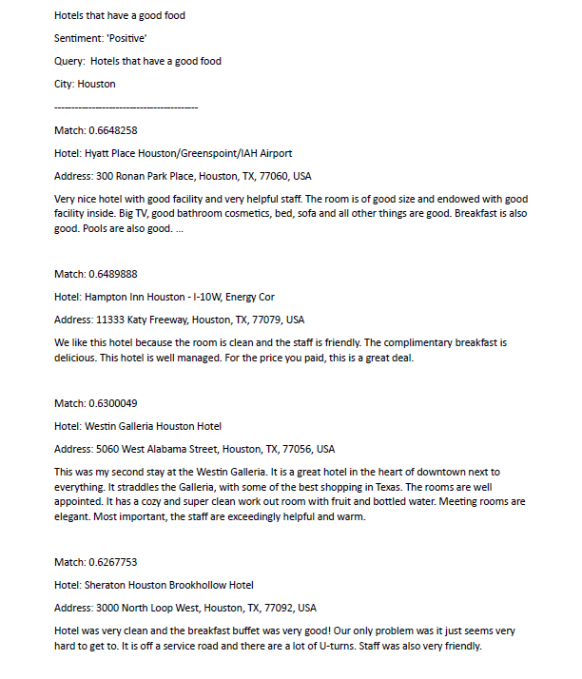
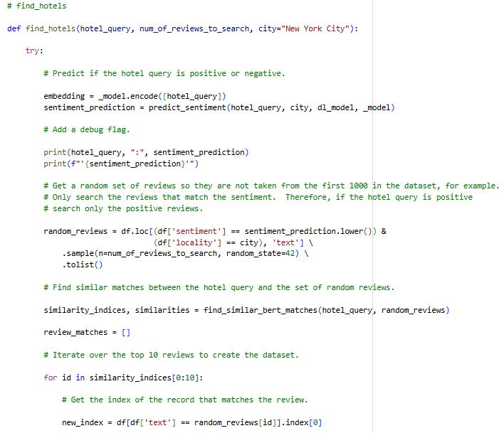
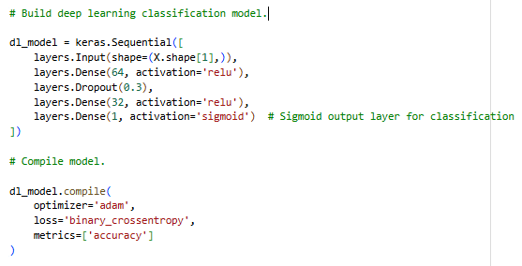
Code Samples and Libraries

Slide 5
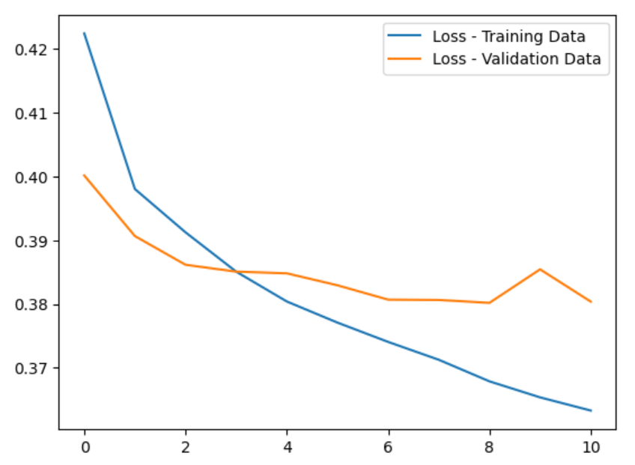
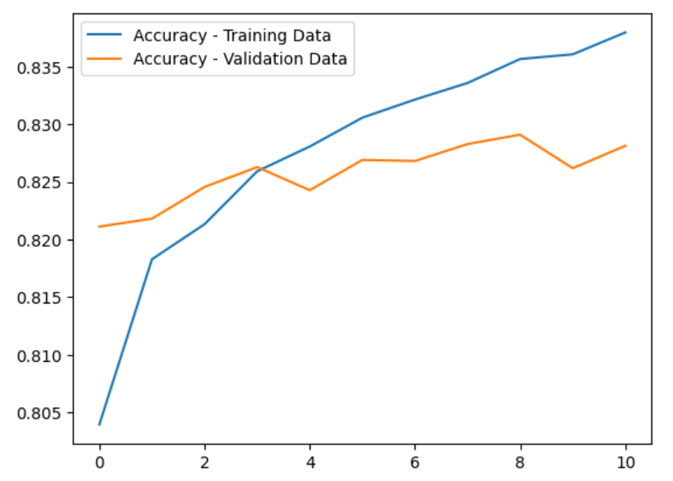
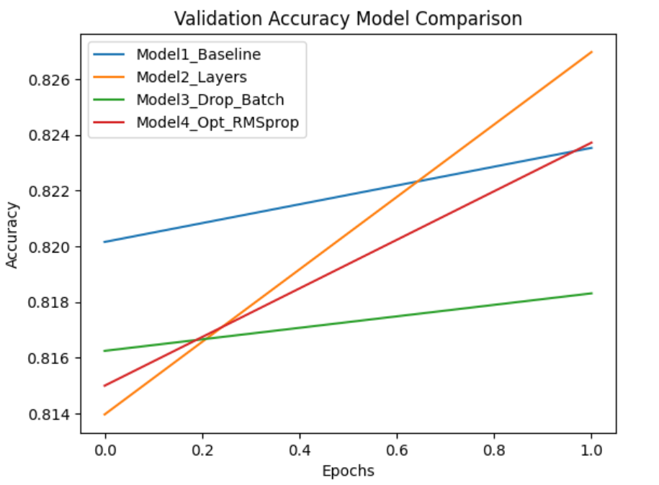
Results and Performance
Sentiment analysis using sentence BERT model correctly yielded the most closely related reviews to an input sentence/word/sentiment

Slide 6
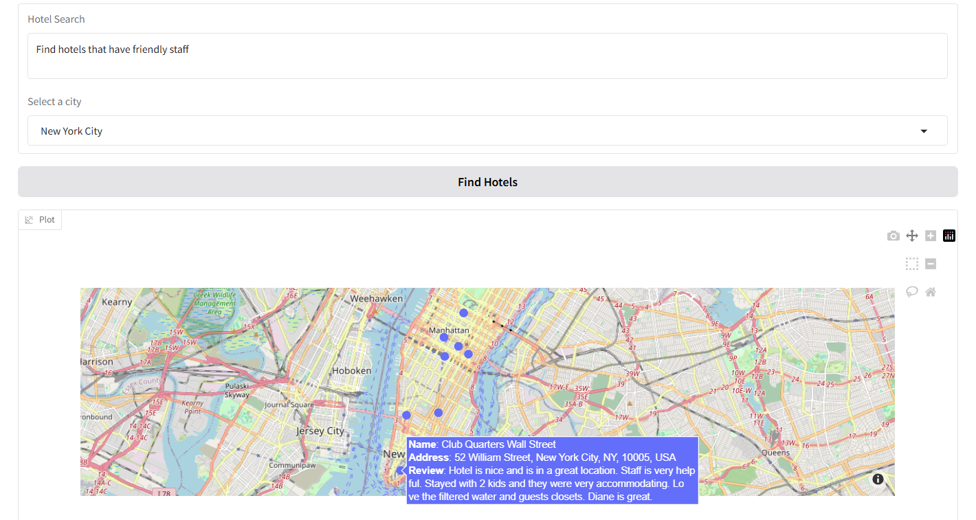
Application Example
Query
City
Mapped Results
Hotel / Review

Slide 7

Conclusion & Further Research
Conclusion
Built a proof-of-concept semantic search system for TripAdvisor hotel reviews.
Combined Sentence-BERT embeddings with a deep learning sentiment classifier.
Returned relevant review matches and useful sentiment-based results.
Achieved baseline test accuracy of about 82.6%
Further Research
Fine-tune the deep learning model to improve accuracy
Improve sentence encoding for subtle or mixed sentiment
Optimize performance for larger datasets and faster search
Save processed embeddings and models for faster reuse
Expand the prototype into a more complete user-facing application

Slide 8
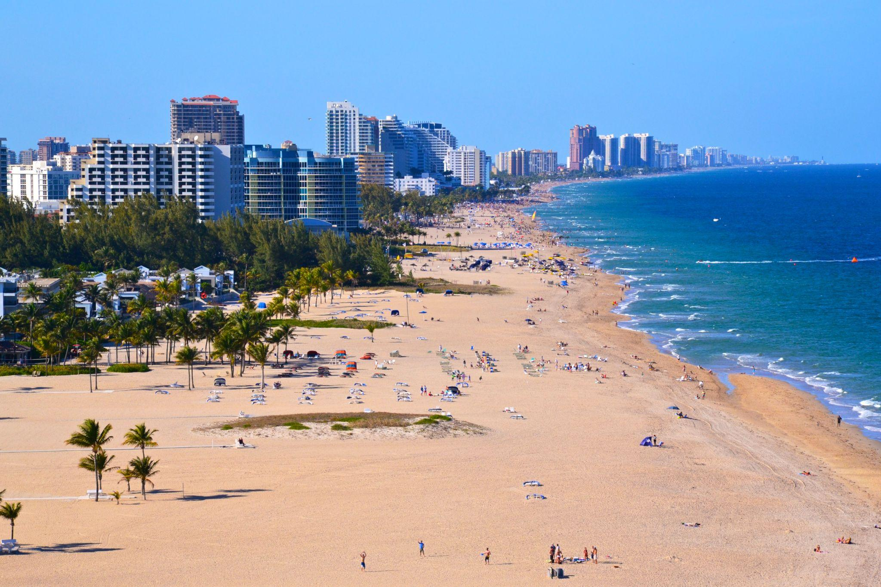
Thank you!

Slide 9
References
https://www.kaggle.com/competitions/traveler-insights-utb
https://www.kaggle.com/datasets/thedevastator/tripadvisor-hotel-reviews
https://huggingface.co/datasets/argilla/tripadvisor-hotel-reviews
https://www.kaggle.com/datasets/jkgatt/restaurant-data-with-100-trip-advisor-reviews-each

