Slide 1

Chatbot for prediction of weight and BMI using Machine Learning
Yash Sharma
Anish Kamble

Slide 2
The Goal:
To build an accurate model that can predict the weight and Body Mass Index using as only height as input
To build a user-friendly and efficient deployment on the web for public release.

Slide 3
Procedure followed:
Collection of data.
Data cleaning and handling missing data.
Exploratory data analysis.
Designing ML models and Neural Networks.
Encapsulating modules, models and data processors.

Slide 4
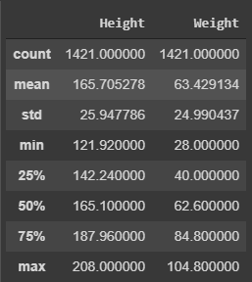
Description of dataset
This data was obtained from Ministry of health and Family Welfare, government of India

Slide 5
Steps taken for cleaning the data:
Replacing missing values (0) with NumPy NaNs.
Filling missing values with respective medians.
Exploring correlation of variables.
Checking correlation and selecting most important features.
Software used: Python 3.8, Pandas, NumPy, MatPlotLib.

Slide 6
Steps for creation of model:
We split the data set into two components . 80% of data values in data set were used for training the data and rest 20% of the values were used in testing the model
We then applied linear regression model to the training dataset. Linear Regression is a machine learning algorithm based on supervised learning. It performs a regression task. Regression models a target prediction value based on independent variables and hence was best suited for our needs.

Slide 7
ML Classifiers:
We used R-squared regression to find out how close are the predicted values to the real values. R squared", is the proportion of the variance in the dependent variable that is predictable from the independent variable. This gave us an accuracy score of 90%.
We also used Mean squared error to figure the percentage of error in out model. In statistics, the mean squared error or mean squared deviation of an estimator measures the average of the squares of the errors that is, the average squared difference between the estimated values and the actual value. It gave the score of 20%.

Slide 8
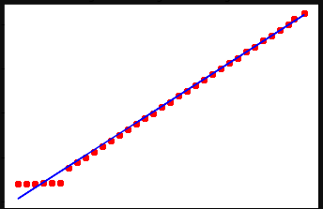
Prediction done using training set
The predicted values are very close to real values.

Slide 9
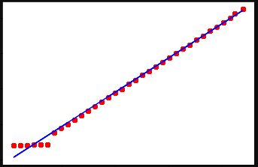
Prediction done using testing set
Predictions using test set verified the model’s accuracy

Slide 10
Creating Chatbot: Libraries used
Natural Language processing toolkit: The Natural Language Toolkit, or more commonly NLTK, is a suite of libraries and programs for symbolic and statistical natural language processing for English written in the Python programming language.
Newspaper: Is a module specifically designed to scrape and organize information from other websites and sources.
Sci-kit learn: Scikit-learn is a free software machine learning library for the Python programming language. It features various classification, regression and clustering algorithms including support vector machines, .

Slide 11
Creating Chatbot : Scrapping website
First import all the necessary modules from the library.
Activate nltk.
Then insert the URL of the page to be scrapped for information.
Download the page and save the data into a variable.
You can print the variable to see the article scrapped
Then convert sentences into array/list format using tokenization.

Slide 12
Creating Chatbot: Creating responses
Define a greeting response.
Sort the data scrapped from the website.
Then using counter vectorizer and similarity scores of the question and data the bot will return the favorable answer.
If similarity scores is zero then return response: “I didn’t understood that”.
Then finally implement the model in the Chatbot and start the chatbot.

Slide 13
List of Software and libraries Used
Python 3.6+
SciKit Learn
Pandas
MatPlotLib
NumPy
Newspaper
Nltk

Slide 14
Conclusions
We have successfully designed, developed and tested a Machine Learning model and a Chatbot that can accurately predict the onset of weight and BMI of a person with high accuracy(90%).
This project is particularly useful for people as it can help in providing early diagnosis and solve the doubts of patients before going to the doctors.
This is also useful for doctors who will be able to test their diagnosis using the model.

