Slide 1
22AIE304 DEEP LEARNING
ATTRIBUTE GUIDED FACE GENERATION
TEAM MEMBERS
AAMITH KISHORE T J - CB.SC.U4AIE24001
NAVEEN U - CB.SC.U4AIE24035
RAGAV S - CB.SC.U4AIE24041
PADMESH SIVALINGAM - CB.SC.U4AIE24044

Slide 2
INTRODUCTION
What is Face Generation?
  Face generation aims to create realistic human faces using deep learning
  GANs learn the underlying distribution of real face images
  Generated faces can be:
    New identities
    Different ages
    Different expressions
    Different hair styles
    With/without accessories
  The goal is not just to generate a face — it is to generate the face we ask for.

Slide 3
PROBLEM STATEMENT
Conventional GANs can generate realistic faces, but the generated characteristics are not directly controllable.
Key challenges
1. Controllability
How can we specify the desired facial attributes?
2. Realism
How can we ensure the generated face looks authentic?
3. Attribute Accuracy
Does the generated face actually contain the requested attributes?
4. Identity Consistency
How can irrelevant facial characteristics remain natural?

Slide 4
OBJECTIVES
01 — Generate realistic faces
Learn the distribution of real human face images.
02 — Enable attribute control
Condition the generation process using attributes such as:
Age | Gender | Smile | Hair | Glasses
03 — Preserve realism
Generated images should resemble real human faces.
04 — Improve attribute consistency
The requested attribute should clearly appear in the generated image.
05 — Evaluate generation quality

Slide 5
LITERATURE REVIEW
1. A Review on the Human Face Generation Approaches — R. Ravinder Reddy et al., ICICT 2024
  Reviews major GAN-based approaches for human face generation.
  Focuses particularly on Conditional GANs (CGANs) for controlled face generation.
  Highlights identity preservation, diversity, expression variation and lighting as important challenges.
2. Conditional Generative Adversarial Nets — Mirza & Osindero (2014)
  Extended GANs by introducing conditional information.
  The condition is provided to both Generator and Discriminator.
  Enables generation according to a desired class or attribute.
  Provides the fundamental idea behind attribute-guided face generation

Slide 6
LITERATURE REVIEW
3. StarGAN: Unified Generative Adversarial Networks for Multi-Domain Image-to-Image Translation — Choi et al. (2017)
  Proposed a single GAN capable of handling multiple facial domains/attributes.
  Demonstrated applications in facial attribute transfer and expression synthesis.
  Shows that multiple attributes can be controlled using a unified model.
4. AttGAN: Facial Attribute Editing by Only Changing What You Want — He et al. (2019)
  Focused specifically on facial attribute manipulation.
  Uses attribute classification, reconstruction, and adversarial learning.
  Designed to change the desired attributes while preserving other facial details.
  Demonstrated results on CelebA and LFW datasets

Slide 7
RESEARCH GAPS
What is still challenging?
1. Precise attribute control
Changing one attribute can unintentionally affect others.
2. Attribute–identity entanglement
Changing age may unintentionally change facial identity/features.
3. Realism vs. controllability
More control may introduce artifacts.
4. Multiple attributes
Simultaneously controlling several attributes increases complexity.
5. Training instability
GAN training can suffer from:
Mode Collapse | Oscillation

Slide 8
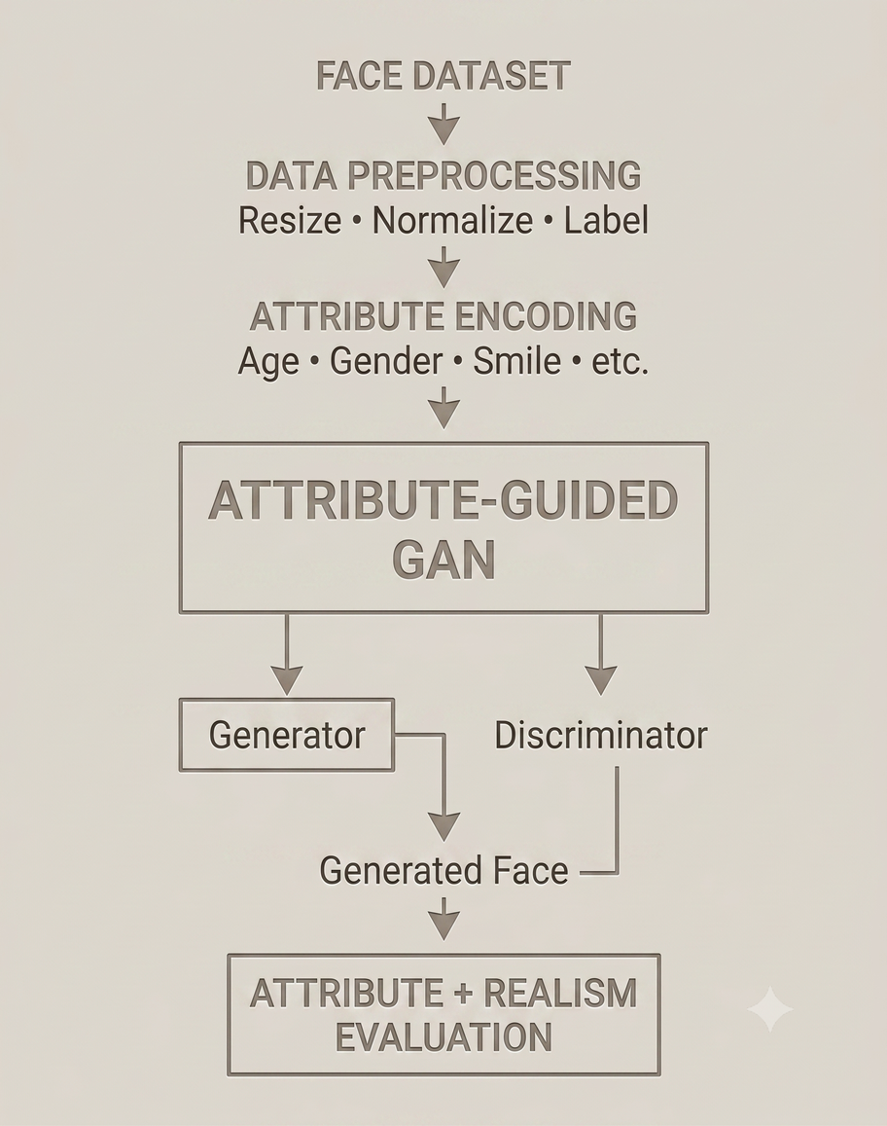
PROPOSED METHODOLOGY
Main components:
Dataset → Preprocessing → Attribute Encoding → Generator → Discriminator → Evaluation

Slide 9
WHAT IS A GAN?
Generative Adversarial Network
A GAN consists of two competing neural networks:
Generator — G
Creates fake images from random noise.
Discriminator — D
Determines whether an image is real or generated.
Adversarial idea
Generator:
“I want to fool the discriminator.”
Discriminator:
“I want to detect fake images.”
Result:
Both networks improve through competition.
The original GAN is formulated as a two-player minimax game between G and D.

Slide 10
HOW A STANDARD GAN WORKS
Training Cycle
Step 1 — Sample real image
Real image x
Step 2 — Generate random noise
z ~ N(0,1)
Step 3 — Generate fake image
Fake image = G(z)
Step 4 — Discriminator evaluates
D(real image) → close to 1
D(fake image) → close to 0
Step 5 — Update networks
Discriminator Learns:
Real → 1
Fake → 0
Generator Learns:
Make D(fake) → 1

Slide 11
GAN LOSS FUNCTION
Standard GAN objective
min_G max_D V(D,G) = Eₓ[log D(x)] + E_z[log(1 − D(G(z)))]
D learns: real → 1; generated → 0.
G learns: generated → 1.
Our implementation adds a 10-attribute classification objective; the exact project losses appear later.
D becomes better at detecting fake
↓
G learns to make better fake images
↓
D becomes better again
↓
G improves again
End goal
Generated distribution ≈ Real face distribution

Slide 12
FROM GAN TO CONDITIONAL GAN
Standard GAN: z → G(z)
Our generator receives noise and attributes:
x_fake = G(z, a)
Our discriminator receives the image only and returns real/fake and attribute logits.
Random Noise
+
[Young, Male, Smile, Glasses]
│
▼
Generator
│
▼
Generated Face
D(x) → (real/fake logit, 10 attribute logits). It is not given the requested attribute vector as an input.

Slide 13
TRAINING DATA AND CONDITIONS
Real batch: (x_real, y_real)
Images and labels come from CelebA.
Noise: z ~ N(0, I₁₀₀)
Fake condition: aᵢ ~ Bernoulli(0.5), i = 1…10
The current training loop samples each target bit independently; it does not use y_real as the fake condition.
x_fake = G(z, a)

Slide 14
DISCRIMINATOR OUTPUTS
Input: an image x only
D(x) = (r, q)
r: one real/fake logit
q ∈ R¹⁰: attribute logits
For real images, q is trained against the CelebA labels y_real.
For generated images, the generator uses q to learn the requested attributes a.

Slide 15
TRAINING LOOP AND SAVING
Each batch updates the discriminator, then the generator. Gradients are backpropagated through their respective losses.
Adam updates both networks. CUDA mixed precision and a batch progress bar are enabled when a CUDA GPU is available.
Sample grids: every 500 batches
Checkpoints: every 5 epochs
The run reached epoch 200; later training did not improve visual variety over the epoch-50 checkpoint.

Slide 16
DATASET AND PREPROCESSING
CelebA images are aligned and cropped to 178 × 178, then resized to 64 × 64.
Tensor normalization:
x_norm = (x − 0.5) / 0.5 = 2x − 1
Label conversion:
y = (y_raw + 1) / 2 ∈ {0,1}
The model uses 10 selected attributes from CelebA’s 40 labels. The current split uses 98% for training and 2% for validation.

Slide 17
NETWORK ARCHITECTURE
Condition and noise:
z ∈ R¹⁰⁰, a ∈ {0,1}¹⁰; concatenate to 110 inputs.
Generator spatial sizes:
4 × 4 × 512 → 8 × 8 × 256 → 16 × 16 × 128 → 32 × 32 × 64 → 64 × 64 × 3
The discriminator downsamples 64 × 64 to 4 × 4 features, then predicts 1 authenticity logit and 10 attribute logits. Generator output uses Tanh.

Slide 18
PROJECT TRAINING LOSSES
BCEWithLogits(s,t) = −[t log σ(s) + (1−t) log(1−σ(s))]
Let r_real and r_fake be authenticity logits; q_real and q_fake are 10 attribute logits.
L_D = BCE(r_real, 0.9) + BCE(r_fake, 0) + λ·BCE(q_real, y_real)
L_G = BCE(r_fake, 1) + λ·BCE(q_fake, a)
λ = 1.0. The 0.9 real target is one-sided label smoothing.

Slide 19
TRAINING CONFIGURATION
Batch size: 128 Epochs completed: 200
Adam: learning rate η = 2 × 10⁻⁴; β₁ = 0.5, β₂ = 0.999
Parameter update (conceptually): θ ← θ − η∇θL
CUDA automatic mixed precision is enabled when available. Checkpoints are saved every 5 epochs.
For this run, epoch 50 had better visual variety than epoch 200; the latest checkpoint was not automatically the best one.

Slide 20
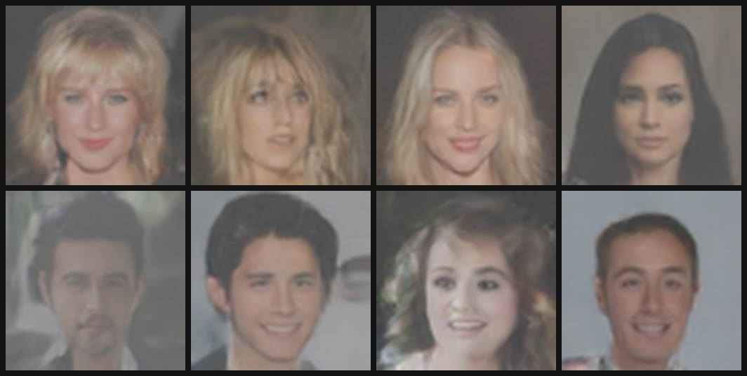
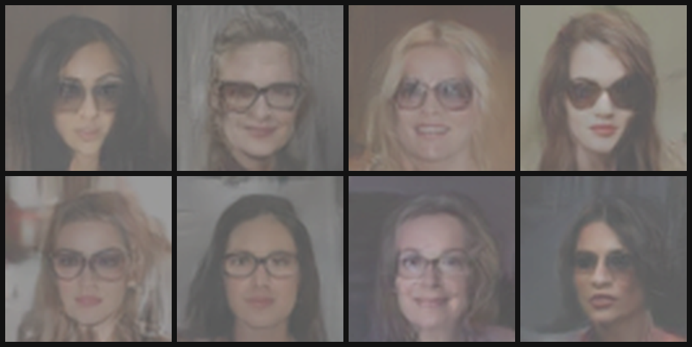
GENERATED RESULTS
Natural CelebA attribute combinations
Requested: Female + Eyeglasses
Checkpoint: epoch 50 · 64 candidates per requested output · 64×64 model images enlarged 4× for display. The samples show the requested traits, but remain soft and low-resolution. Attribute scores come from the project’s own discriminator; no independent metric such as FID was run.
Notes:
Generated from E:/Me/Sem-5/Dl/Face_Gen/Attribute-based-face-generator-main/checkpoints/ckpt_epoch050.pt. The natural grid uses --attrs "" and one latent candidate per sample. The conditioned grid uses --attrs "Female,Eyeglasses" and selects the highest discriminator attribute score from 64 candidates. Output display applies contrast enhancement and 4x Lanczos enlargement; the model itself remains 64x64.

Slide 21
CONCLUSION & FUTURE SCOPE
Implemented: attribute-guided 64×64 face generation with a discriminator that predicts 10 attributes.
  Observed: epoch 50 gave more visual variety than epoch 200; faces remain soft.
  Limitation: training target combinations are sampled independently, and generated-attribute evaluation uses the project’s own discriminator.
  Next: sample real CelebA label combinations, improve fidelity, and evaluate with independent metrics.
  Future: higher resolution, more attributes, identity preservation, pose and style control.

Slide 22
THANK YOU

