Slide 1

IMPROVEMENT OF STABILITY IN INTELLIGENT CONTROLLED MICROGRID USING DROOP

Slide 2
What is a Microgrid?
A microgrid is a local grid that combines renewable energy sources, energy storage devices, and load management. It may operate independently (islanded mode) or in synchronism with the grid to enhance reliability and efficiency.

Slide 3

What is it for?
Regulates Power Flow:
Identifies active, reactive, and apparent power. Optimizes Solar Energy:
Uses MPPT (Maximum Power Point Tracking) to extract maximum power. Ensures Stability:
Adjusts voltage reference dynamically for smooth operation.

Slide 4
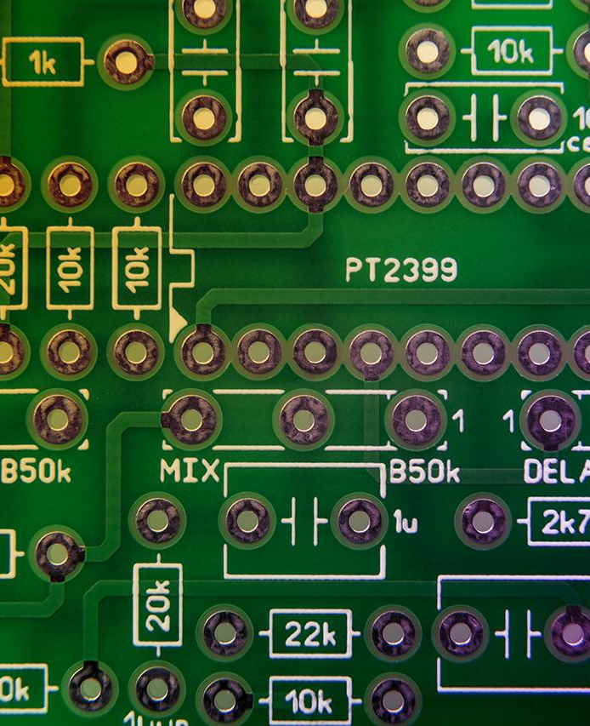
DROOP
Droop control is a decentralized control technique used in microgrids to distribute power among multiple energy sources without real-time communication. It is primarily used for voltage and frequency control in islanded microgrids.

Slide 5

What is this for?
Avoids Overloading:
Scales up power transfer smoothly from solar PV, batteries, and loads.
Enhances Stability:
Provides voltage and frequency stability for the microgrid.
Works Without Communication:
Unlike centralized control, droop will operate automatically under local power conditions.

Slide 6

METHODOLOGY
1. System Modelling in Simulink
Created a microgrid simulation with: →Solar PV system →DC-DC converter →Load measurement →Active & Reactive Power calculation Utilized MPPT (Maximum Power Point Tracking) with Perturb & Observe (P&O) algorithm.

Slide 7
2. Intelligent Control Implementation
→Designed a Voltage Reference Generator (RefGen(V, I)) in MATLAB.
→Applied Droop Control to regulate power flow between energy sources.
→Used power flow equations to calculate:
→Active Power (P)
→Reactive Power (Q)
→Apparent Power (S)

Slide 8
3.Simulation and Performance Analysis
→Frequency Stability Analysis:
Target Frequency: 60 Hz (Nominal)
Observed Frequency: 60 Hz (Minor Fluctuations)
→Voltage Regulation Performance:
Expected Voltage Regulation: 230V
Observed Voltage: 230V (Stable after control adjustment)

Slide 9
Understanding the blocks used in our Simulink model.
PV SOLAR ARRAY
Inputs:
Irradiance – Power of solar radiation per unit area (W/m²)
Temperature – Cell temperature of the PV Array(°C)
Outputs:
Current (I_PV) - Output current of the PV panel.
Voltage (V_PV) – Output voltage of the PV panel.

Slide 10
Power Conversion Section
Blocks used:
IGBT
Diode
Series RLC Components(Inductor, Capacitor and resistor)
PWM Control Signals
Current and Voltage measurement blocks.

Slide 11
How does the Power Conversion system blocks work?
IGBT – It acts as a high-speed switch control to control the current through the circuit. Turns ON and OFF based on the PWM (Pulse Width Modulation) control signals to regulate the output voltage.
Diode - In a boost converter, the diode prevents the output capacitor from discharging back into the input when the IGBT is OFF
Inductor and capacitor smoothen voltage and current ripples.
The PWM signal controls the ON and OFF times of the IGBT.

Slide 12
MPPT CONTROL LOGIC(Perturb and Observe)
Blocks used are:
V_PV and I_PV from PV Solar array.
Unit delay blocks- The block holds and delays the input by one sample period.
MATLAB Function- It contains the algorithm for MPPT
PID Controller - It continuously adjusts a system's input to minimize the error between a desired setpoint and the actual system output.
Relational Operator - In MPPT systems, relational operators are used to make decisions based on comparisons between measured values.
Repeating sequence -A Repeating Sequence is a signal that repeats itself after a fixed interval of time.

Slide 13
Active and Reactive Power System Blocks
Rms block – To calculate Vrms and Irms from the load measurement of voltage and current.
Product block – To multiply the Vrms and Irms.
Trigonometric functions - To calculate the cos theta and sin theta.

Slide 14
Droop control System Block
Constant block – We define Nominal frequency ,Nominal Voltage, Pref and Qref.
Subtract block – To subtract Active power – Pref and Reactive power – Qref.
Gain block – For droop coefficient kp and kq respectively.
Add block – To calculate the Frequency droop and Voltage droop control.

Slide 15
Implementation
We Will Move To The Implementation in Simulink

