Slide 1

IMPROVEMENT OF STABILITY IN INTELLIGENT CONTROLLED MICROGRID USING DROOP

Slide 2
What is a Microgrid?
A microgrid is a local grid that combines renewable energy sources, energy storage devices, and load management. It may operate independently (islanded mode) or in synchronism with the grid to enhance reliability and efficiency.

Slide 3

What is it for?
Regulates Power Flow:
Identifies active, reactive, and apparent power. Optimizes Solar Energy:
Uses MPPT (Maximum Power Point Tracking) to extract maximum power. Ensures Stability:
Adjusts voltage reference dynamically for smooth operation.

Slide 4
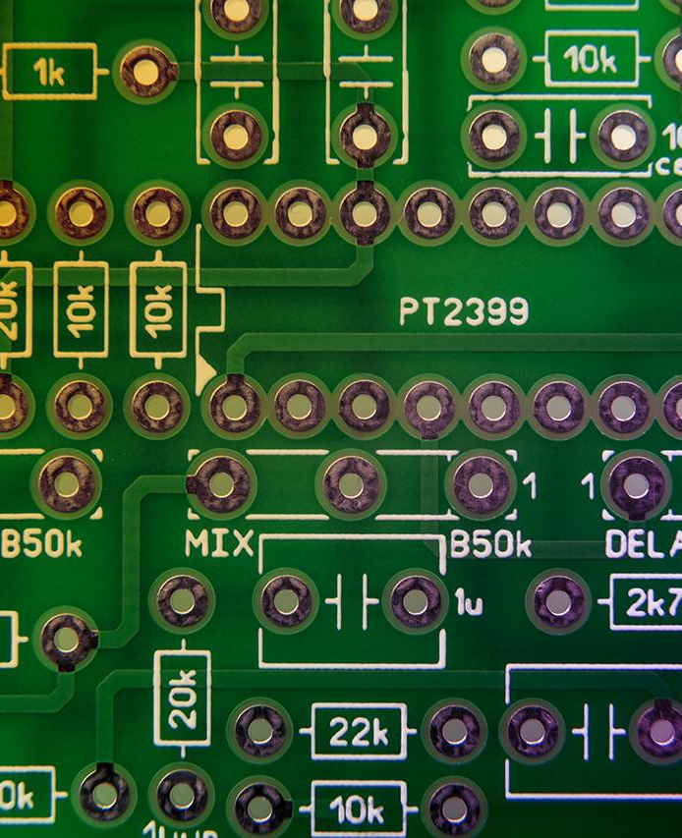
DROOP
Droop control is a decentralized control technique used in microgrids to distribute power among multiple energy sources without real-time communication. It is primarily used for voltage and frequency control in islanded microgrids.

Slide 5

What is this for?
Avoids Overloading:
Scales up power transfer smoothly from solar PV, batteries, and loads.
Enhances Stability:
Provides voltage and frequency stability for the microgrid.
Works Without Communication:
Unlike centralized control, droop will operate automatically under local power conditions.

Slide 6

METHODOLOGY
1. System Modelling in Simulink
Created a microgrid simulation with: →Solar PV system →DC-DC converter →Load measurement →Active & Reactive Power calculation Utilized MPPT (Maximum Power Point Tracking) with Perturb & Observe (P&O) algorithm.

Slide 7
2. Intelligent Control Implementation
→Designed a Voltage Reference Generator (RefGen(V, I)) in MATLAB.
→Applied Droop Control to regulate power flow between energy sources.
→Used power flow equations to calculate:
→Active Power (P)
→Reactive Power (Q)
→Apparent Power (S)

Slide 8
3.Simulation and Performance Analysis
→Frequency Stability Analysis:
Target Frequency: 60 Hz (Nominal)
Observed Frequency: 60 Hz (Minor Fluctuations)
→Voltage Regulation Performance:
Expected Voltage Regulation: 230V
Observed Voltage: 230V (Stable after control adjustment)

Slide 9
Implementation
We Will Move To The Implementation in Simulink

Slide 10
CONCLUSION
The project has been successful in applying smart control techniques for microgrid power management with regulated voltage at 230V and frequency stability at 60Hz. The use of Maximum Power Point Tracking (MPPT) using the Perturb and Observe method with droop control facilitated effective energy harvesting and fair load distribution. Initial simulations through MATLAB indicated support for the system's ability to dynamically adjust voltage references and maximize power flow. While the system performs as anticipated, enhancements and experimental validation are required to enhance efficiency, flexibility, and scalability.

