Slide 1
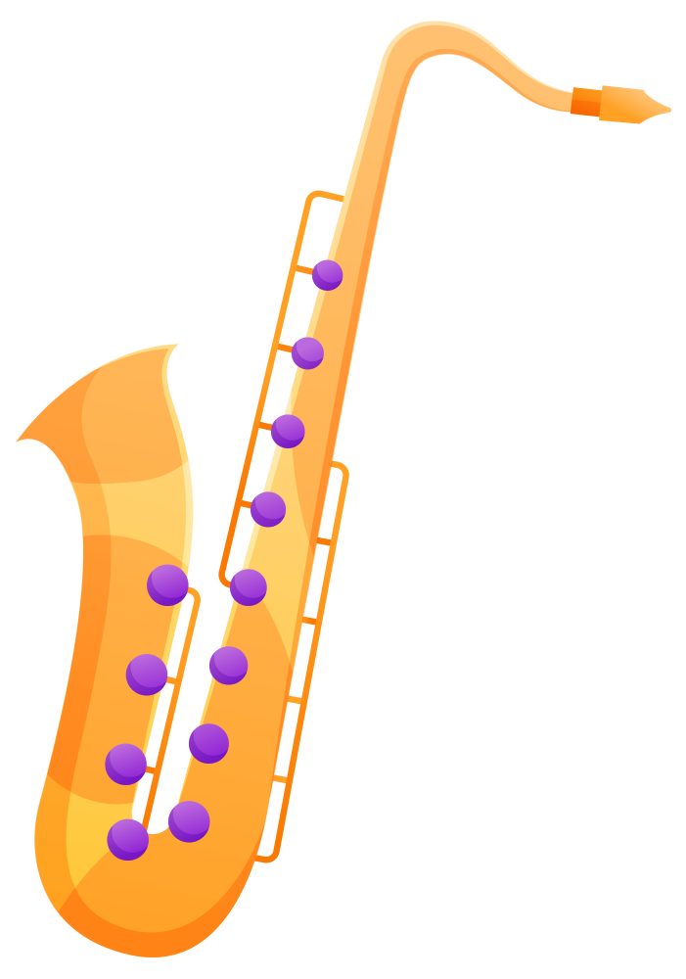
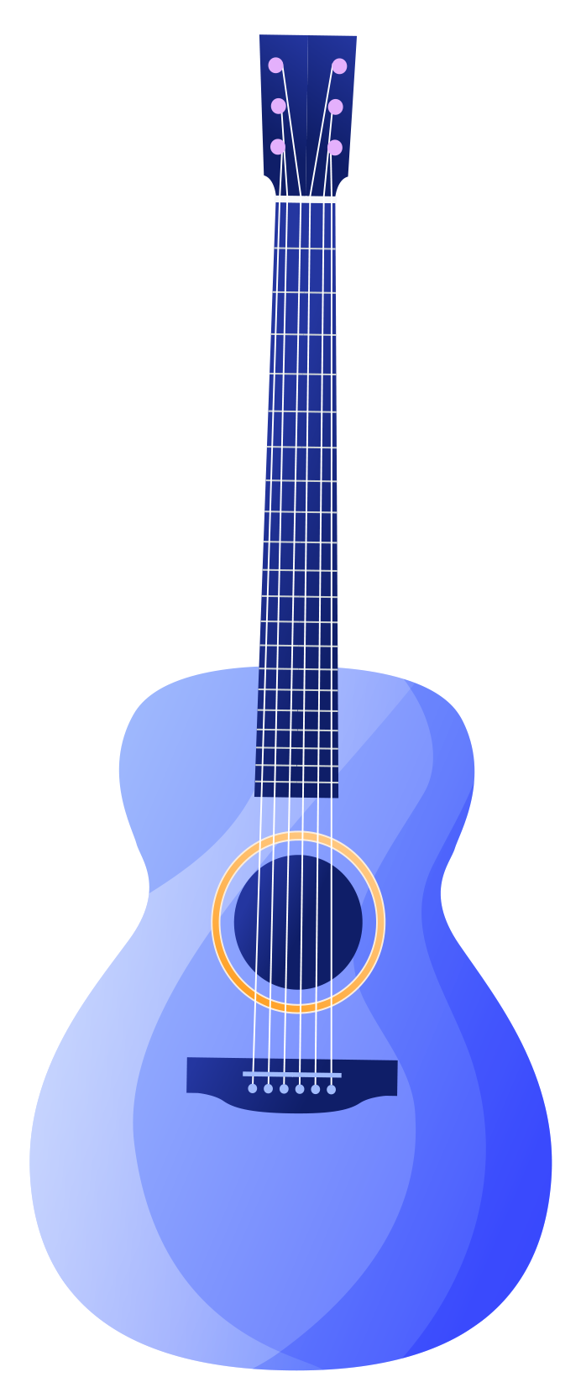
MUSIC INSTRUMENT RECOGNITION

Slide 2
TEAM MEMBERS
AAMITH KISHORE T J --- CB.SC.U4AIE24001
RAGAV S --- CB.SC.U4AIE24041
S PADMESH --- CB.SC.U4AIE24044
SRI KRISHNA P --- CB.SC.U4AIE24054
B.YASWANTH REDDY --- CB.SC.U4AIE24061

Slide 3
TABLE OF CONTENTS
1.INTRODUCTION
2.LITERATURE REVIEW
3.RESEARCH GAP
4.OBJECTIVES
5. FOURIER TRANSFORM
6.MEL SPECTROGRAM
7.DATA AUGMENTATION
8.MAX POOLING
9.METHODOLOGY
10.DATASET DESCRIPTION

Slide 4
INTRODUCTION
In this project, we are developing a musical instrument recognition system using Convolutional Neural Networks (CNNs) to accurately classify and identify musical instruments.
By leveraging CNNs' ability to automatically extract and learn features, the system analyzes spectrograms or images of instruments to achieve high accuracy.

Slide 5
LITERATURE REVIEW
S.no | Research Paper | Methodology | Contribution
1 | Audio Signal Processing and Musical Instrument Detection using Deep Learning Techniques(2021) | Using Convolutional Neural Networks (CNNs) With Short-Time Fourier Transform (STFT) | Short-Time Fourier Transform (STFT)
2 | Music and Instrument Classification using Deep Learning(2019) | Using Convolutional Neural Networks (CNNs) With Mel-Spectrograms | Mel-Spectrograms
3 | Music Instrument Recognition using Deep Convolutional Neural Networks(2019) | Using 8-Layer Deep Convolutional Neural Network For Predominant Instrument Recognition In Polyphonic Music | Max Pooling

Slide 6
RESEARCH GAP
Challenges with Real-World Audio Data – Models trained on studio-recorded sounds struggle with noisy environments, requiring better noise in feature extraction and classification​
MFCCs May Not Be Optimal for Instrument Classification – MFCCs compress spectral data and may not capture fine-grained timbral features.
Lack of Data Augmentation Techniques – Many models are trained without augmentation, making them sensitive to variations in recording conditions​.
Pooling Strategies in CNNs Need Further Optimization – Max pooling is commonly used, but alternative pooling methods (e.g., global average pooling, adaptive pooling) *may* improve performance​

Slide 7
OBJECTIVES
We want to develop a system that can reliably identify and classify musical instruments based on the sounds they produce.
Focus on capturing the unique features of each instrument, like the patterns in their sound waves or visual details, to make recognition more accurate.
Use a diverse range of musical data to train the system, ensuring it performs well across different genres and instrument types.
Use Of Short Time Fourier Transformation, Mel-Spectrograms , Max Pooling And Data Augmentation.

Slide 8
WHAT IS FOURIER TRANSFORM
The Fourier Transform is a mathematical tool that decomposes a function or signal into its constituent frequencies.
Basically it converts a signal from the time domain into the frequency domain.
WHY USE OF SHORT TIME FOURIER TRANSFORM INSTEAD OF FOURIER TRANSFORM?
The Short-Time Fourier Transform (STFT) does the same thing as the normal Fourier Transform, but it also keeps track of when each frequency occurs.
Key Difference:
The Fourier Transform gives you the overall frequency content but loses time information.
The STFT shows how frequencies change over time by analyzing short segments of the signal.

Slide 9
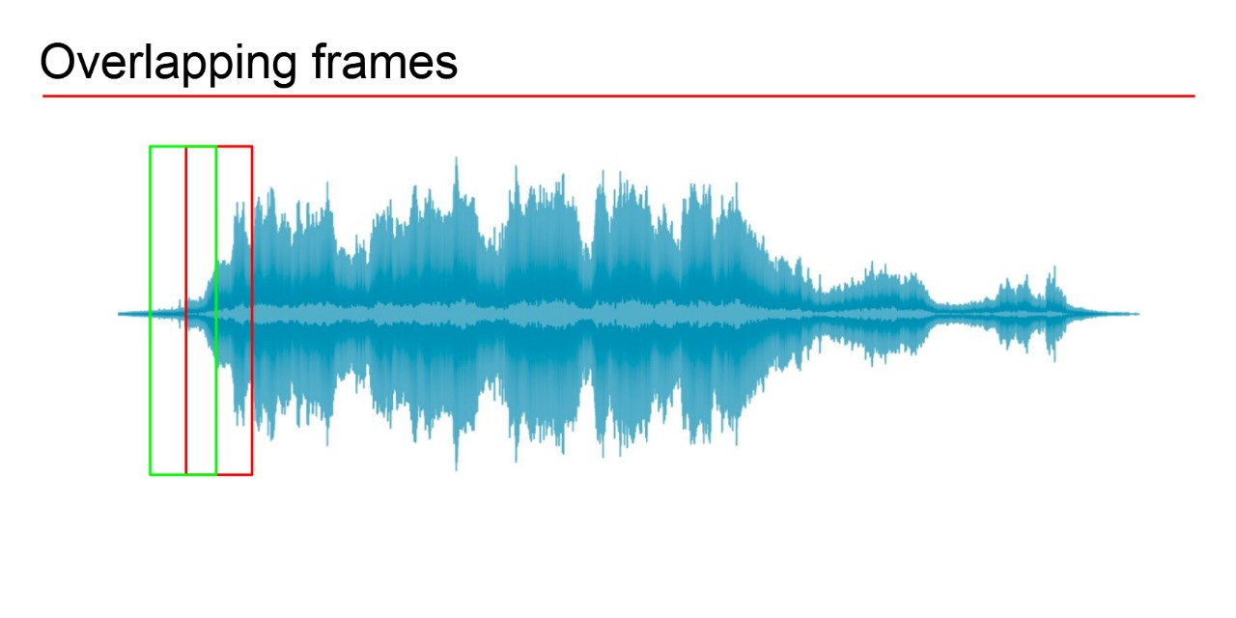
HOW DOES SHORT TIME FOURIER TRANSFORM WORK ?
It gets the input audio signal
Splits the audio signal into time small overlapping time windows.
It apply Fourier transform for each window separately.
Combines the result into a time frequency called as spectrogram.

Slide 10
MEL SPECTROGRAM
A Mel spectrogram is a time-frequency representation of an audio signal, where frequencies are mapped to the Mel scale, which closely resembles human auditory perception.
WHY USE MEL-SPECTROGRAMS OVER MFCCs?
Unlike MFCCs, which reduce spectral data, Mel spectrograms preserve important frequency information, helping distinguish between similar instruments.
Key Difference:
Mel Spectrograms preserve rich spectral and temporal details, making them ideal for musical instrument classification.
Mel Spectrograms work directly with CNNs as image-like inputs, improving deep feature extraction.

Slide 11
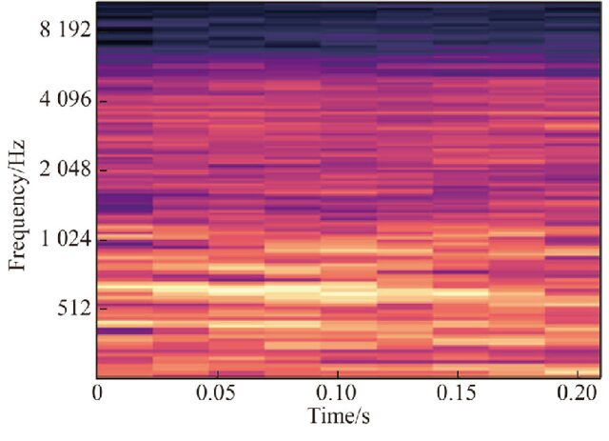
HOW DOES AN MEL-SPECTROGRAM WORK?
Convert Audio to Frequency Domain (STFT)
Apply Mel Filter Banks
Convert to Log Scale
Generate Spectrogram Image

Slide 12
DATA AUGMENTATION
Data augmentation is a technique used to artificially expand a dataset by applying transformations to existing data.
WHY DATA AUGMENTATION?
Prevents overfitting by introducing variability
Helps CNN models become more robust to real-world conditions.
Improves classification accuracy with limited training data.

Slide 13
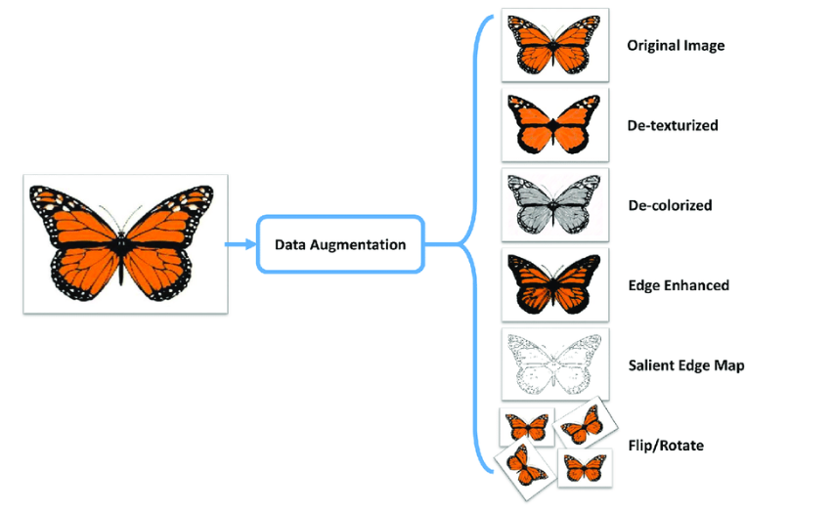
HOW DOES DATA AUGMENTATION WORK?
Apply Transformations to Original Audio
Common Augmentation Techniques
Improve Model Generalization
Used Before Training

Slide 14
MAX POOLING
Max Pooling is a down sampling technique used in CNNs to reduce feature map size while preserving important information. It helps improve computational efficiency and prevents overfitting.
WHY MAX POOLING?
Reduces computational cost by decreasing the number of parameters.
Retains dominant features while discarding minor variations.

Slide 15
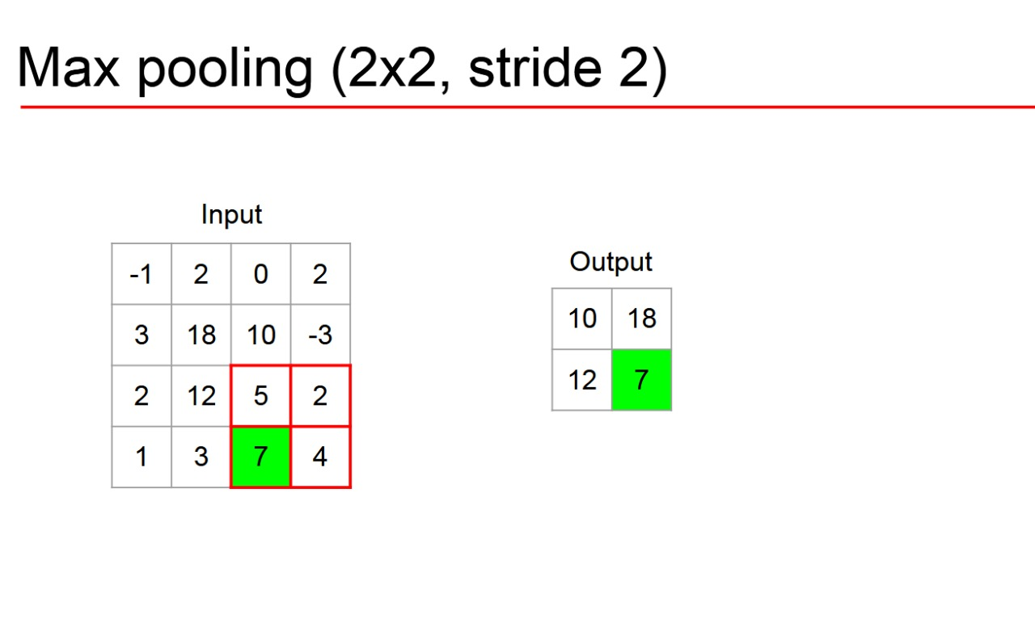
HOW DOES MAX POOLING WORK
A fixed-size filter (e.g., 2×2) moves over the feature map.
The maximum value within the filter region is selected.
The output is a smaller feature map with the most prominent features retained.

Slide 16
METHODOLOGY
Dataset Collection - Collection of audio recordings of various musical instruments. This ensures diversity in terms of style, recording condition and instrument types.
Preprocessing - Standardize the sampling rate of all audio files to a common rate (e.g., 44.1 kHz) to maintain consistency. And normalize the audio amplitude to ensure uniformity across the dataset.
Feature Extraction:
Short-Time Fourier Transform(SFFT): Converts time-domain audio signals into time-frequency representations, capturing both spectral and temporal information.
Mel Spectrogram - Maps the frequency axis of the spectrogram to the Mel scale, which aligns more closely with human auditory perception.
Data Augmentation – Data Augmentation for music instrument recognition involves creating modified versions of existing audio data to increase the diversity of the dataset, improving the robustness and generalization of the recognition model.
Deep Learning model - Use a Convolutional Neural Network (CNN) to classify the spectrographic data. CNNs are effective for image-based data, including spectrograms.
Incorporation of Pooling Strategies

Slide 17
Evaluation Layer
Confusion Matrix - Generate a confusion matrix to analyze class-specific performance and identify misclassifications.
Feedback Loop - Use the evaluation results to adjust the preprocessing steps or neural network parameters.
Output – The final prediction output, with validated efficiency and performance metrics.

Slide 18
DATASET DESCRIPTION
IRMAS is Intended for algorithm training and testing for automatic identification of prominent musical instruments in audio recordings. Musical instruments used in this study are the cello, clarinet, flute, acoustic guitar, electric guitar, organ, piano, saxophone, trumpet, violin, and vocals. This dataset is derived from the collection accumulated by Ferdinand Fuhrmann in his Ph.D. thesis, with significant variations being the availability of audio data in stereo form, restriction in the test dataset annotations to specific pitched instruments, and diversity in the number and length of audio excerpts.
DATASET LINK
IRMAS_ a dataset for instrument recognition in musical audio signals.html

Slide 19
THANK
YOU!

