Slide 1
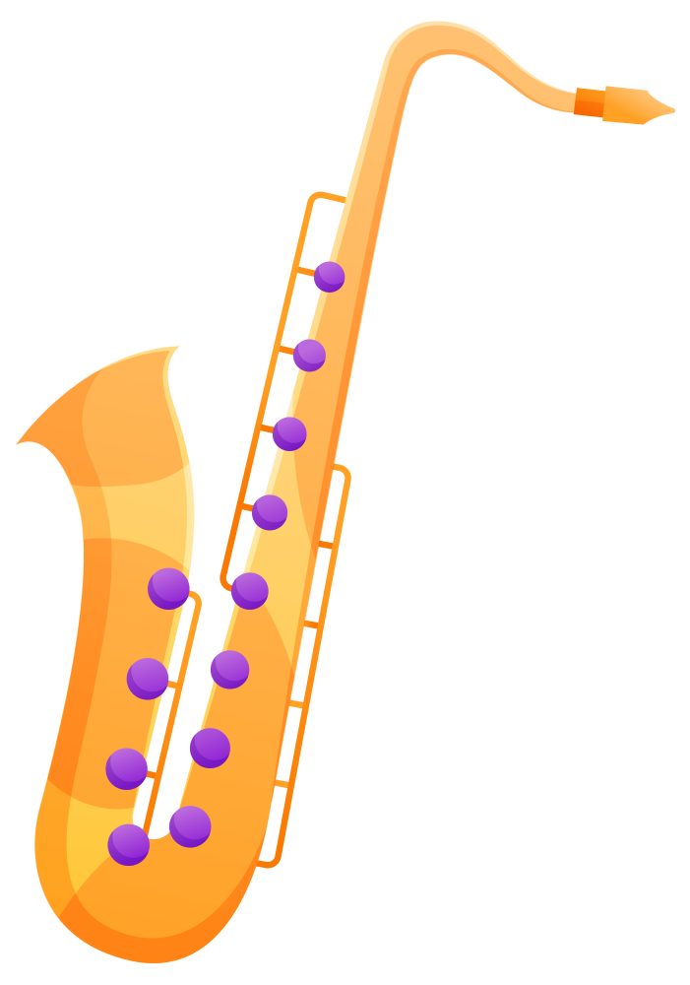
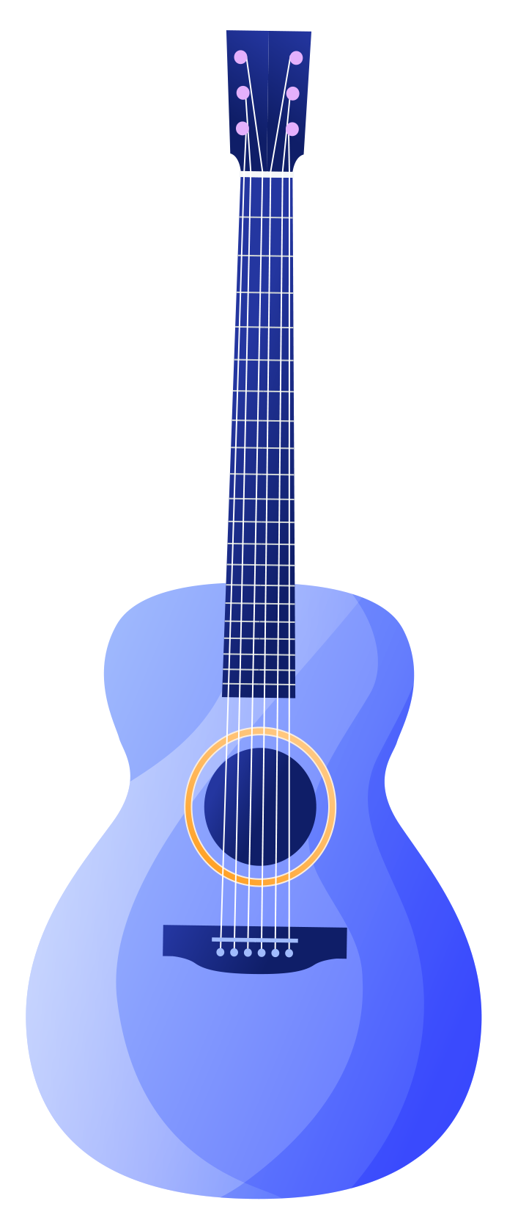
MUSIC INSTRUMENT CLASSIFICATION

Slide 2
TEAM MEMBERS
AAMITH KISHORE T J --- CB.SC.U4AIE24001
RAGAV S --- CB.SC.U4AIE24041
S PADMESH --- CB.SC.U4AIE24044
SRI KRISHNA P --- CB.SC.U4AIE24054
B.YASWANTH REDDY --- CB.SC.U4AIE24061

Slide 3
OBJECTIVES
Build a deep learning-based system to classify different musical instruments using the IRMAS Datasets.
Convert audio signals into Mel spectrogram representations for feature extraction, improving classification accuracy.
Normalize and standardize audio data to ensure uniform input size for CNN training.
Design a CNN architecture with convolutional, pooling, batch normalization, and dense layers for high classification accuracy.
Apply L2 regularization, dropout layers, learning rate adjustments, and early stopping to prevent overfitting.

Slide 4
METHODOLOGY
Dataset Collection - Collection of audio recordings of various musical instruments. This ensures diversity in terms of style, recording condition and instrument types.
Preprocessing - Extract .wav files , Convert each waveform into a Mel spectrogram , Convert raw spectrogram values to decibel scale , Apply min-max normalization to rescale values between 0 and 1 , Ensuring a fixed input shape of 128*128 pixels.
Feature Extraction - Extract Mel spectrograms (time-frequency representations of audio signals) , Apply log scaling , Convert spectrograms into 2D matrices and reshape them into a (128, 128, 1) format.

Slide 5
Model Architecture (CNN) –
Input Shape: (128,128,1).
Architecture Design: Three Conv2D layers with ReLU activation , Kernal size of (3,3).
Batch Normalization & Max Pooling: Batch Normalization Normalizes activations for stable
training , MaxPooling2D Down samples feature maps to reduce computational complexity.
Global Average Pooling: Replaces Flattening to reduce overfitting.
Fully Connected (Dense) Layers: Dense layer with 256 neurons using ReLu , Dropout (50%) to
prevent overfitting.
Output Layer: Soft max activation for multi-class classification.

Slide 6
Model Compilation & Training:
Optimizer: Adam (learning rate = 0.0005) for efficient weight updates.
Callbacks for Optimization: ReduceLROnPlateau (reduce learning rate when loss plateaus) ,
EarlyStopping (stops training if validation loss doesn’t improve).

Slide 7
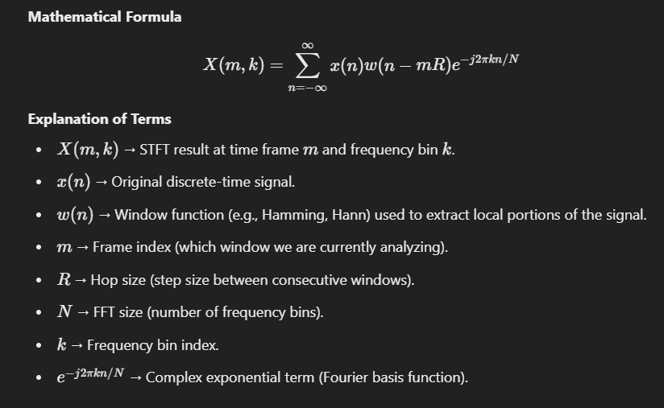
Short-Time Fourier Transform (STFT)
The Short-Time Fourier Transform (STFT) is used to convert an audio signal from the time domain to the spectral domain. The overall idea of STFT is to split the audio into small, overlapping pieces—usually called windows—translate each piece into its respective frequency representation and then sum these representations to form a spectrogram.

Slide 8
. Mel Spectrogram
After the STFT is calculated, a Mel spectrogram is created. The Mel scale is a perceptual scale of pitches which mimics how humans perceive sound. It assigns more resolution to lower frequencies (which are more perceptible to human ears) and fewer to higher frequencies.
The Mel spectrogram is computed by applying a filter bank (which approximates the Mel scale) to the STFT result.
The output is a 2D matrix where:
Rows represent different frequency bins.
Columns represent time frames.

Slide 9
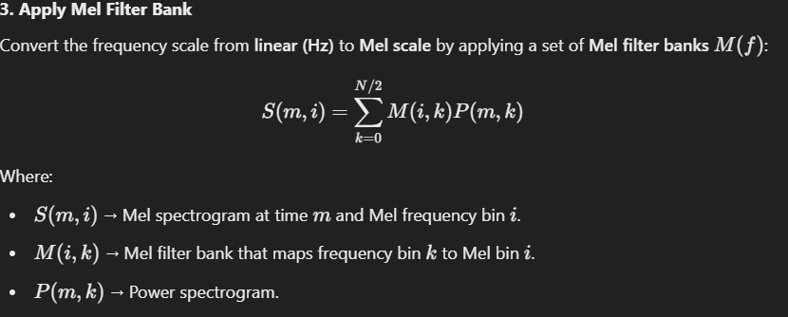
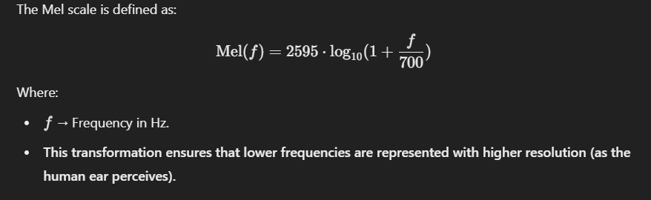
The Mel spectrogram values are converted into decibels (dB) using a logarithmic scale. This makes the data more suitable for machine learning models, as the human ear perceives sound intensity on a logarithmic scale.
The spectrogram is either padded or truncated to ensure that all spectrograms have a uniform size. This is important because neural networks expect input data to have consistent dimensions.
The spectrogram is padded with zeros where needed (if it's smaller than the target size), or it’s truncated (if it's larger).
The values of the spectrogram are normalized to fall within a range [0, 1]. This helps the neural network process the data more effectively, as it avoids large variations in values.

Slide 10
POOLING
Max Pooling:
What it is:
It shrinks the size of the data by picking the biggest value in small 2x2 boxes. Where it’s used:
After each convolutional layer (3 times in your model).
Why it’s used:
Makes the data smaller, so the model runs faster and uses less memory.Keeps only the most important patterns (like strong sounds in the audio).Helps the model work even if patterns shift a little in the audio
How it works:
If you have a 128x128 image, it turns it into 63x63, then 31x31, then 15x15.

Slide 11
Global Average Pooling (GlobalAveragePooling2D):
What it is:
It takes the average of everything in each feature map to make one number per map.
Where it’s used:
Near the end, before the dense layers.
Why it’s used:
Turns big data (15x15x256) into a small list (256 numbers).Makes the model simpler and less likely to overfit.
Why Max Pooling is Great :
Our audio data (Mel spectrograms) has time and frequency info. Max Pooling keeps the loudest, most important sounds (like a guitar pluck or violin hum).

Slide 12
RESULTS AND ANALYSIS
Training and Validation Performance:
Training Progress:
The model was trained for 60 epochs, with a learning rate starting at 0.0005 and gradually reduced using ReduceLROnPlateau based on validation loss.
Accuracy steadily increased from 0.21 at epoch 1 to 0.91 at epoch 60, demonstrating improvement in classification performance.
Loss gradually decreased from 2.31 to 0.36 , indicating better learning over time
Validation Performance:
Validation Accuracy reached a peak of 0.78 after 60 epochs, showing good generalization to the test data.
Validation Loss decreased from 2.85 at the start to 0.73 at the end of training, reflecting reduced error on the validation set.

Slide 13
Learning Rate Adjustments:
The learning rate was dynamically adjusted during training:
Epoch 10: Learning rate was reduced to 0.00025 after detecting stagnation in validation performance.
Further reductions occurred after epochs 18, 38, and 51, optimizing model convergence and preventing overfitting.

Slide 14
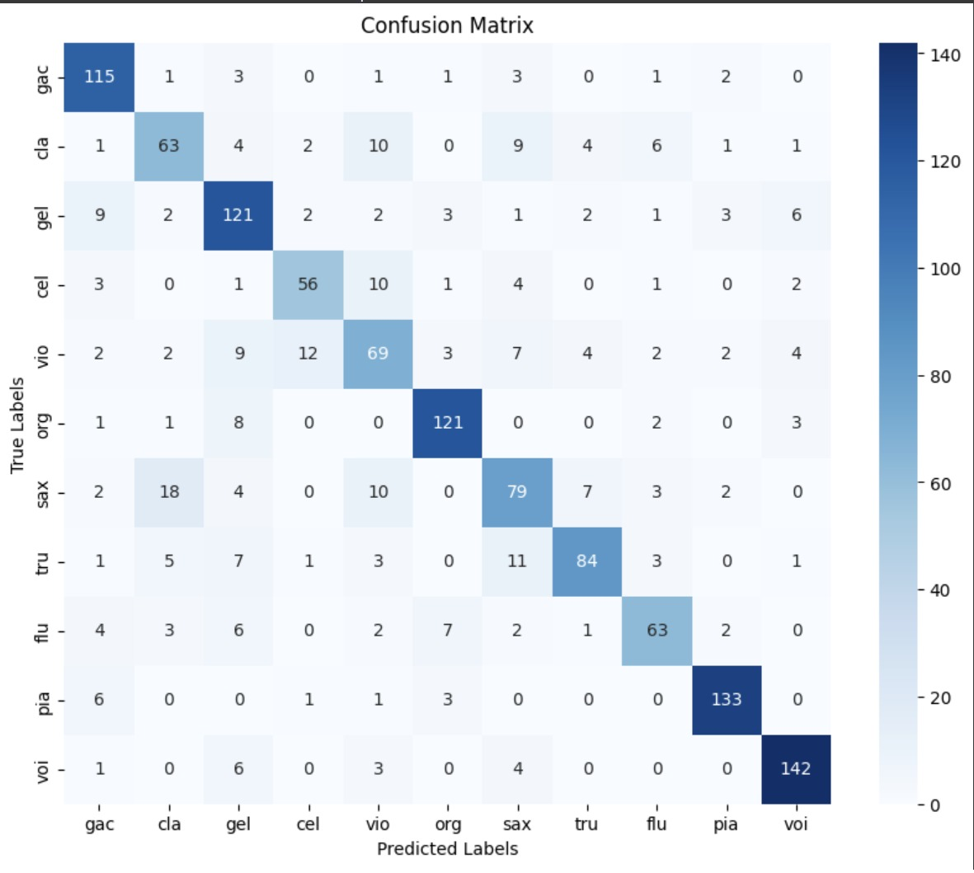
Confusion Matrix:

Slide 15
Model Evaluation:
Test Accuracy:
The model achieved a final test accuracy of 78.37%, demonstrating good generalization on the unseen test data.
Test Loss: The test loss at the end of training was 0.7364, which suggests the model is making relatively low error on the test set.

Slide 16
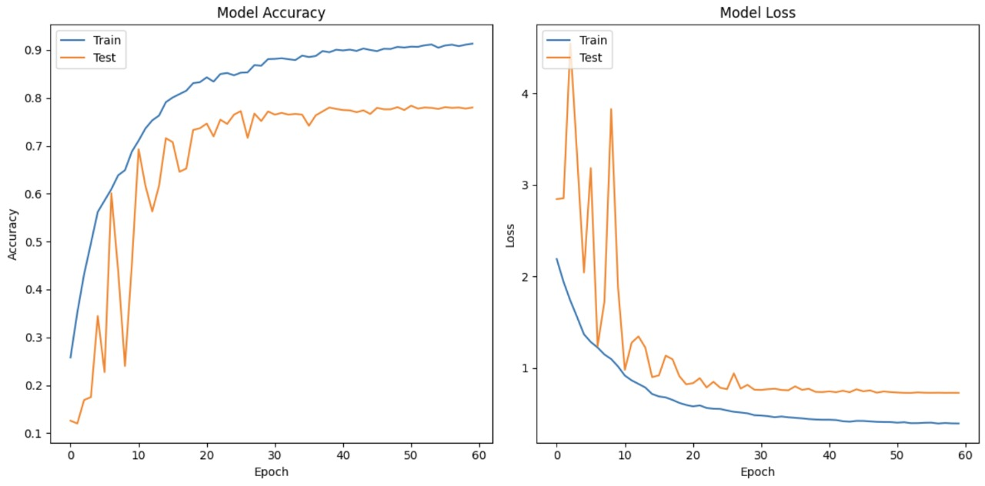
Visuals and Graphs:

Slide 17
DATASET DESCRIPTION
IRMAS is Intended for algorithm training and testing for automatic identification of prominent musical instruments in audio recordings. Musical instruments used in this study are the cello, clarinet, flute, acoustic guitar, electric guitar, organ, piano, saxophone, trumpet, violin, and vocals. This dataset is derived from the collection accumulated by Ferdinand Fuhrmann in his Ph.D. thesis, with significant variations being the availability of audio data in stereo form, restriction in the test dataset annotations to specific pitched instruments, and diversity in the number and length of audio excerpts.

Slide 18
THANK
YOU!

