Slide 1


Robust CNN-Based Musical Instrument Recognition with Enhanced Feature Learning.
Padmesh Sivalingam , Aamith Kishore T J,
Sri Krishna P , Yaswanth Reddy B , Ragav S.
ICICT Conference 2025

Slide 2
Overview/Table of Contents
You can delete this slide when you’re done editing the presentation
Fonts | To view this template correctly in PowerPoint, download and install the fonts we used
Used and alternative resources | An assortment of graphic resources that are suitable for use in this presentation
Thanks slide | You must keep it so that proper credits for our design are given
Colors | All the colors used in this presentation
Icons and infographic resources | These can be used in the template, and their size and color can be edited
Editable presentation theme | You can edit the master slides easily. For more info, click here
For more info: Slidesgo | Blog | FAQs
You can visit our sister projects: Freepik | Flaticon | Storyset | Wepik | Videvo

Slide 3
Introduction
Musical instrument recognition: A fundamental task in Music Information Retrieval (MIR)
Applications span automated transcription, content-based recommendation, and music analysis
Key challenges:
Spectral overlap between similar instruments
Variability in recording conditions and playing techniques
Background noise and environmental factors
Deep learning offers promising solutions through feature extraction directly from audio data

Slide 4
Research Objectives
Develop a robust CNN-based system for musical instrument classification using Mel spectrograms
Optimize feature extraction from audio signals to identify distinctive instrument timbres
Evaluate classification performance across 11 diverse instrument categories
Compare results with state-of-the-art methods to benchmark effectiveness
Analyze model robustness and generalization capability

Slide 5
Literature Review
Early approaches: Handcrafted features (MFCCs) + classical ML techniques (Heittola et al.)
Feature-based classification: Fusion models with spectral/temporal features (Kitahara et al.)
Machine learning advancement: SVMs and source separation (Fuhrmann et al., Bosch et al.)
Deep learning innovations: CNN + Mel-spectrograms (Han et al.)
CNNs with optimized timbral features (Pons et al.)
Multi-task learning approaches (Yu et al.)
Transfer learning for instrument detection (Gomez et al.)
Transform-based approaches: Hilbert-Huang, WaveGAN (Soraghan et al., Lekshmi et al.)

Slide 6
Dataset Description
IRMAS-TrainingData Dataset: 6,705 audio clips (3 seconds each, .wav format)
11 instrument classes: acoustic guitar, clarinet, electric guitar, cello, violin, organ, saxophone, trumpet, flute, piano, and voice
Sample distribution:
Piano: 721 samples
Voice: 778 samples
Electric Guitar: 760 samples
Acoustic Guitar: 637 samples
Other instruments: ~400-600 samples each

Slide 7
Methodology - Audio Preprocessing
Audio processing with Librosa:
Fixed sampling rate (22,050 Hz) for consistency
Feature extraction through time-frequency representation
Mel Spectrogram Computation:
128 Mel bands
FFT window size: 2,048 samples
Hop length: 512 samples
Power-to-dB conversion to emphasize amplitude variations
Standardization process:
Uniform shape (128×128 pixels) through padding/truncation
Min-max normalization to range [0,1]
Addition of channel dimension for CNN compatibility

Slide 8
Mel Spectrogram Visualization
Visual comparison of instrument spectrograms:
Piano: Clear note onsets, wide frequency range
Acoustic Guitar: Visible harmonic structure
Flute: Higher frequency concentration, fewer lower harmonics
Violin: Rich harmonic content with vibrato patterns
Key observations:
Each instrument exhibits distinct spectral patterns
Frequency distribution varies significantly across instruments
Temporal evolution provides crucial discriminative information

Slide 9
CNN Architecture
Three-stage convolutional design:
Input: 128×128×1 Mel spectrogram
Stage 1: 64 filters (3×3), ReLU, BatchNorm, MaxPool (2×2)
Stage 2: 128 filters (3×3), ReLU, BatchNorm, MaxPool (2×2)
Stage 3: 256 filters (3×3), ReLU, BatchNorm, MaxPool (2×2)
Feature aggregation: GlobalAveragePooling2D
Classification: Dense(256) → Dropout(0.5) → Dense(11, softmax)
Regularization techniques:
L2 regularization (coefficient: 0.0001)
Batch normalization for training stability
Dropout (50%) to prevent overfitting

Slide 10
Implementation Details
Model complexity:
Total parameters: 440,075
Trainable parameters: 439,179
Non-trainable parameters: 896
Training configuration:
Optimizer: Adam (learning rate: 0.0005)
Loss function: Categorical cross-entropy
Batch size: 32
Dataset split: 80% training, 20% testing (stratified)
Adaptive training strategies:
ReduceLROnPlateau: Reduce LR by factor of 0.5 if validation loss plateaus
EarlyStopping: Halt training after 10 epochs without improvement

Slide 11
Training Process
Training dynamics:
Total epochs: 60
Peak validation accuracy: 78.37% (at epoch 51)
Final training accuracy: 90.96%
Learning rate adaptation: 0.0005 → 1e-6
Convergence behavior:
Steady improvement in both metrics
Gap between training and validation accuracy indicates slight overfitting
Validation loss stabilizes at 0.73 after initial fluctuations
Early stopping mechanism prevents performance degradation

Slide 12
Results Analysis
Performance metrics:
Final test accuracy: 78.37%
Training accuracy: 90.96%
Validation loss: 0.73
Accuracy and loss trends:
Steady improvement throughout training
Evidence of model convergence by epoch 50
Training-validation gap indicates room for further optimization
Key observations:
Model effectively learns instrument-specific features
Performance variation across instrument classes
Challenging cases: instruments with similar timbral qualities

Slide 13
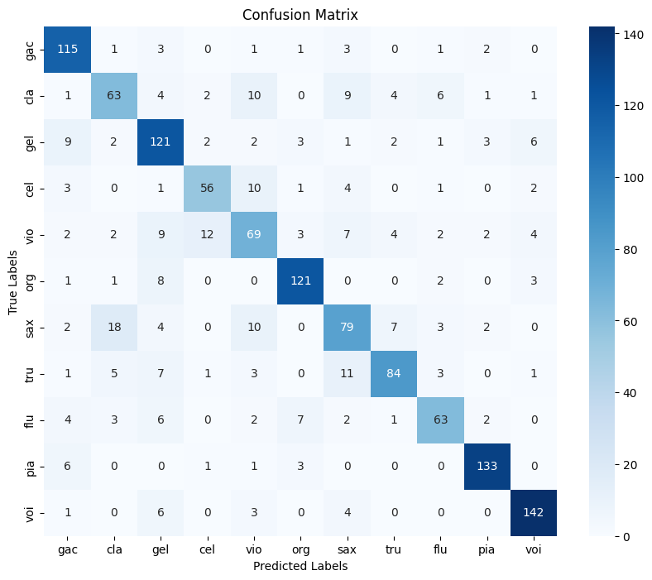
Performance Visualization & Error Analysis

Slide 14
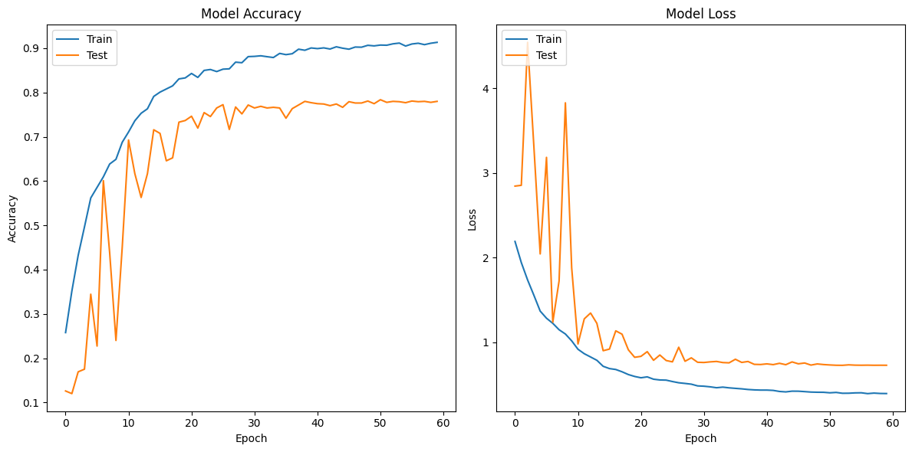

Slide 15
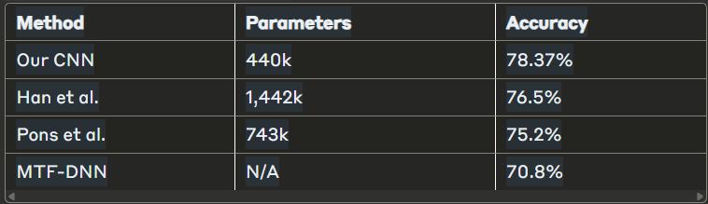
Performance Comparison
Key advantages:
Higher accuracy with significantly fewer parameters
No dependency on sliding window analysis or aggregation
Direct feature learning outperforms handcrafted features
More computationally efficient than competing approaches

Slide 16
Conclusion & Future Work
Achievements:
Developed an efficient CNN for instrument classification (78.37% accuracy)
Successfully applied deep learning for feature extraction from Mel spectrograms
Achieved superior performance with fewer parameters than SOTA methods
Future directions:
Incorporate advanced architectures (CRNNs, attention mechanisms)
Expand dataset with more diverse samples and augmentation techniques
Explore alternative spectrogram representations
Address confusion between similar instruments
Applications: Automated transcription, music search, genre classification

