Slide 1
Data collection for signal processing
By : Patrick . A .Joseph

Slide 2
INDEX
Introduction to Data Collection
Preparation of Subject for Data Collection
Data Collection Process

Slide 3
Introduction to Data Collection

Slide 4
Definition of Data Collection
Data collection : It defined as the process of gathering and measuring information on targeted variables ( interested signals ) in an established system
Data collection is important for EEG signal processing as data of various subjects is the fundamental requirement for working on EEG signals
Only based on the data , we can characterize the EEG signal and infer something about the EEG signal.
Data serves as an essential interface between the external ( human ) environment and the internal ( computer ) system.
Measuring of data should be precise and must be reliable.

Slide 5
Why EEG ?
EEG is performed to evaluate the following conditions :
1. Confusion
2. Dementia
3. Head Injuries
4. Brain Infections
5. Tumors
6. Sleep Disorders
7. Degenerative Diseases
8. Metabolic Disturbances which affect the brain function

Slide 6
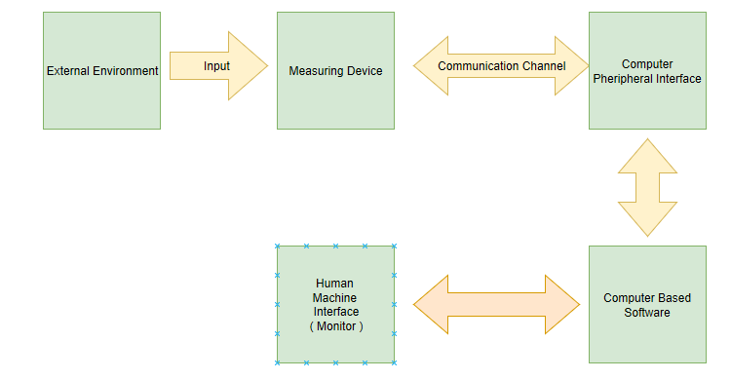
General block diagram of Data Collection and data flow

Slide 7
Preparation of Subject For Data Collection

Slide 8
Preparation of Subject For Data Collection
Keep patient initially relaxed in a cool room and with moderate lighting.
No kind of material ( such as oil , hair gel ) should be applied on the forehead and hair of the patient before the placement of the electrode.
Pre-relaxation of the patient ( both physically and mentally )
The subject should ask their doctor whether they should stop taking medication before the EEG procedure.
Avoid eating or drinking anything containing caffeine for at least 8 hours before the test.
The doctor may prescribe the patient to have low hours of sleep before the EEG test if the patient has to sleep during the EEG test.

Slide 9
Measurement Process

Slide 10
Measurement Process
The patient is asked to lie down on the back in a reclining chair or on a bed.
Technician measures the subjects head and mark where to place the electrodes. These spots are scrubbed with a special cream ( Examples : TD-244 Ten20 EEG Adhesive Paste , TD-242 EC2 EEG Electrode Cream) which is a conductive cream.
The technician places the electrodes on the marked spots on the scalp of the patient .
To check whether the device(s) work properly , the patient is asked to do tests such as rapidly blinking the eyes or varying the intensity of the light in the test environment.
The EEG test alone will take about 20 – 40 minutes ( according to the Epilepsy Foundation ) and about 1 to 1.5 hours for the entire process ( including the preparatory process ).

Slide 11
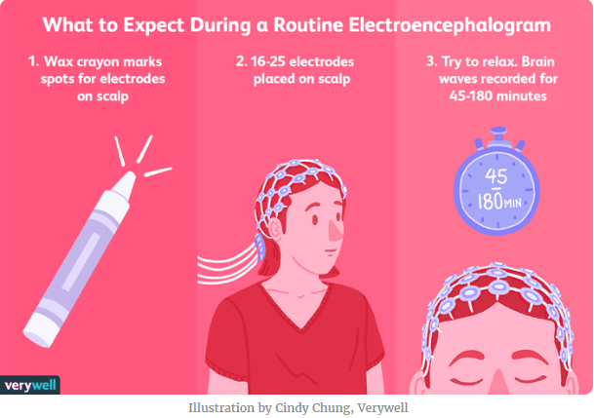

Slide 12
Time Latency Correction

Slide 13
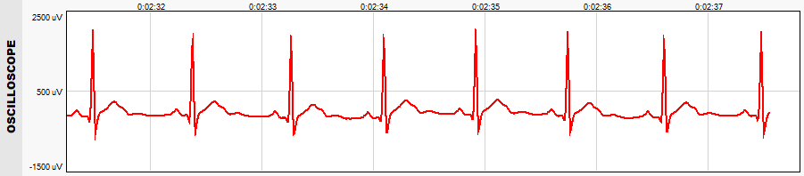
Need for time latency correction
EEG (Electro Enchephelo Gram )and EOG ( Electro Ocullo Gram ) cannot be measured using the same device and hence different devices are needed.
Since magnitude of EOG signals is in the order of 300μV and the magnitude of EEG signals is in the order of 10-15 μV, the interference of the EOG signal in the EEG signal will be more

Slide 14
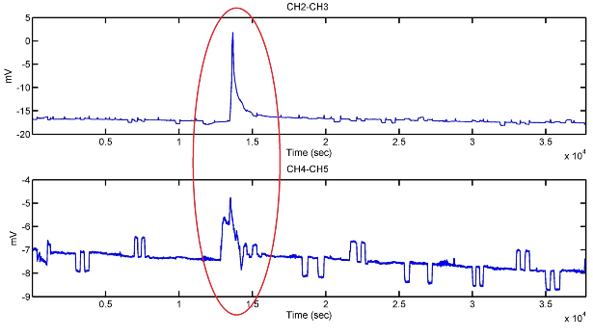
Need for time latency correction
Hence for events occurring during the same time , the time stamps for the EEG and EOG signals will be different and so the EEG and EOG signals cannot be compared for EOG artifact reduction in the EEG signal effectively.
In order to synchronize the EEG and EOG signal data , we need to for some time latency correction.

Slide 15
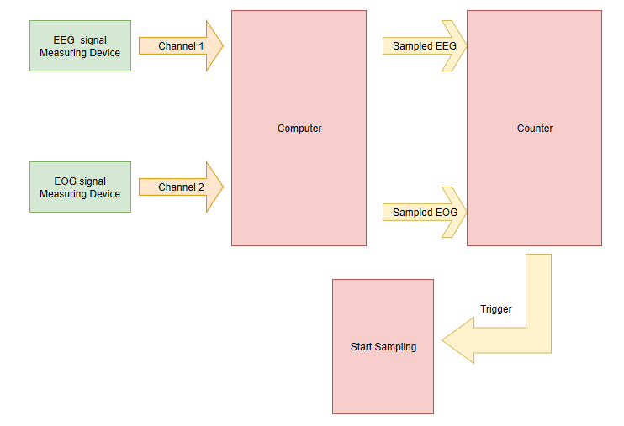
Implementation of Time Latency Correction
When data is needed to be recorded , the patient is told to rapidly blink his eyes.
This will produce spikes on both the EEG and EOG waveforms .
We can count the number of pulses (spikes ) produced in the waveforms.
When the number of spikes in the waveforms exceed a pre-defined count , then we can start to record the data.

Slide 16
Measurement conditions and Tests

Slide 17
Measurement tests
To study the EEG signal under various conditions , we have to perform various experiments pertaining to these conditions.
During the simulation of each condition of the mind , proper procedures should be followed .
Focus of the mind and the careful monitoring of the patient should be done.
All possible conditions of human thinking should be considered .

Slide 18
Measurement tests
Some of the conditions under which the EEG signals can be monitored are as follows :
Sleeping state
Meditating state
Focused state

Slide 19
Sleeping state
The person is asked to only sleep for a few hours during the night.
During the test , the lighting level in the room is kept minimum so that the person may fall asleep quickly.
The person is asked to breathe deeply for a few times so that the heartbeat is relaxed and so the EGC interface with EEG signal is minimized.
The person is also asked to loosen up his body so that the EEG signals are free from muscular strains.
This method is best for monitoring the EEG signals since the mind is in the relaxed state and the EEG response under idle mind state can be obtained.

Slide 20
Meditating / Subconscious State
The patient is asked to keep his mind the relaxed state (although the patient is in the awake state ).
The patient is also asked to close his eyes and take deep breaths.

Slide 21
Focused State
An object is placed at a certain distance and the person is asked to focus on the object.

Slide 22
Fa

Slide 23
References and Links

Slide 24
References and Links
scholarworks.uark.edu/cgi/viewcontent.cgi?article=3699&context=etd
A Model-Based Objective Evaluation of Eye Movement Correction in EEG Recordings Joep J. M. Kierkels*, Geert J. M. van Boxtel, and Leo L. M. Vogten
https://imotions.com/blog/5-basics-eeg-data-processing/
https://www.healthline.com/health/eeg
https://www.fri-fl-shop.com/product/td-244-eeg-adhesive-paste/
https://www.test-and-measurement-world.com/Equipments/Biomedical/ECG-test-vs-EEG-test-vs-EMG-test.html

Slide 25
References and Links
https://www.webmd.com/epilepsy/guide/electroencephalogram-eeg
https://www.medicalnewstoday.com/articles/325191.php#procedure
www.measurement.sk/2002/S2/Teplan.pdf
https://www.onlinelibrary.wiley.com/doi/epdf/10.1111/1469-8986.3720127
https://infoscience.epfl.ch/record/200114/files/2014_OnlineLatencyCorrection.pdf

