Slide 1
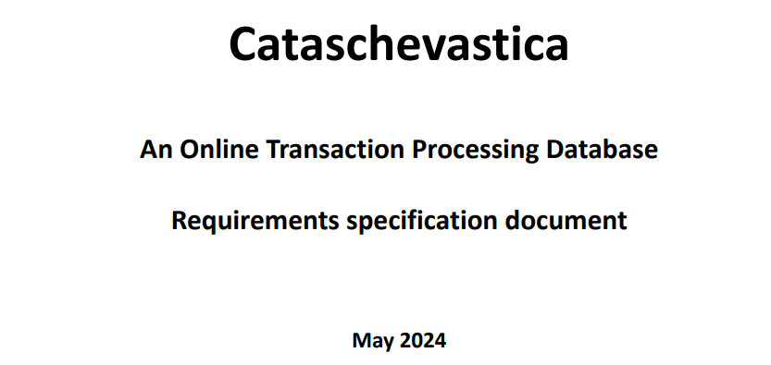

Team 3
Katerina Skoumpourdi
Eleni Angelakaki
Sofoklis Kalonis
Georgios Kitsios
Pantelis Zapadiotis

Slide 2

Contents
I. SCOPE OF THE PROJECT AND ANALYSIS TOOLS
II. ERDPLUS
Conceptual Diagram Design (ERD)
From ERD to RS
III. SQL SERVER MANAGEMENT STUDIO
SQL script authoring
IV. MITIGATIONS ACTIONS
Challenges
Tackling Project Issues

Slide 3
I. SCOPE OF THE PROJECT AND ANALYSIS TOOLS

Slide 4

Requirements
Functional
Implement the database according to the ER diagram, ensuring normalization to the third normal form (3NF)
Populate each table with a minimum of ten rows of data
Non-functional requirements
Employ MS-SQL Server for the database implementation
Use of MS-SQL Server for the database
Adopt appropriate naming conventions for tables and fields
Include comments in the script to track version history

Slide 5
Scope of the Project #1
Development of an Online Transaction Processing (OLTP) Database:
Design and implement a comprehensive database for the Cataschevastica manufacturing company
Database Functionality:
Manage the end-to-end manufacturing process including order intake, production, and delivery
Track and persist all stages of the manufacturing process
Key Features and Functionalities:
Record detailed product information including specifications, compliance, cost, and raw materials
Capture customer orders with complete details and track their status through various stages
Facilitate the assignment of delivery tasks to logistics partners
User Interaction:
Customers can submit, modify, or cancel orders via an online web application
Departments (sales, production, logistics, accounting) can check and update order statuses
Database Design and Implementation:
Develop a conceptual Entity-Relationship Diagram (ERD) and normalize the database to 3NF
Populate tables with initial data (minimum of ten rows per table)
Query and Command Statements:
Provide necessary SQL queries for operational reports and data retrieval
Implement SQL commands for creating orders, finalizing production, and completing deliveries

Slide 6


Analytical Tools Utilized
To conduct a thorough analysis for this project, we utilized the following essential tools:
ERDPLUS
SQL Server Management Studio (SSMS)
Notes:
Sophia 14

Slide 7
II. ERDPLUS

Slide 8
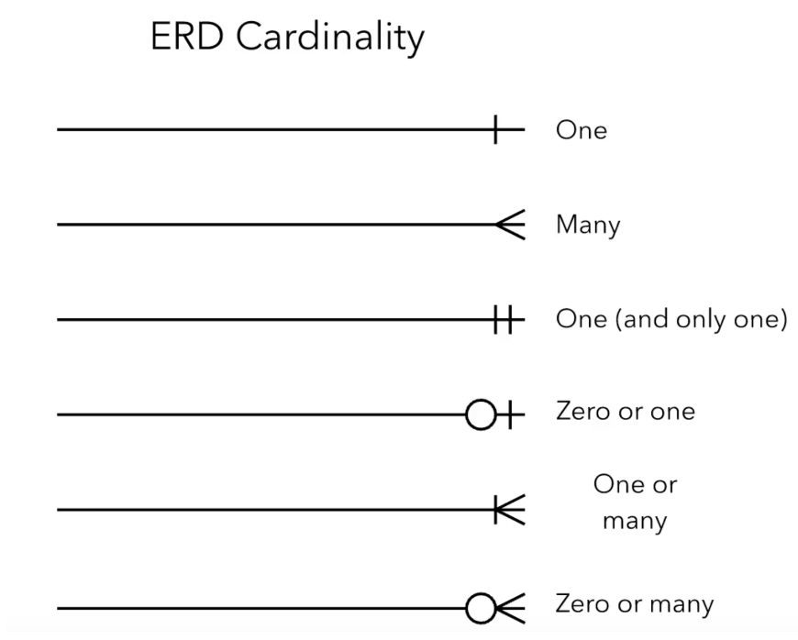
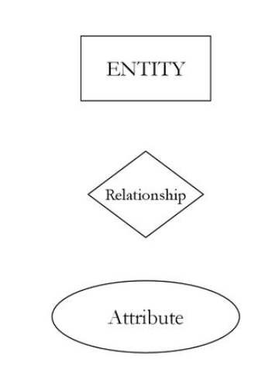
Conceptual Diagram Design (ERD)
An ERDPlus diagram provides a visual representation of the database structure, illustrating the entities, their attributes, and the relationships between them, which helps in understanding and designing the database schema.
Entities
For the ERD Diagram are created 9 tables:
Product
Customer
ProductRawMaterial (Join Table)
RawMaterial
Supplier
Order
OrderDetails (Join Table)
LogisticsPartner
ProdTeamMember
Notes:
Sophia 14

Slide 9
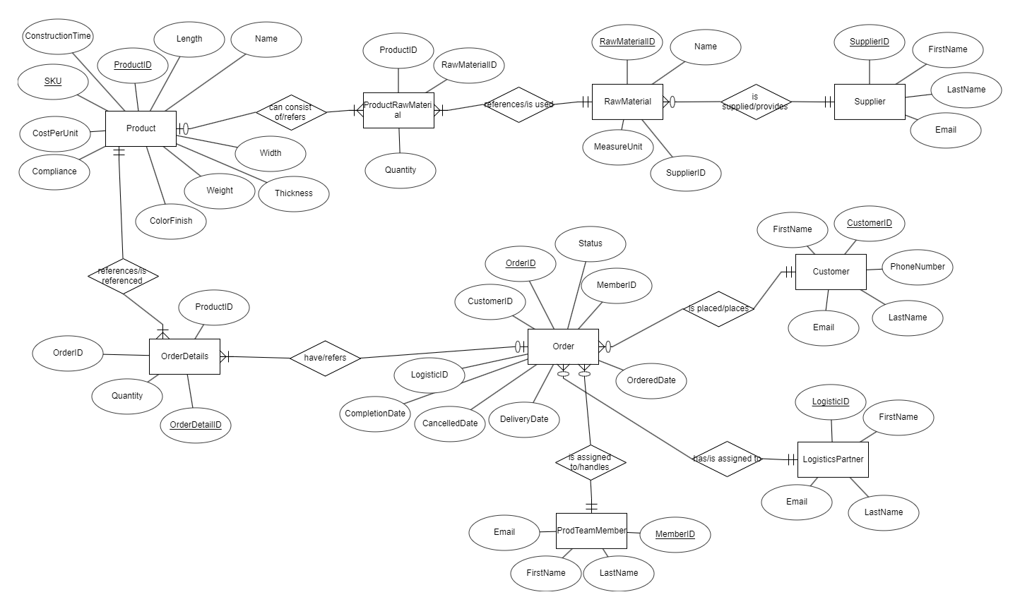
Conceptual Diagram Design (ERD)
Notes:
Sophia 14

Slide 10
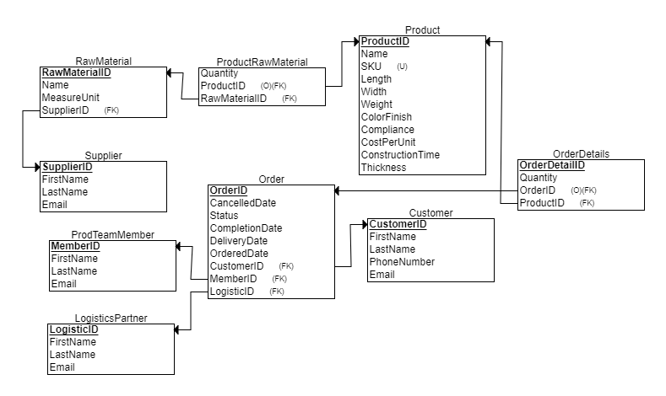
From ERD to RS
Notes:
Sophia 14

Slide 11
IV. SQL SERVER MANAGEMENT STUDIO

Slide 12
SQL script authoring
The following steps outline the process followed to create the SQL script for the database. This structured approach ensures the efficient creation, population, and querying of the database to meet project requirements.
Create database:
Use of the CREATE DATABASE statement to define a new database named “Cataschevastica”
Create Tables:
Use of the CREATE TABLE statement to define tables within the database
Specify the table name and the columns with their data
Establish Relationships:
Define PRIMARY KEYS of each table
Define FOREIGN KEYS to establish relationships between tables
Define Data Types:
Select appropriate DATA TYPES for each column to ensure data integrity and optimal storage.
INT, DECIMAL, NVARCHAR, DATETIME
Populate Tables:
Use the INSERT INTO statement to add data to the tables
Create queries:
Write SELECT statements to retrieve data from the tables
Notes:
Sophia 14

Slide 13
IV. MITIGATIONS ACTIONS

Slide 14

Challenges
Project Pitfalls: Our Comical Journey Through Challenges
Time Management issues
- Delays in some phases of the project, that occurred the entire project timeline to slip
Misinterpreting Data Relationships
- Designing the database schema or writing queries without fully understanding how different tables and fields relate to each other
- That led to suboptimal performance
Common SQL Problems/Technical issues
- Mistyped SQL keywords, missing punctuation, or incorrect query structure led to syntax errors
Performance issues
- That problem arised from missing or incorrect Data (during the population of the tables)
- The Queries returned incomplete or incorrect data or incorrect assumptions about the data
Quality assurance
- Some final deliverables did not meet the required standards, need for quality control measures

Slide 15

Tackling Project Issues
Problem-Solving Hacks: Turning Headaches into Triumphs!
Plan Before Writing: Understand the requirements and design the query logic before writing SQL code
Test Incrementally: Write and test small parts of the query incrementally to identify and fix issues early –partly solving each query
Use Comments: Add comments to queries to explain the logic and make it easier to understand
Leverage Documentation: Refer to SQL documentation and resources for guidance on functions, operators, and best practices
Seek Help When Needed: Collaborate with colleagues when encounter persistent issues

Slide 16

Curious? Confused?
Bring it on!
Thank you!

