Slide 1


POLARITY
E-BIKES
PREPARED BY PADHMAJA K, IIM RAIPUR

Slide 2
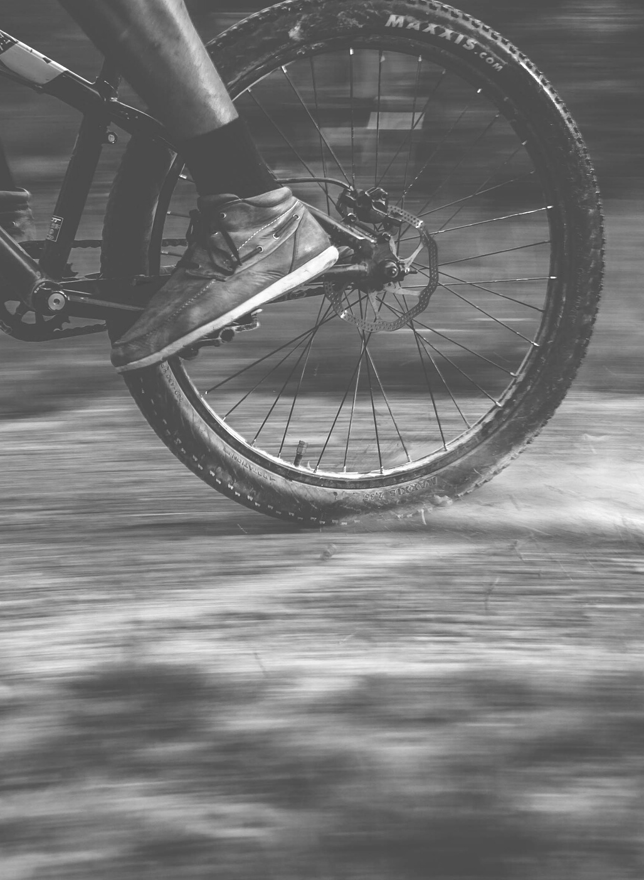
BENGALURU

Slide 3
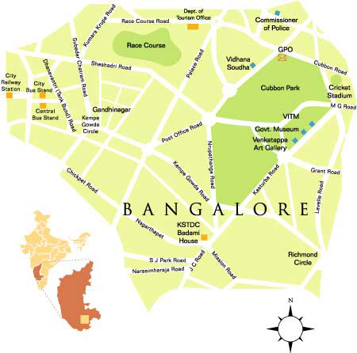
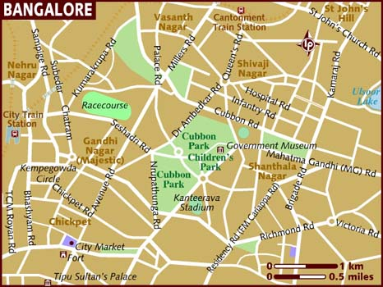

Slide 4

Average price / sq.ft = Rs. 4023
The places are chosen by dividing the city into four major regions for better reach
DEALERSHIP LOCATIONS
MAJESTIC
JAYA NAGAR
Rs2321-Rs30000/sq.ft
Rs17000-Rs25000/sq.ft
JC ROAD
SHIVAJI NAGAR (2ND HAND)
Closest Rs. 2000/sq.ft (Mysore Road )
Rs8000- Rs 10000/sq.ft

Slide 5
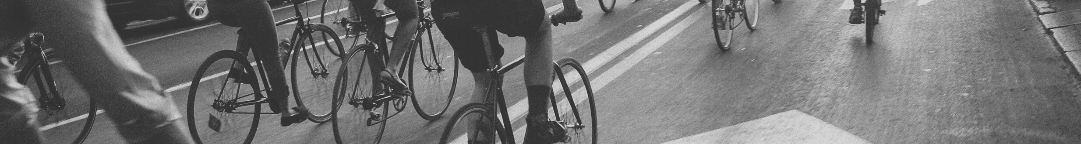
DATE | DAY | HOLIDAY
14-Jan | Thu | Makara Sankranti
26-Jan | Tue | Republic Day
11-Mar | Thu | Maha Shivaratri
02-Apr | Fri | Good Friday
13-Apr | Tue | Ugadi
14-Apr | Wed | Dr Ambedkar Jayanti
25-Apr | Sun | Mahavir Jayanti
01-May | Sat | May Day
13-May | Thu | Idul Fitr
14-May | Fri | Basava Jayanti
20-Jul | Tue | Bakrid / Eid al Adha
15-Aug | Sun | Independence Day
19-Aug | Thu | Muharram
10-Sep | Fri | Ganesh Chaturthi
02-Oct | Sat | Gandhi Jayanti
06-Oct | Wed | Mahalaya Amavasye
14-Oct | Thu | Maha Navami
15-Oct | Fri | Vijaya Dashami
19-Oct | Tue | Eid e Milad
20-Oct | Wed | Maharishi Valmiki Jayanti
01-Nov | Mon | Kannada Rajyothsava
04-Nov | Thu | Diwali
05-Nov | Fri | Deepavali Holiday
25-Dec | Sat | Christmas Day
Main Festivals
Deepavalli
Sankranti
Ugadi
Ganesh Chaturdi
Peak Marriage season – Feb
The festivals of Deepavalli and Sankranti – people get bonus
The other 2 festivals - workers like flower sellers etc. earn more

Slide 6
CHENNAI

Slide 7
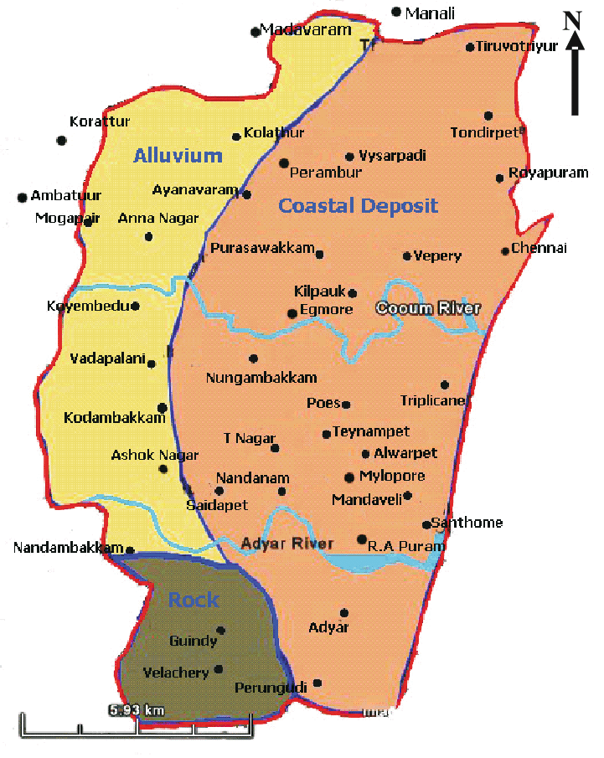
Based on the divisions , at each region one place is chosen for dealership based on proximity

Slide 8
DEALERSHIP LOCATIONS
ANNA NAGAR
EGMORE
Rs2399-Rs.23611/sq.ft
Rs.3700-Rs.25000/sq.ft
T NAGAR
KK NAGAR
Rs3700-Rs. 28846/sq.ft
Rs.3700-Rs.15243/sq.ft
ADYAR
ASHOK NAGAR
Rs.4166-Rs.23913/sq.ft
Rs.2546-Rs.24739/sq.ft

Slide 9
FESTIVALS
S.NO | PUBLIC HOLIDAYS | DATE | DAY
1 | New Year’s Day | 01.01.2021 | Friday
2 | Pongal | 14.01.2021 | Thursday
3 | Thiruvalluvar Day | 15.01.2021 | Friday
4 | Uzhavar Thirunal | 16.01.2021 | Saturday
5 | Republic Day | 26.01.2021 | Tuesday
6 | * Annual closing of Accounts for Commercial Banks & Co-operative Banks | 01.04.2021 | Thursday
7 | Good Friday | 02.04.2021 | Friday
8 | Telugu New Year’s Day | 13.04.2021 | Tuesday
9 | Tamil New Year’s Day and Dr. B.R.Ambedkar’s Birthday | 14.04.2021 | Wednesday
10 | Mahaveer Jayanthi | 25.04.2021 | Sunday
11 | May Day | 01.05.2021 | Saturday
12 | Ramzan (Idul Fitr) | 14.05.2021 | Friday
13 | Bakrid (Idul Azha) | 21.07.2021 | Wednesday
14 | Independence Day | 15.08.2021 | Sunday
15 | Muharram | 20.08.2021 | Friday
16 | Krishna Jayanthi | 30.08.2021 | Monday
17 | Vinayakar Chathurthi | 10.09.2021 | Friday
18 | Gandhi Jayanthi | 02.10.2021 | Saturday
19 | Ayutha Pooja | 14.10.2021 | Thursday
20 | Vijaya Dasami | 15.10.2021 | Friday
21 | Milad-un-Nabi | 19.10.2021 | Tuesday
22 | Deepavali | 04.11.2021 | Thursday
23 | Christmas | 25.12.2021 | Saturday
Pongal
Deepavalli
Vinayaka Chaturdi
Tamil new year
Marriage Season
Ramzan (Ramadan), Christmas and Newyear

Slide 10
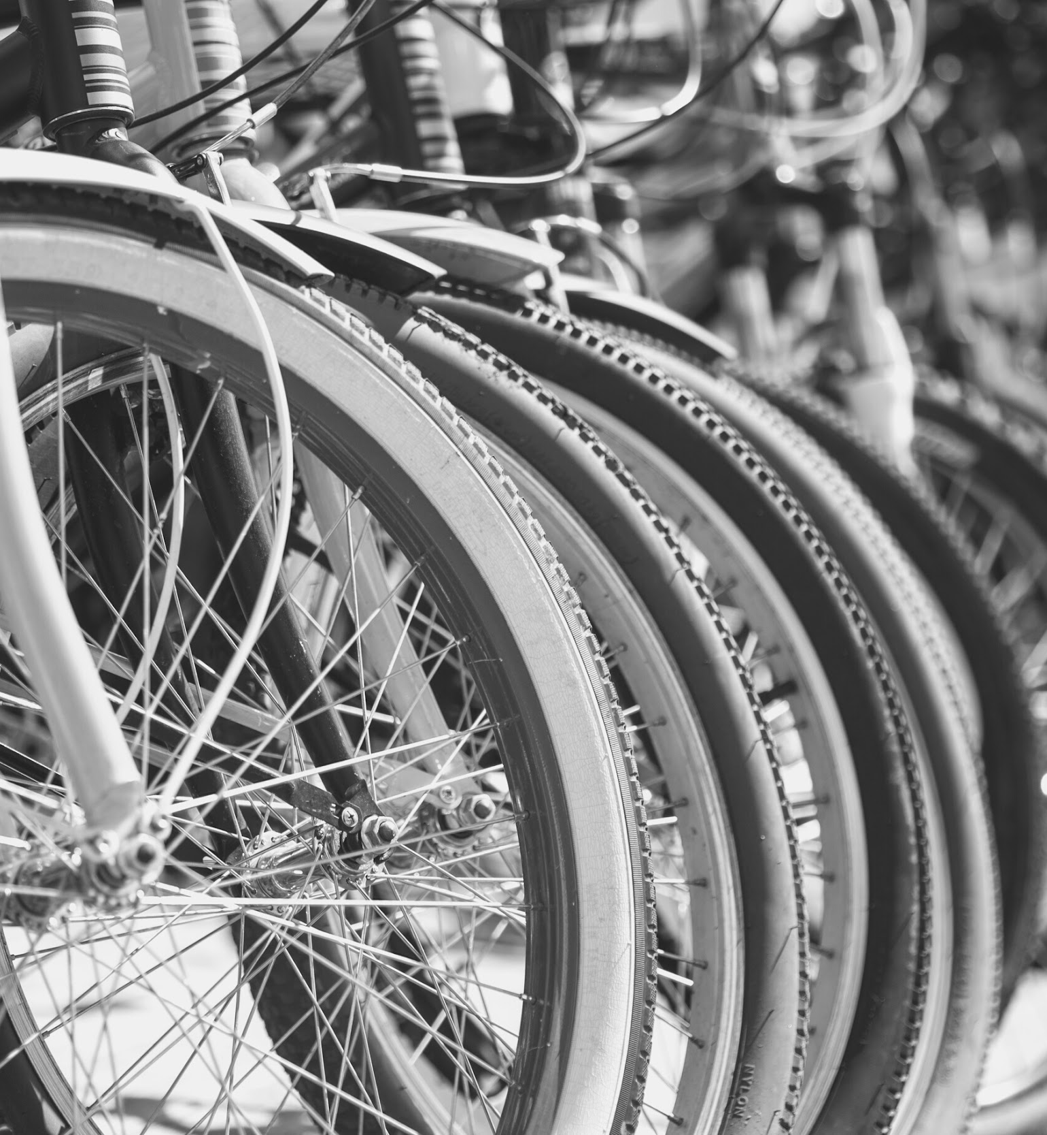
GENERIC RESEARCH

Slide 11
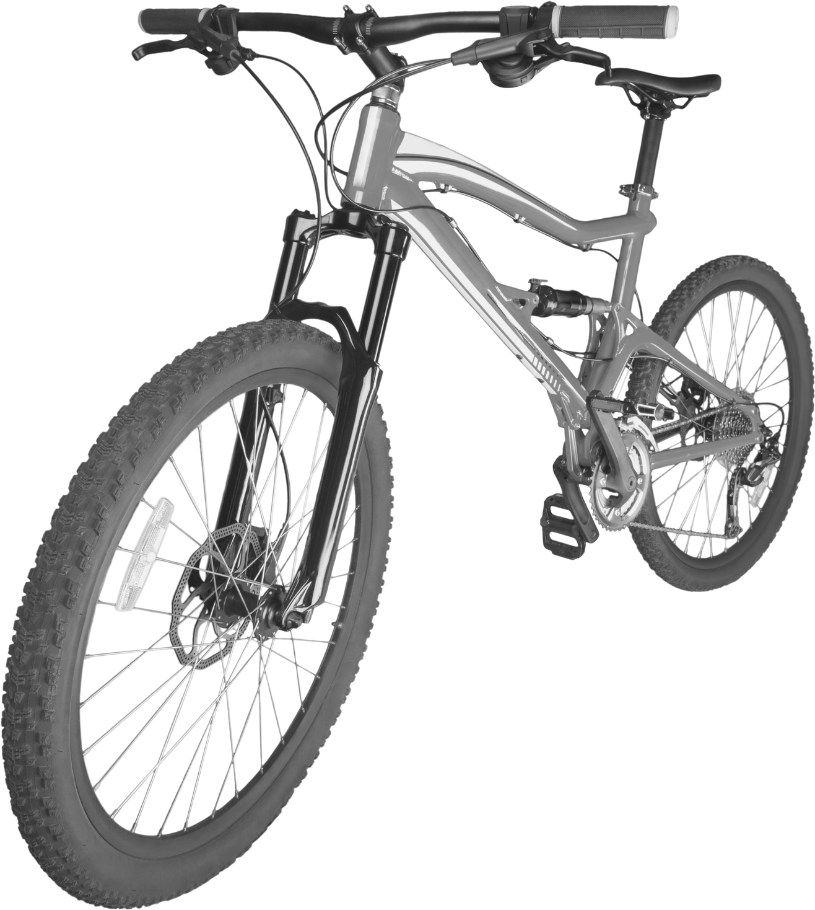
Basic E-bike market
Minimal share – 0.6% , Sales increase – 129%
Government initiatives –
Amma Scooter 2020
Karnataka – No specific scheme for e-bikes ( But for bicycles)
17.43Bn by 2024 , 42.95% CAGR
Tamil-nadu has a greater reception and promoted.
Budget-2021 , Scrapping of automobiles not fit, eco-friendly vehicles promoted.
March 2020 – Version BS4 bikes scrapped

Slide 12
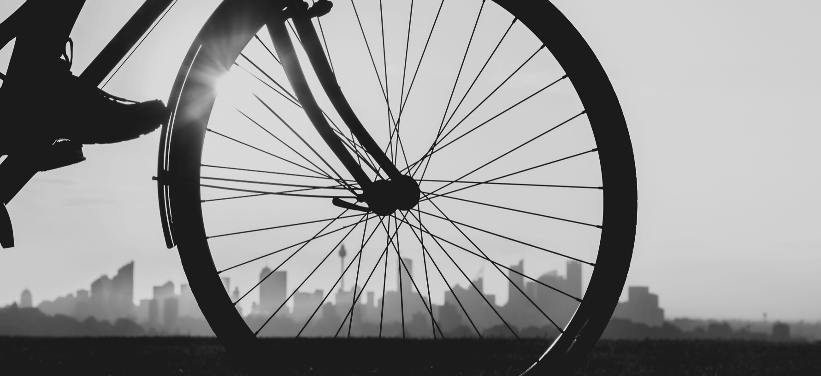
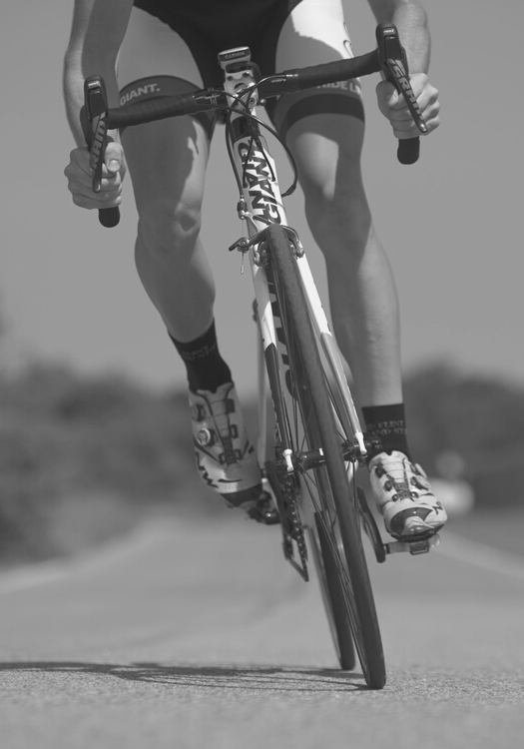
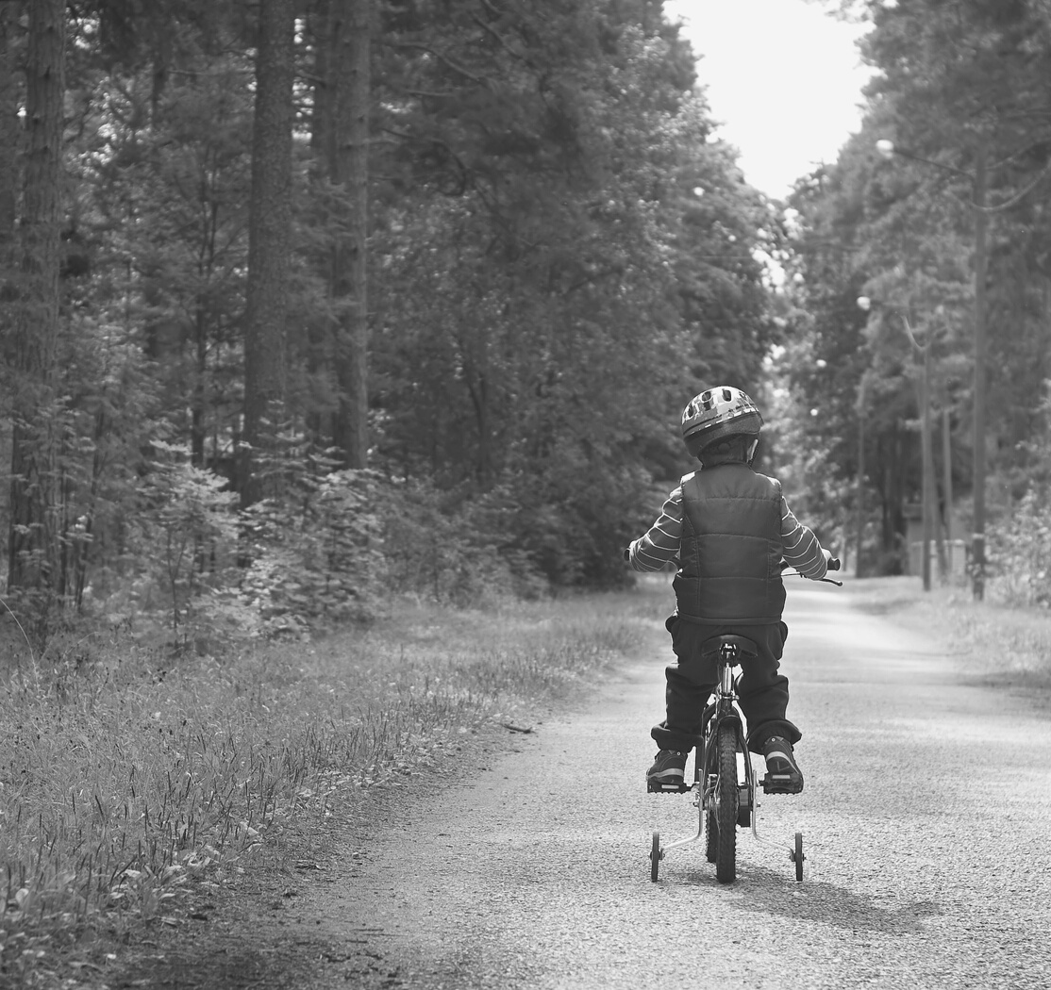
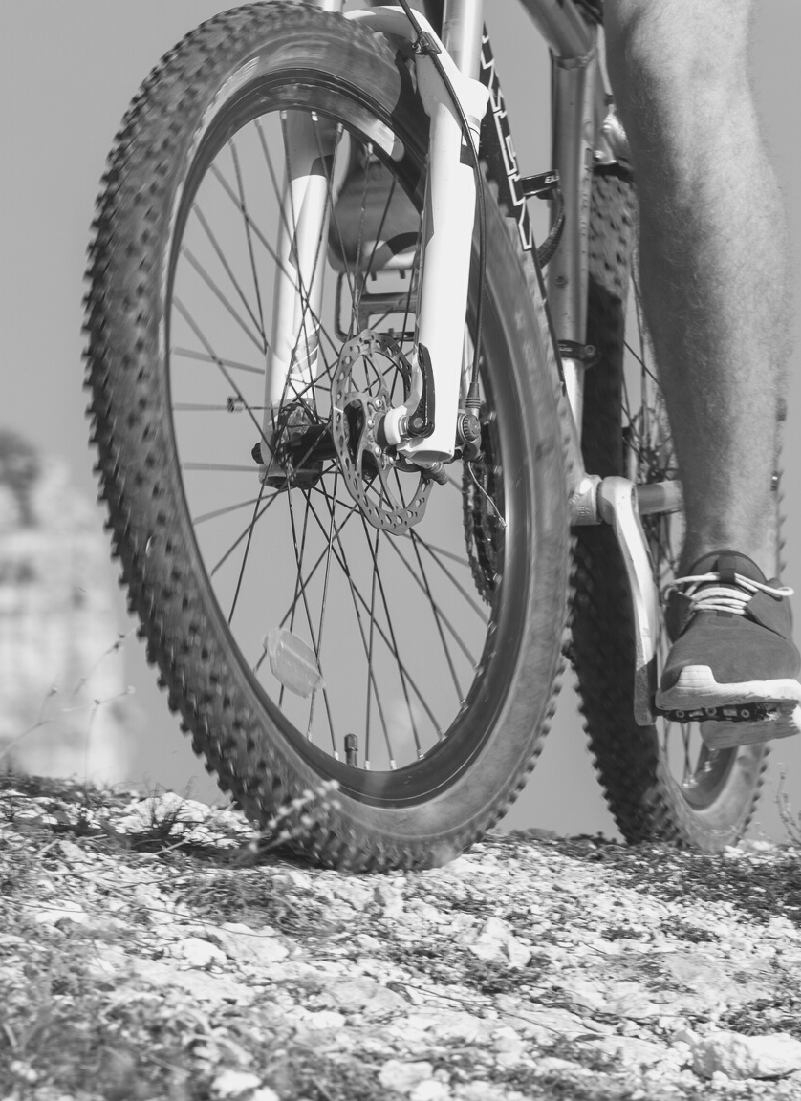
COMPETITORS
Electrotherm (India) Limited
Ampere Vehicles Private Limited
Ather Energy Private Limited
Avon Cycles Limited
Hero Electric Vehicles Private Limited
Lohia Auto Private Limited
NDS Eco Motors Private Limited
Okinawa Autotech Private Limited
Tork Motors Private Limited
Tunwal E-Bike India Private Limited

Slide 13

POSSIBLE MARKETS
Uber , Ola , Rapido
Swiggy, Zomato
School children
Under- 18 – No license required (less than 50cc)
IIT Madras – Inter college (617 acres)
IIM Bangalore – ( 100 acres )
THANKYOU!!

