Slide 1
FALL SEMESTER 2026–2027
CYBERSHIELD SOC
A Database-Driven Security Operations
and Incident Management Platform
SOC
BACSE202 – DATABASE MANAGEMENT SYSTEMS
Faculty: Dr. S. Geetha
Team:
Shrinithi.N.M - 25BCE5742
J.Padhmavathi - 25BCE1510
Srivikasni.S – 25BCE1435
GitHub: [Insert repository URL]

Slide 2
Problem Statement & Project Objectives
THE PROBLEM
OUR APPROACH
Security events, alerts, incidents, investigator assignments and forensic evidence can become disconnected across separate tools or manual records.
A unified relational database and Flask application connects the event-to-resolution workflow with role controls and traceable history.
PROJECT OBJECTIVES
Capture simulated security events and generate alerts using a configurable severity threshold.
Manage incidents, investigator assignments, investigation cycles and SLA deadlines.
Preserve evidence metadata, SHA-256 hashes, custody transfers and forensic findings.
Provide role-based access, audit history and operational reporting.

Slide 3
System Architecture & Technology Stack
USER
FLASK APP
DB ACCESS
ORACLE DB
REPORTS
Browser UI
HTML • Jinja • CSS
Routes • Sessions
Validation • RBAC
python-oracledb
Bind parameters
Transactions
Tables • Constraints
PL/SQL • Triggers
Views • Indexes
Dashboard views
Incident / SLA
Custody / Audit
DATABASE MIGRATION STRUCTURE
DESIGN PRINCIPLES
V001–V007: schema, security helpers, workflows, audit and views.
V008–V009: runtime grants and synthetic demo data.
V010: asset administration and related grants.
Server-side authorization and parameterized database access.
Transactions for multi-step operations; rollback on failure.
Auditability and controlled access to evidence records.

Slide 4
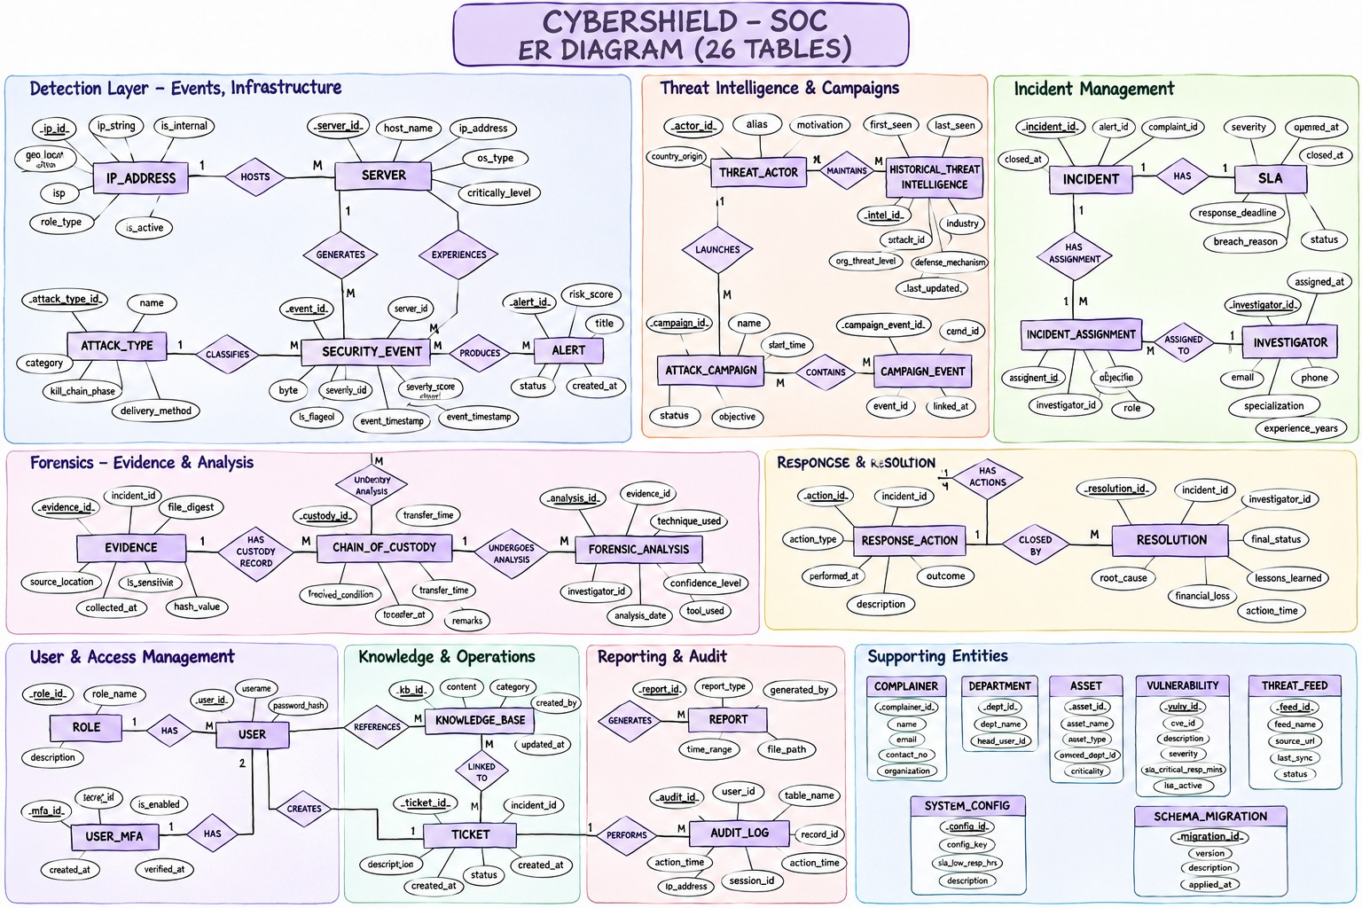
System Architecture & ER Diagram

Slide 5
Database Design: Entities & Relationships
IDENTITY & ASSETS
EVENT & THREAT
INCIDENT LIFECYCLE
app_user • investigator
server • ip_address
attack_type
security_event • alert
threat_actor • campaign
historical intelligence
incident • investigation_cycle
incident_assignment • sla
status history
FORENSICS & RESPONSE
GOVERNANCE
evidence • chain_of_custody
forensic_analysis
response_action • resolution
audit_log
schema_migration
reporting views
RELATIONSHIP HIGHLIGHTS
• Event → Alert → Incident → Investigation Cycle → Assignment / SLA / Status History
• Incident → Evidence → Custody Transfers and Forensic Analysis
• Campaign ↔ Events through campaign_event; Incident ↔ Alerts through incident_alert

Slide 6
Normalization, Keys & Integrity
PRIMARY & CANDIDATE KEYS
FOREIGN & COMPOSITE KEYS
CONSTRAINTS & WORKFLOWS
Identity primary keys identify rows. Unique constraints provide additional candidate keys such as email, hostname and source_event_key.
Foreign keys connect parent/child records. Bridge tables use composite keys, e.g. campaign_event(campaign_id, event_id).
NOT NULL, UNIQUE, CHECK and FK constraints protect data. PL/SQL validates roles and lifecycle transitions.
3NF DECOMPOSITION EXAMPLE
UNNORMALIZED
1NF / 2NF
3NF
Incident + user + cycle + investigator + evidence in one wide record
Atomic values; separate repeating groups and partial-key facts
Separate APP_USER, INCIDENT, CYCLE, INVESTIGATOR, ASSIGNMENT, EVIDENCE

Slide 7
Core Features & Incident Workflow
1
2
3
4
5
6
EVENT
ALERT
INCIDENT
INVESTIGATE
EVIDENCE
RESOLVE
Simulated telemetry
Threshold-based
Case creation
Assign + SLA
Hash + custody
Analysis + action
ROLE-BASED ACCESS
SLA TARGETS
ADMIN – user/reference administration and authorized operations.
MANAGER – assignment, SLA monitoring, escalation and reopening.
ANALYST – assigned investigations, triage, evidence and resolution.
AUDITOR – read-only audit and incident history.
LOW: 8 h response / 72 h resolution
MEDIUM: 4 h / 48 h
HIGH: 1 h / 24 h
CRITICAL: 15 min / 4 h
Incident states: OPEN → TRIAGED → INVESTIGATING → CONTAINED → RESOLVED → CLOSED

Slide 8
Implementation & Important SQL Operations
Examples of how the database supports the application
EXAMPLE: JOIN SECURITY_EVENT WITH ALERT
SQL OPERATIONS
INSERT • SELECT • UPDATE • controlled DELETE • JOIN • GROUP BY • HAVING • COUNT / SUM / AVG • subqueries
SELECT e.event_id, e.severity_score,
a.alert_id, a.severity, a.status
FROM security_event e
JOIN alert a ON a.event_id = e.event_id;
PL/SQL PROCEDURES
sp_ingest_event • sp_create_incident • sp_assign_investigator • sp_change_status • sp_resolve_incident • sp_reopen_incident • evidence procedures
REPORTING VIEWS
TRANSACTIONS, TRIGGERS & INDEXES
vw_open_incidents • vw_critical_alerts • vw_investigator_workload • vw_sla_status • vw_custody_history • vw_dashboard_summary
Commit successful work; rollback failed multi-step operations. Audit triggers record actor/action history. Indexes support frequently used lookups and constraints.

Slide 9
Testing, Limitations & Conclusion
TESTING FOCUS
VERIFICATION NOTE
LIMITATIONS
Oracle connectivity • login and RBAC
Duplicate event handling
Status transitions and rollback
Evidence custody • SLA/report queries
Earlier project notes reported Oracle health success and 64 focused pytest tests passing. Re-run against the exact submitted version and attach current evidence.
Synthetic events only; no live network collection, malware execution or automatic blocking. Some schema migration/relationship checks require final verification.
CONCLUSION
CyberShield SOC demonstrates how Oracle relational design and PL/SQL workflows can support a traceable security incident lifecycle—from simulated event ingestion to investigation, evidence handling, reporting and resolution.

