Slide 1
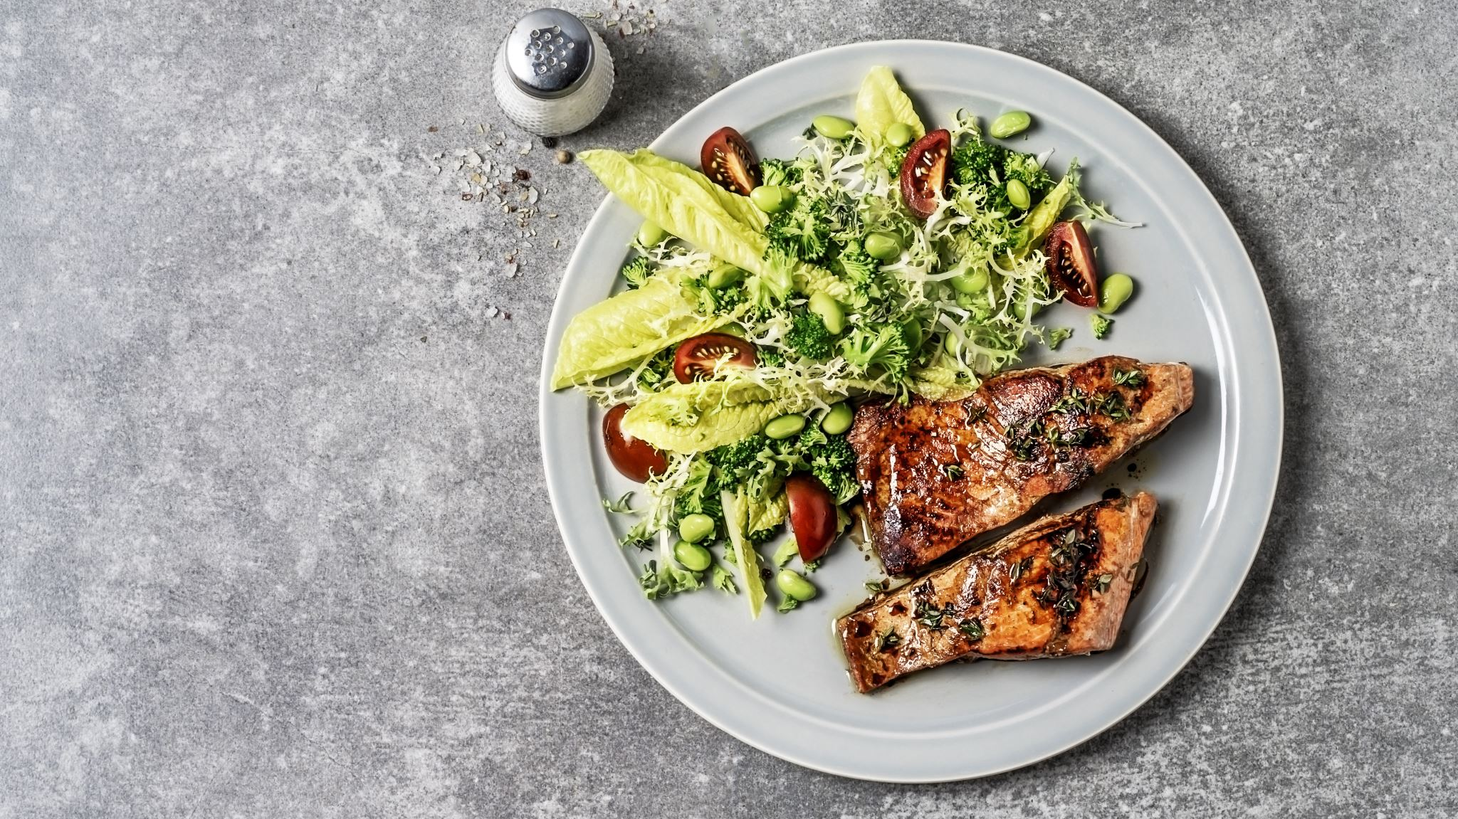
HealthBot
Nutrition Made Easy, One Meal at a Time.

Slide 2

About us
Team Name:
Memento
Team Members:
Lesedi Padi
Nathan Chisadza
Abhay Rooplall

Slide 3

Problem Statement 🤖 AI‑Powered Solution Create an AI‑driven tool to make daily life easier — study assistant, finance tracker, scheduler, or even a mental health chatbot. Use free resources like Google’s AI Studio with Gemini to power your creativity.

Slide 4

Our Solution
Meet our All-in-One Health Chatbot: HealthBot
We've created a single, powerful web application that consolidates everything your users need for their health and wellness journey.
Powered by Gemini’s API, designed to deliver instant health insights. Get personalized healthy recipes, meal plans, dietary tips, and even a ready-to-go grocery list -- everything in seconds. Say goodbye to endless web searches!

Slide 5
Tech Stack
BUILT WITH MODERN TECHNOLOGIES
Frontend:
HTML5, CSS3, JavaScript (ES6+)
PHP for server-side rendering
Responsive CSS Grid/Flexbox design
Backend:
Node.js with Express.js
Socket.io for real-time chat
Google Gemini AI API for nutrition intelligence
Database & Security:
PostgreSQL for data storage
Secure API key authentication
Password hashing with Argon2

Slide 6
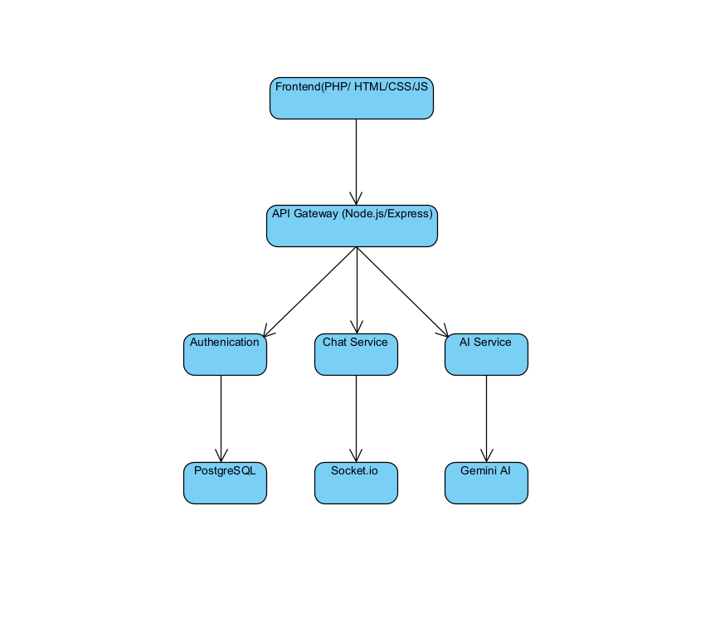
System Architecture

Slide 7
Gamification
Streaks: Our streak system tracks the number of consecutive days you log in to the web application, rewarding your consistency.
Points System: For every day you maintain your login streak, you'll earn 10 points. However, if you miss a day, your streak will be broken and you will lose 10 points. To encourage daily engagement, consecutive missed days will result in a continuous deduction of points.

Slide 8
Why we stand out?
One Platform, All Answers: Instead of endless searching, users get instant, accurate information in one place. We eliminate the noise and deliver clarity.
Expert Guidance, Instantly: Our chatbot is exclusive on health and nutritional data, providing focused and trustworthy advice without distractions.
Gamified Engagement: We're turning health into a habit. Our gamification features, including challenges, points, and rewards, keep users motivated and committed to their goals.

Slide 9

Thank you

