Slide 1
Watch Tip
An user focussed recommendation engine
Tom Lauth, Patrick Dieser

Slide 2





Agenda
1. Recap of the challenge
2. Roadmap
3. The approach????
4. Results
5. Conclusion

Slide 3
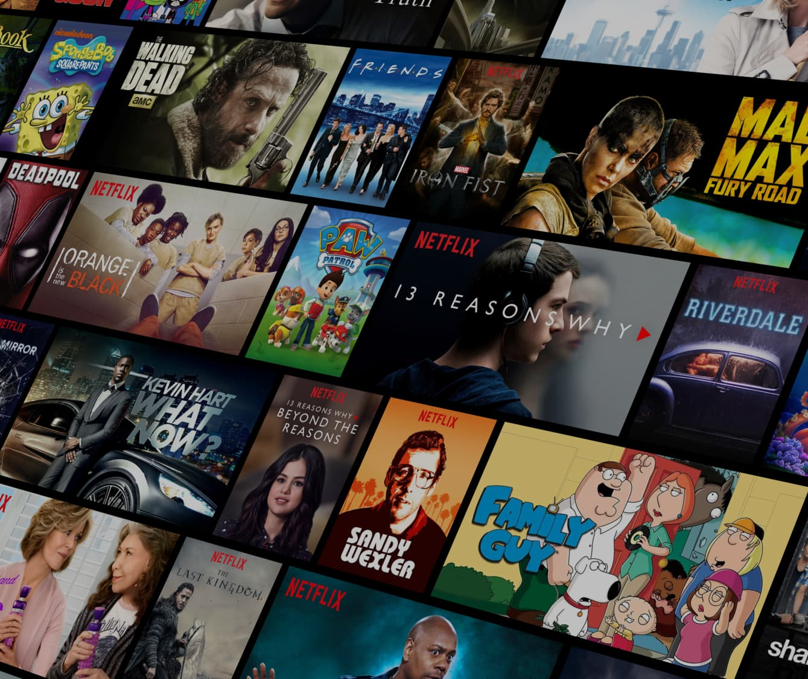

Recap
Current recommendation engines
Notes:
Challenge: Movie recommendation systems focus on gaining money, not the user preferences
With increasing monetization, viewers receive worse movie recommendations

Slide 4



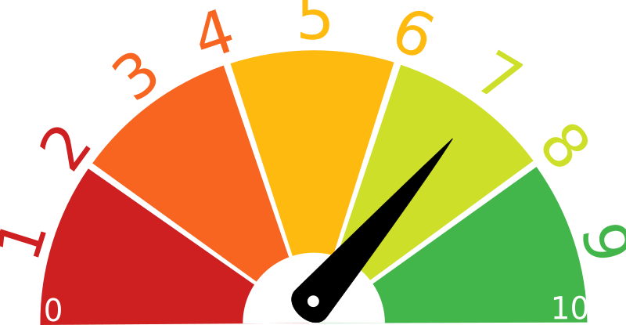
Roadmap
Notes:
Major iterations:
Content matching = Find the movies matching the most to the user‘s preferences
Ranking = Rank movies and recommend user the best movie, matching to his perferences
New movies = System/model can handle and recommend new available movies

Slide 5


Ranking
.
.
.

Slide 6
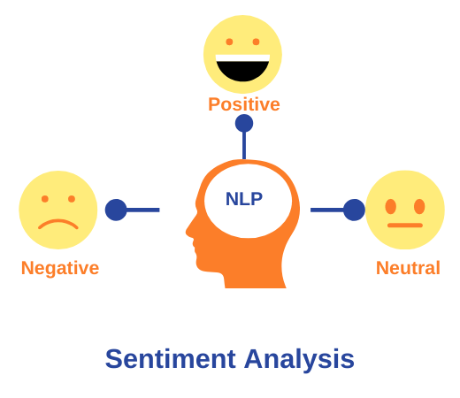


Approaches
Ratings of the user reviews
+
Sentiment Analysis with a LLM
Sentiment Analysis with VADER
= Final score

Slide 7
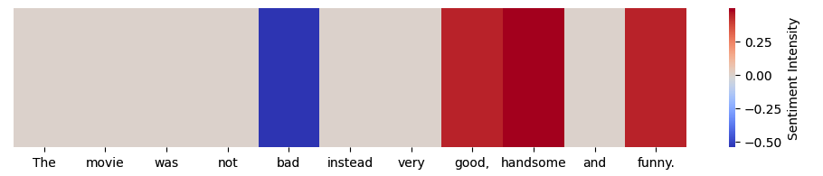
Sentiment analysis
VADER (Valence Aware Dictionary and sEntiment Reasoner)
Example review: “The movie was not bad instead very good, handsome and funny.“
sentiment_scores: {'neg': 0.0, 'neu': 0.36, 'pos': 0.64, 'compound': 0.9085}
Notes:
Searches the text and evaluates each word individually based on a predefined sentiment lexicon.
Each word has a predefined sentiment value (positive, neutral or negative) on a scale from -4 to +4.
It also takes modifiers such as “very”, “extremely” or “hardly”, which can influence the intensity of a word's sentiment.

Slide 8
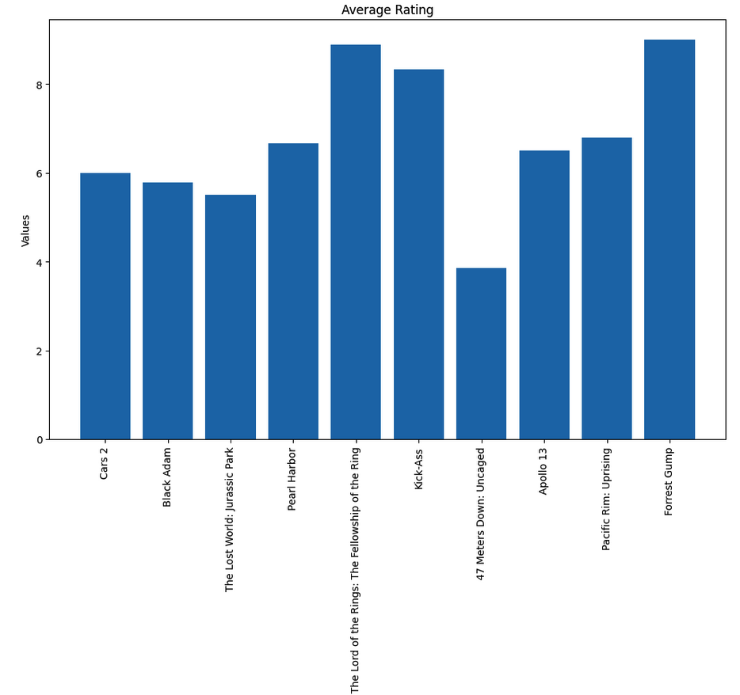
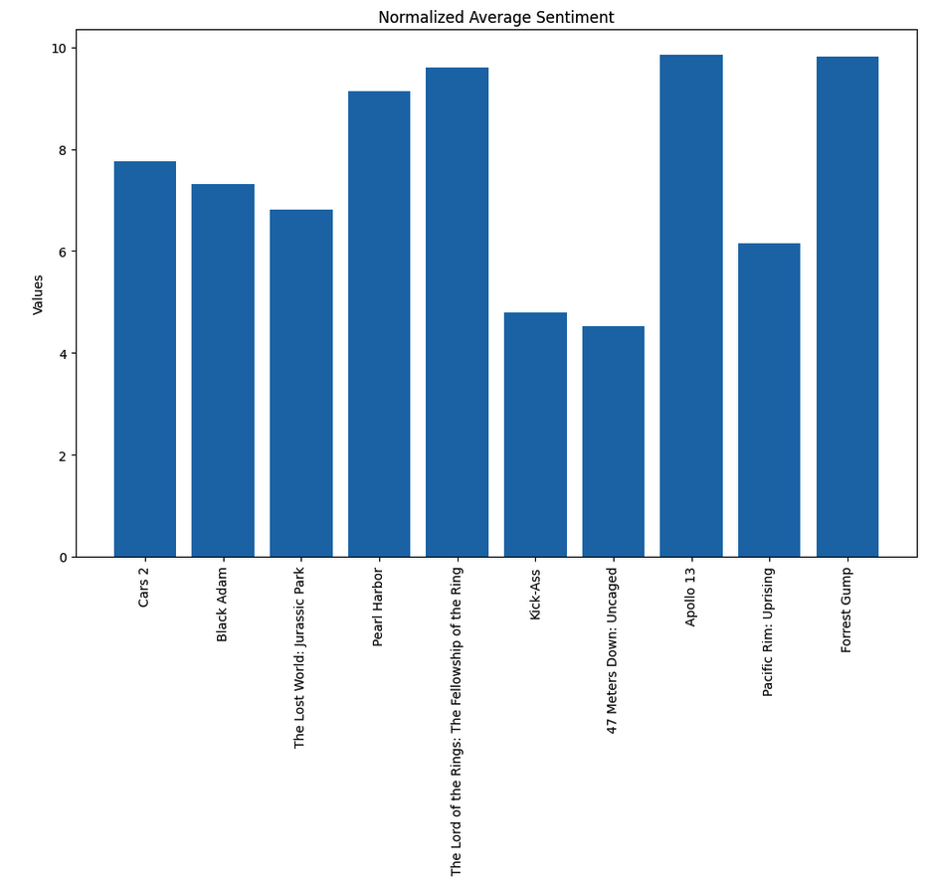
User review visualized
Notes:
Ratings only without the None values!!!

Slide 9
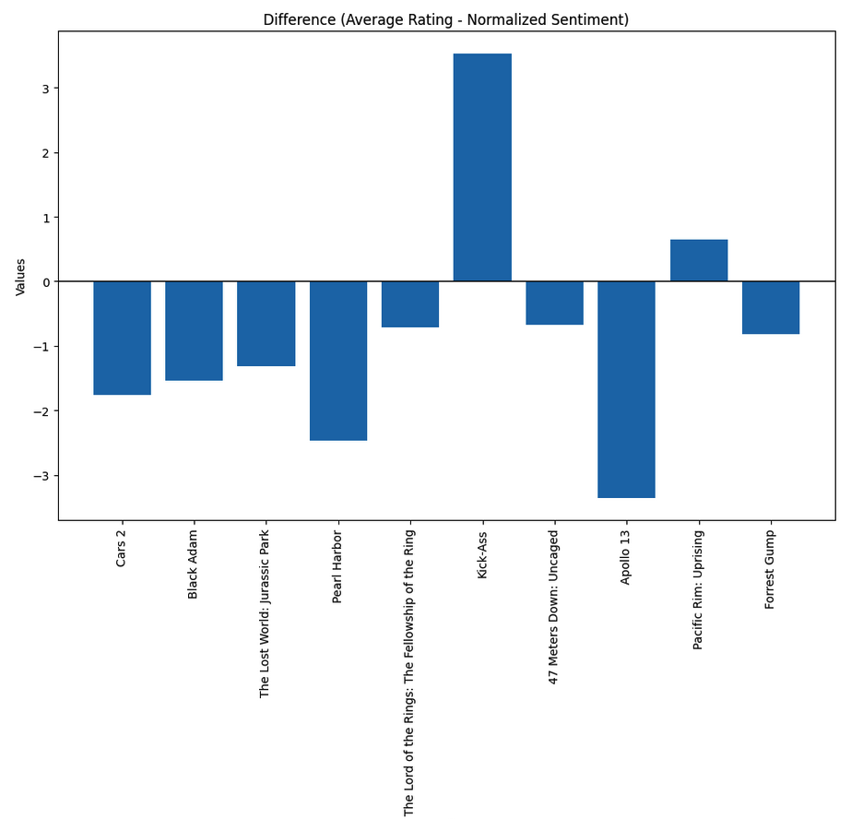
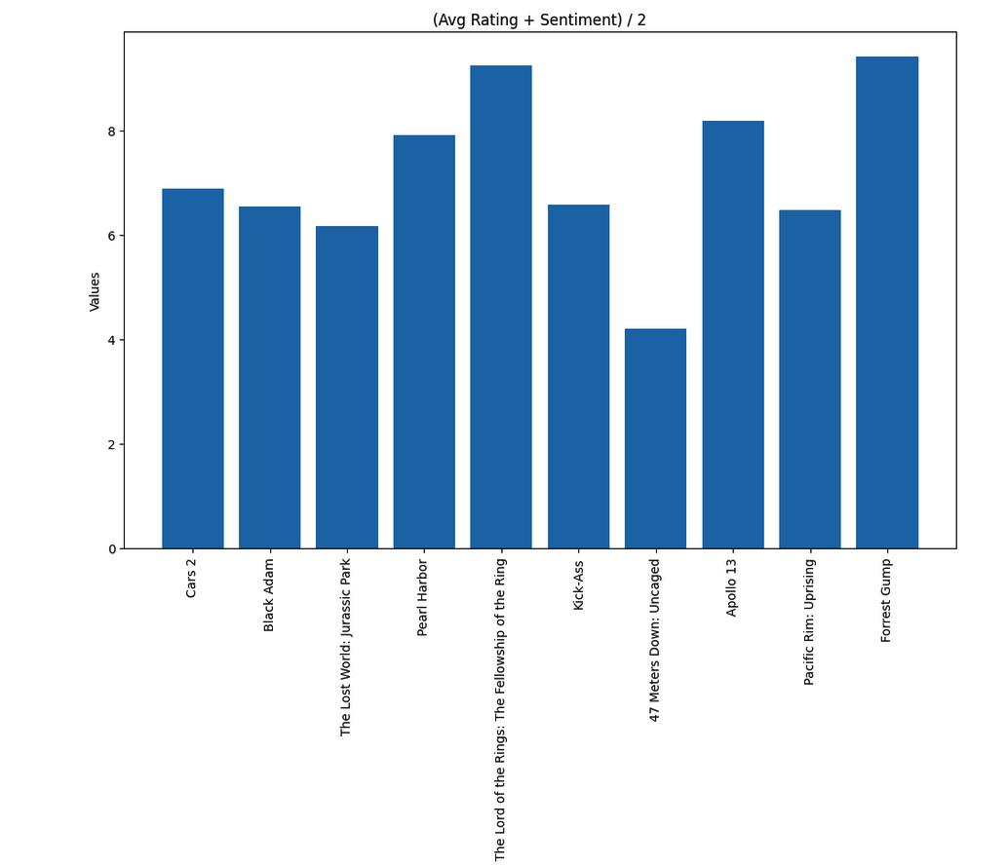
User review visualized

Slide 10
Metrics
Result without None values
Result without 1,10 and None values
Result without 2,9 and None values
Result without 1,2,9,10 and None values

Slide 11
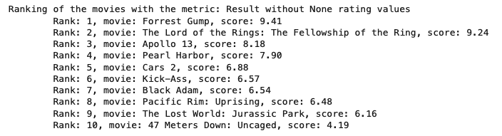
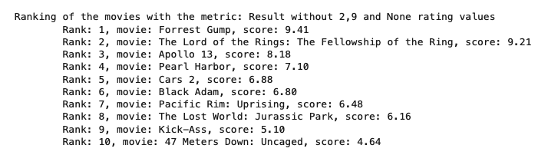
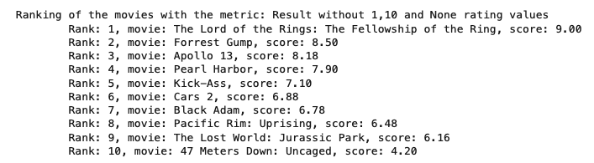
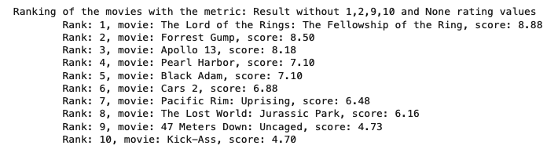
Results

Slide 12
Thank you for your attention!

Slide 13
References
https://external-content.duckduckgo.com/iu/?u=https%3A%2F%2Fcdn-icons-png.flaticon.com%2F512%2F149%2F149206.png&f=1&nofb=1&ipt=857712a595c7a8ec3ec471afb0f4309f6a15458d83add16d201bffc93b25ec3a&ipo=images
https://external-content.duckduckgo.com/iu/?u=https%3A%2F%2Fcdn-icons-png.flaticon.com%2F512%2F7580%2F7580943.png&f=1&nofb=1&ipt=30c2c7c22d94a3366229920dd7a54a9c40fd790df9d9e6ed596e5eaf8511fc03&ipo=images
https://external-content.duckduckgo.com/iu/?u=https%3A%2F%2Fstatic.vecteezy.com%2Fsystem%2Fresources%2Fpreviews%2F002%2F565%2F586%2Foriginal%2Fartificial-intelligence-ai-icon-vector.jpg&f=1&nofb=1&ipt=39123d7676300e1572d931f2168567727b10c51a5090aab06be1d3
https://external-content.duckduckgo.com/iu/?u=https%3A%2F%2Fopenclipart.org%2Fimage%2F800px%2F237767&f=1&nofb=1&ipt=8e7a5d33a6ca3c1c684082fc2d4c73ef7d01b4d07298eee857922c94cbaffbeb&ipo=images
https://external-content.duckduckgo.com/iu/?u=https%3A%2F%2Fwww.proxzar.ai%2Fwp-content%2Fuploads%2F2019%2F12%2FImportance-of-NLP-for-businesses-Sentiment-analysis.png&f=1&nofb=1&ipt=89aa5c45a780725ce1ef6c4570167557f39838779affcaf583dfb8e188cd12c4&ipo=ima

