Slide 1
Watch Tip
Tom Lauth, Patrick Dieser

Slide 2
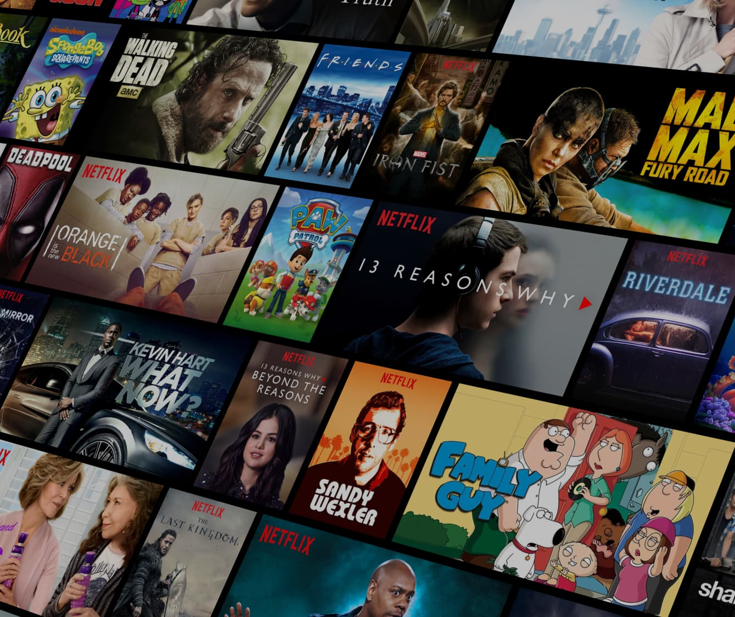

Challenge
Current recommendation engines like Netflix:
Notes:
Challenge: Movie recommendationsystem focus on gaining money, not the user preferences
With increasing monetization, viewers receive worse movie recommendations

Slide 3

Solution & objectives
Solution
Objective
Make recommendations focussed on user preferences
Recommendation engine proposing more matching movies
Notes:
Solution: Make recommendations focussed on user preferences (only for movies)
Objective: Recommendation engine proposing more matching movies

Slide 4
Market opportunities
Profit by advertisement
Watching more movies
Expandable to series
Expandable to animes: movies & series
Notes:
Profit by advertisement
Better recommendations => watching more movies
Expandable to series: changing qualities and gernes of different seasons (= again more profit)
Expandable to animes for movies and series = new customer base

Slide 5

Roadmap
Data understanding
Data preparation
Modeling
Evaluation
1. Content matching
2. Ranking
3. New movies
Deployment
Notes:
Content matching = Find the movies matching the most to the user‘s preferences
Ranking = Rank movies and recommend user the best movie, matching to his perferences
New movies = System/model can handle and recommend new available movies

Slide 6
Thank you for your attention!

Slide 7
References
https://external-content.duckduckgo.com/iu/?u=https%3A%2F%2Fuser-images.githubusercontent.com%2F33485020%2F108069438-5ee79d80-7089-11eb-8264-08fdda7e0d11.jpg&f=1&nofb=1&ipt=d1276bb0aec725de15b67f3b7837131c832ee36cf7469ab49def5879f8df259e&ipo=images
https://external-content.duckduckgo.com/iu/?u=https%3A%2F%2Fwallpapercave.com%2Fwp%2FtQWo0PP.jpg&f=1&nofb=1&ipt=026ebc8668636ac8324327a8609840e3981ea9173995cd2cfc4158e0ff10bb21&ipo=images
https://external-content.duckduckgo.com/iu/?u=https%3A%2F%2Fwww.trueanthem.com%2Fwp-content%2Fuploads%2F2023%2F05%2Fhuman-and-AI-collaboration-scaled.jpeg&f=1&nofb=1&ipt=978c1c7b4bcbb32d1320f076db6d05c010dec3206090b5d59f1b02dd6718d12e&ipo=images

