Slide 1
Watch Tip
Tom Lauth, Patrick Dieser

Slide 2
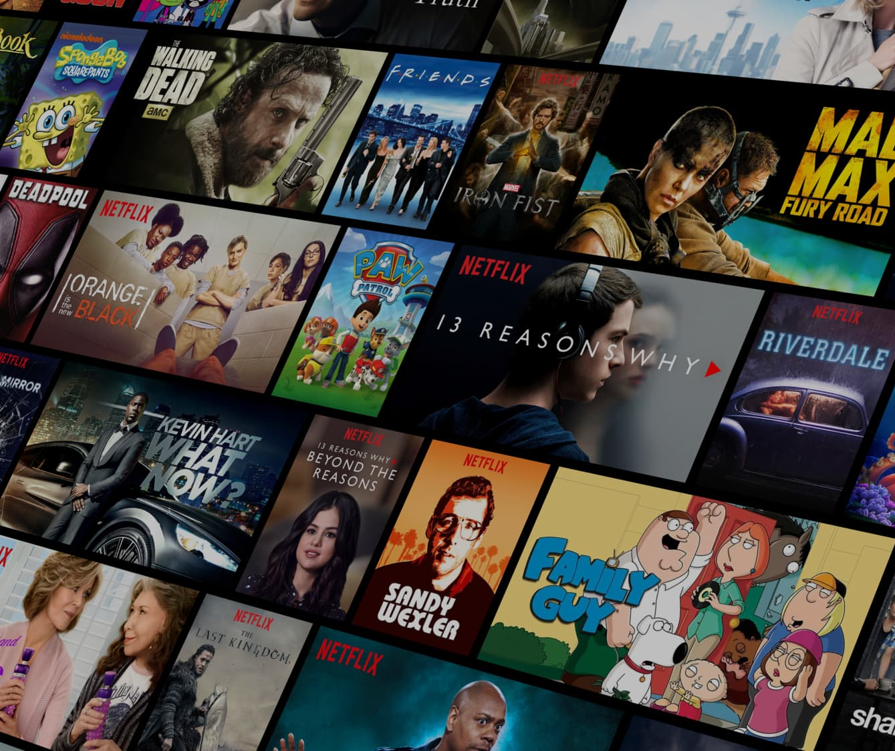

Challenge
Current recommendation engines like Netflix:
Notes:
Challenge: Movie recommendationsystem focus on gaining money, not the user preferences
With increasing monetization, viewers receive worse movie recommendations

Slide 3

Solution & objectives
Solution
Objective
Make recommendations focussed on user preferences
Recommendation engine proposing more matching movies
Notes:
Solution: Make recommendations focussed on user preferences
Objective: Recommendation engine proposing more matching movies

Slide 4
Market opportunities
Profit by advertisement
Watching more movies
Expandable to series
Expandable to animes: movies & series
Notes:
Profit by advertisement
Better recommendations => watching more movies
Expandable to series: changing qualities and gernes of different seasons (= again more profit)
Expandable to animes for movies and series = new customer base

Slide 5

Roadmap
Data understanding
Data preparation
Modeling
Evaluation
1. Content matching
2. Ranking
3. New movies
Deployment
Notes:
Content matching = Find the movies matching the most to the user‘s preferences
Ranking = Rank movies and recommend user the best movie, matching to his perferences
New movies = System/model can handle and recommend new available movies

