Slide 1
AI Based Diabetes Prediction System
INNOVATION

Slide 2
Name: V.PADMASREE
Branch: Bio Medical Engineering
Year: III rd year
Register Number: 112021121010

Slide 3
INTRODUCTION
Diabetes related diseases have recently become one of the top ten causes of death in developing countries.
AI has been used for disease diagnosis for several years
Machine learning algorithms were applied and using the two best classification methods, an ensemble method and deep learning to diagnose diabetes

Slide 4
ENSEMBLE LEARNING
The ensemble finds ways to combine multiple machine learning models into one predictive model.
The ensemble learning will provide a composite prediction where the final accuracy is better than the accuracy of the individual classifiers using following equations:
Here, p is the predicted probability for each classifier, and w_{j} is the weight given to the jth classifier
𝑦̂= argmax𝑖∑𝑗=1𝑚𝑤𝑗𝑝𝑖𝑗

Slide 5
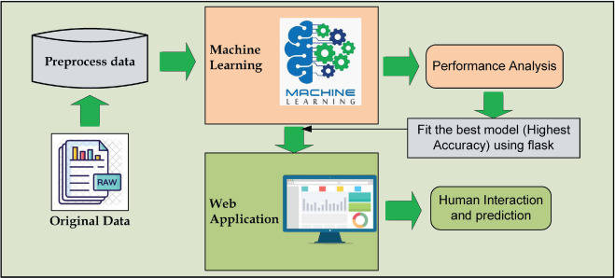
DEEP LEARNING ARCHITECTURE

Slide 6
DIABETES PREDICTION SYSTEM
The dataset comprises crucial health-related features such as 'Pregnancies', 'Glucose', 'Blood Pressure', 'Skin Thickness', 'Insulin', 'BMI', 'Diabetes Pedigree Function', and 'Age'. The main objective was to predict the 'Outcome' label, which signifies the likelihood of diabetes.

Slide 7
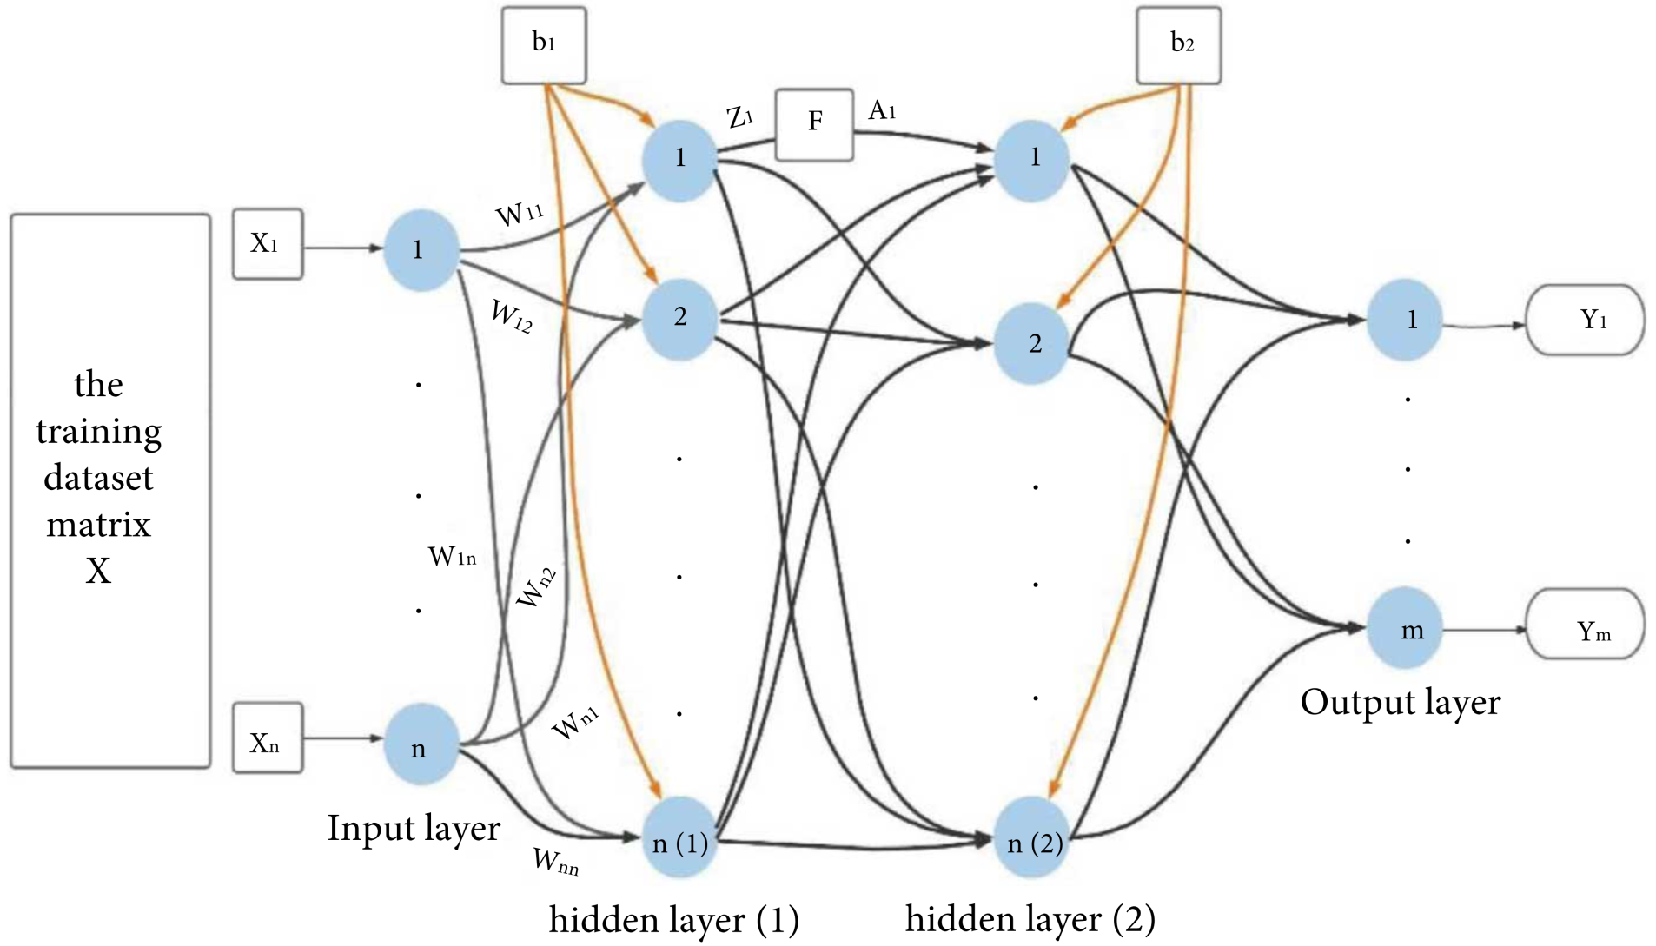
DEEP NEURAL NETWORK

Slide 8
Deep Neural Network:
The Deep Neural Networks (DNNs) are one of the architectures of Deep Learning . DNNs have the same basic architecture as ANNs, with the exception that DNNs may have several hidden layers; that is why we use the term “deep.”
Based on Deep Neural Network (DNN) algorithm to identify whether or not a person has diabetes.

Slide 9
Thank you

